Slide 1
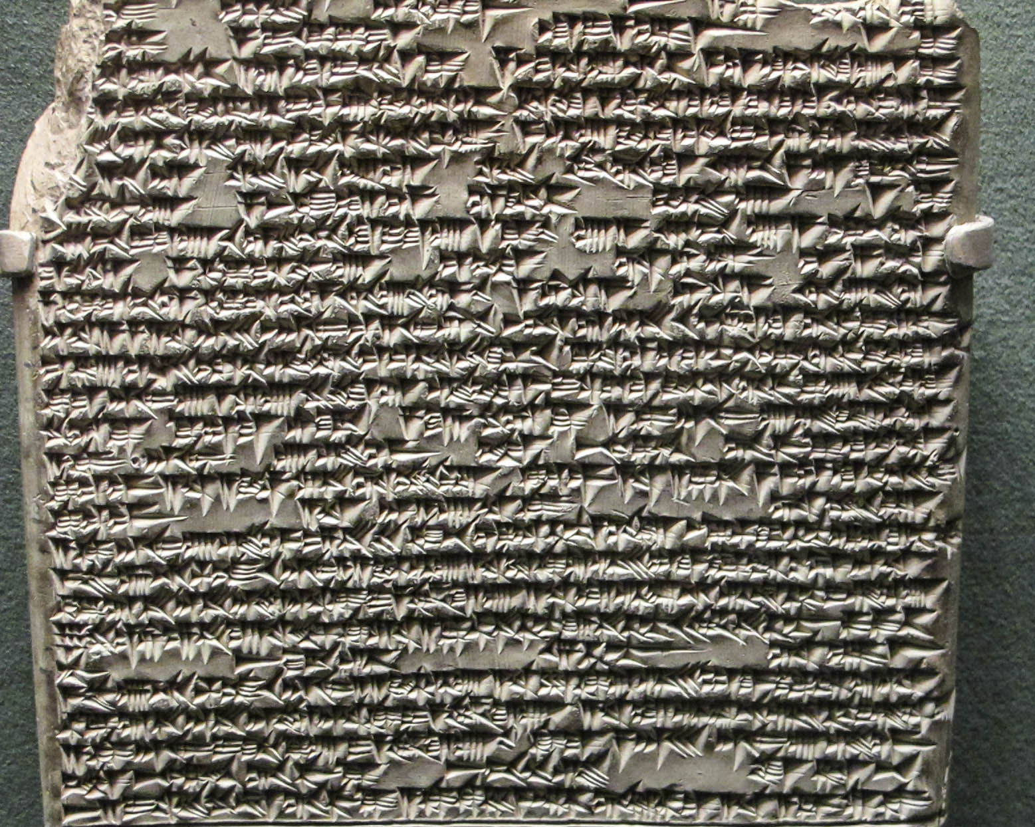

Slide 2
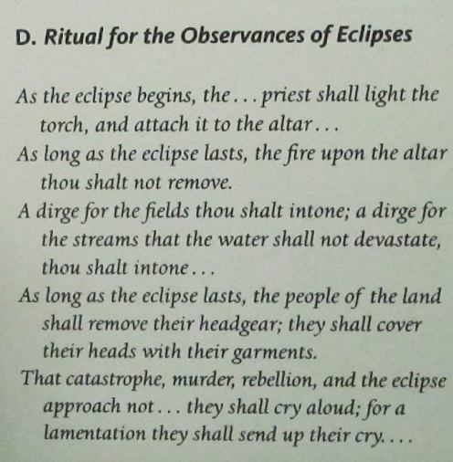

Slide 3
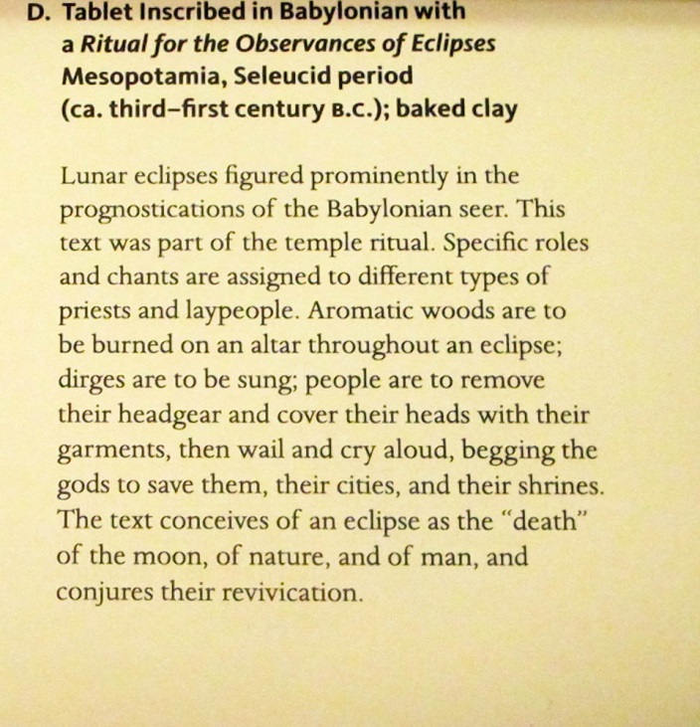

Slide 4
SUN AND MOON AS WE SEE THEM

Slide 5
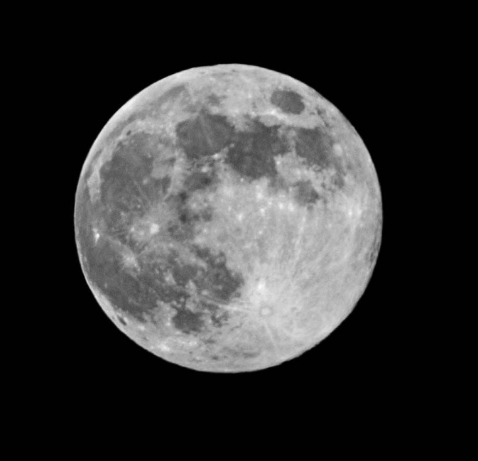
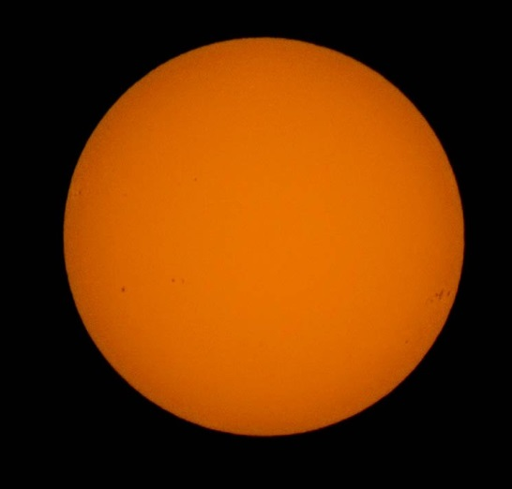
SUN & FULL MOON

Slide 6
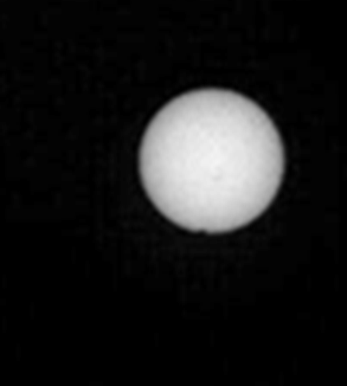
SUN & DEIMOS FROM CURIOSITY

Slide 7
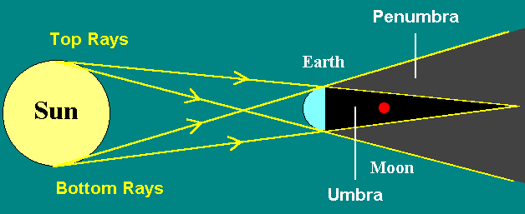

Slide 8
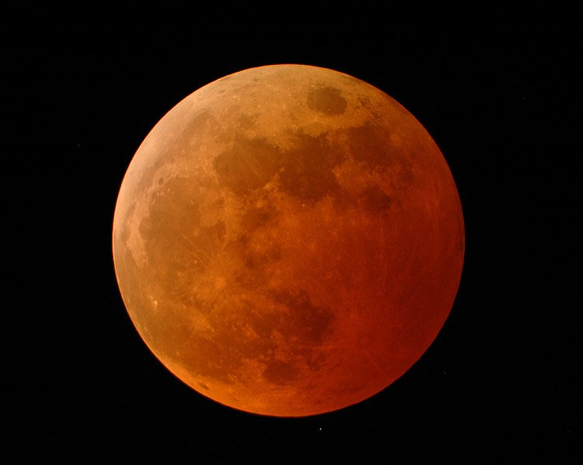
TOTAL LUNAR ECLIPSE

Slide 9
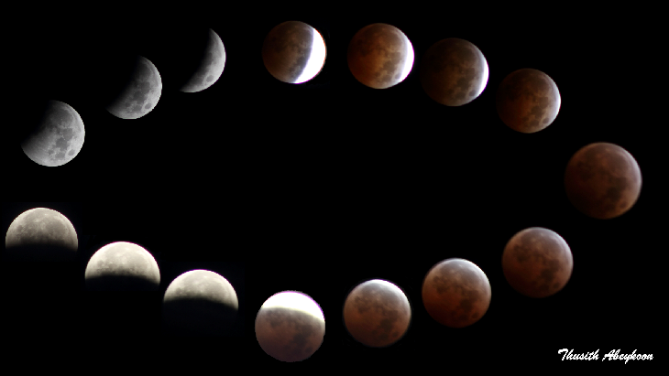
October’s Eclipse

Slide 10
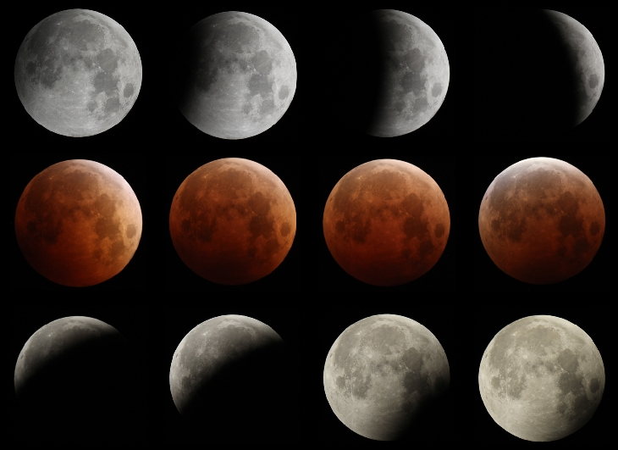
RIVERSIDE, CALIFORNIA

Slide 11
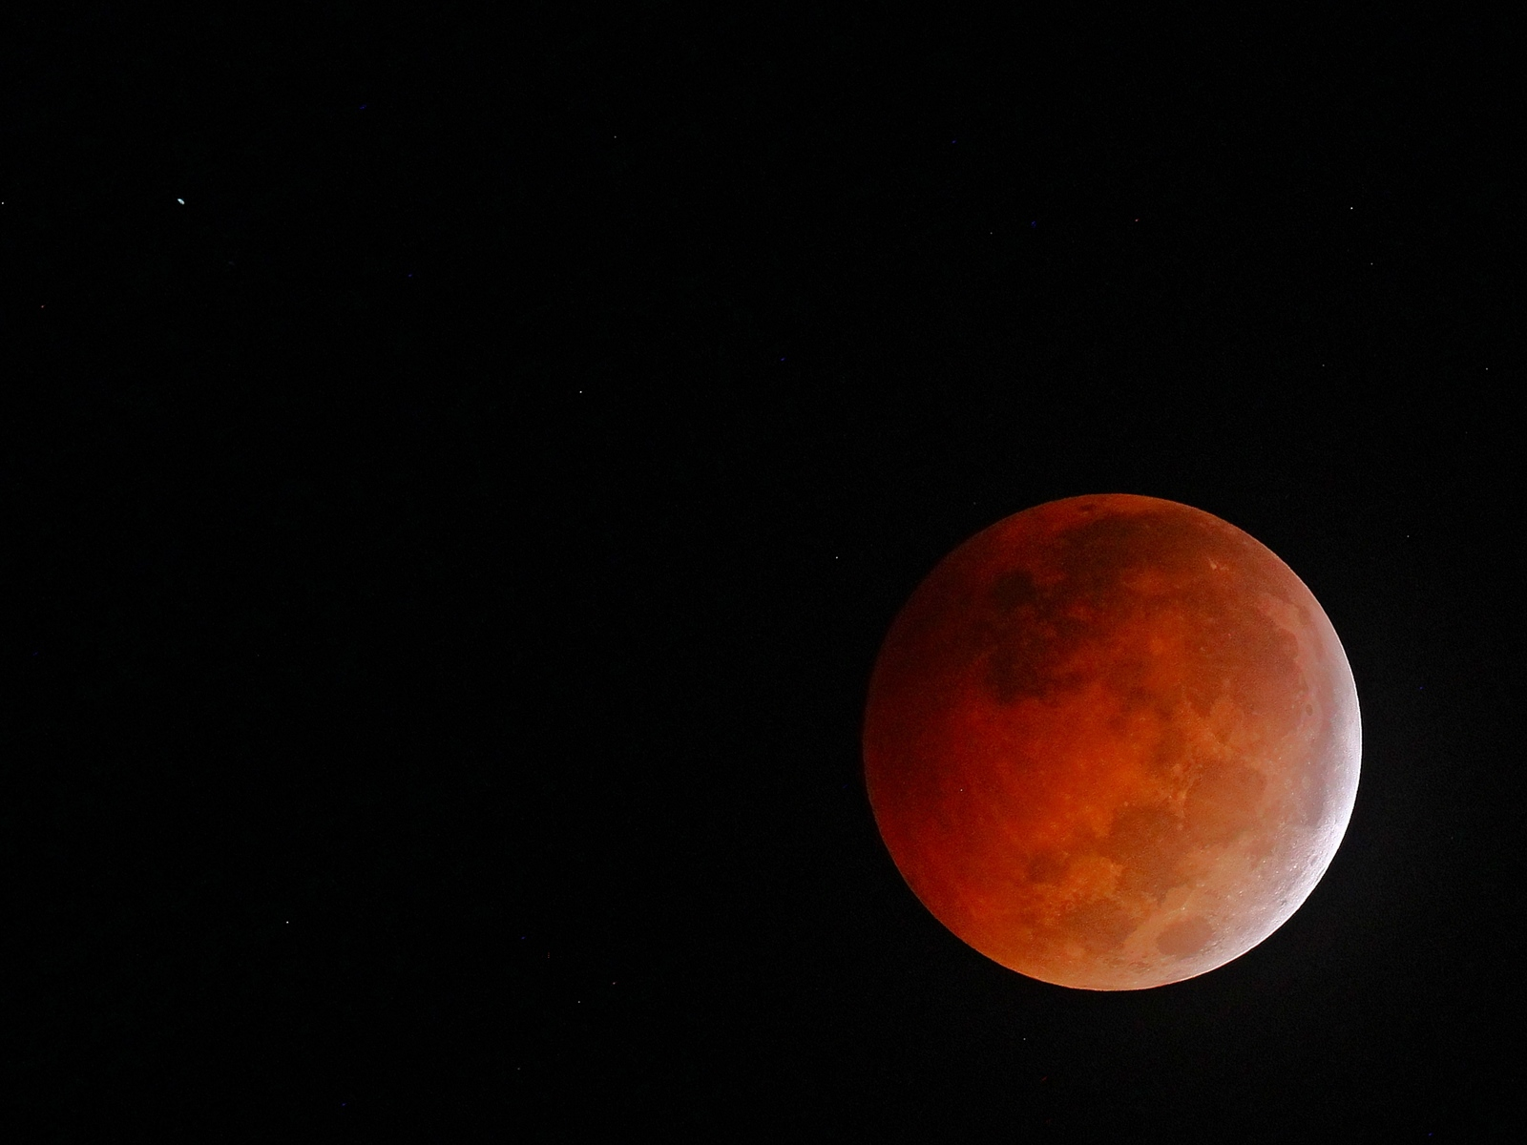
GAINSVILLE, FLORIDA

Slide 12
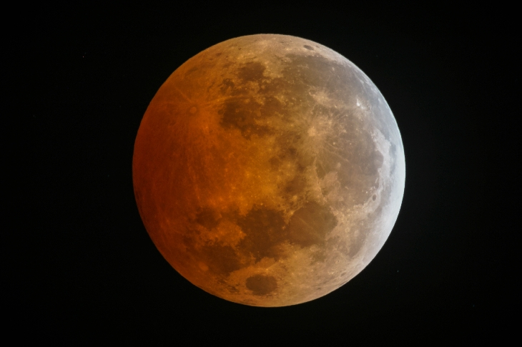
KANSAS

Slide 13
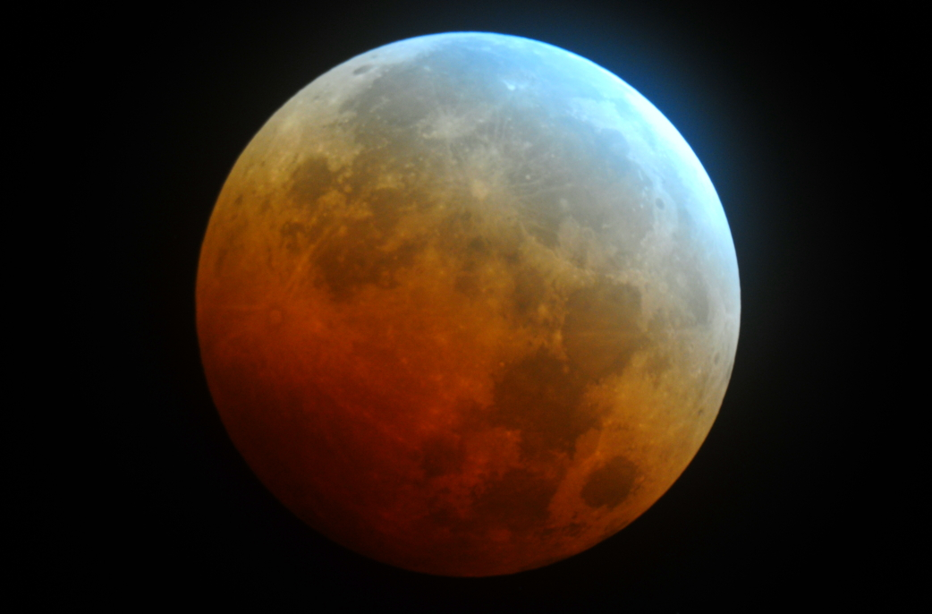

Slide 14
Lunar eclipses are supposed to be red. This morning's eclipse had an extra dash of turquoise. "The colors on this eclipsed moon were more varied and vivid than any in memory -- maybe because it stayed so close to the edge of the shadow for the duration of the eclipse," reports astronomy professor Jimmy Westlake, who sends this picture from Stagecoach, Colorado:

Slide 15
"Nearly every color of the rainbow appeared on the Moon just before the end of totality," he says.
Atmospheric scientist Richard Keen of the University of Colorado explains the colors: "During a lunar eclipse, most of the light illuminating the Moon passes through Earth's stratosphere where it is reddened by scattering. However, light passing through the upper stratosphere penetrates the ozone layer, which absorbs red light and actually makes the passing light ray bluer." This can be seen, he says, as a soft blue fringe around the red core of Earth's shadow--colors which are reflected from the surface of the Moon.

Slide 16
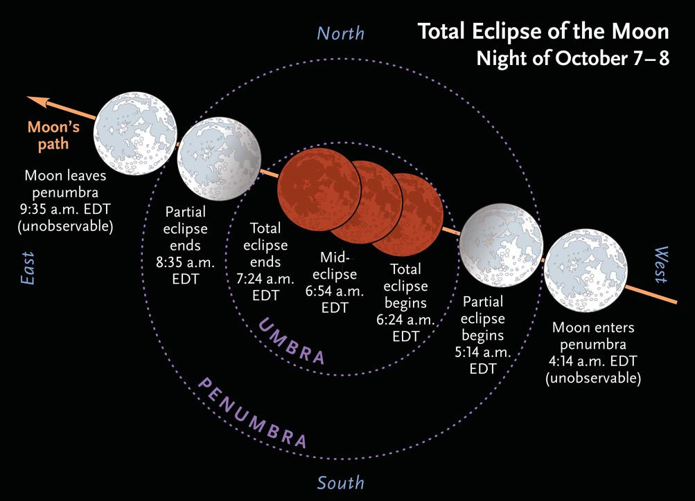

Slide 17
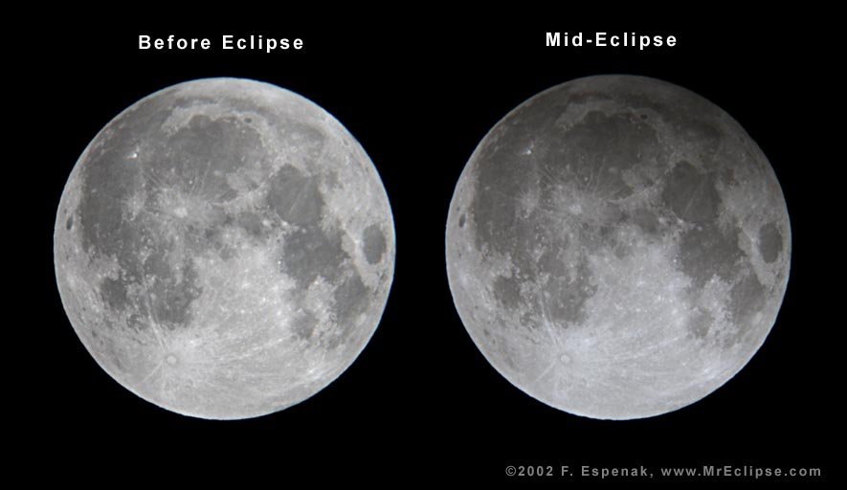
PENUMBRAL PART OFLUNAR ECLIPSE

Slide 18
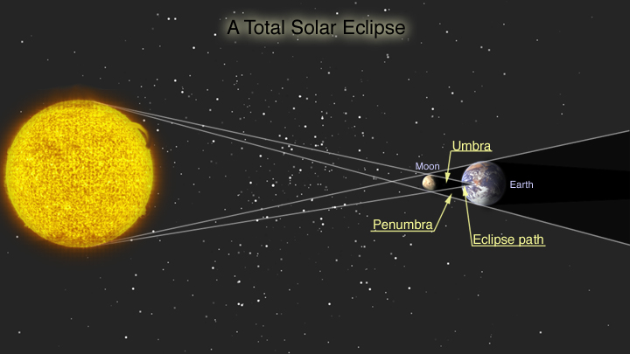

Slide 19
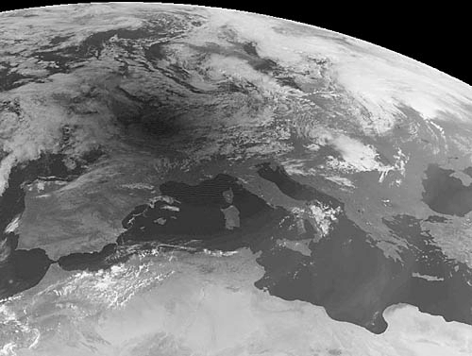

Slide 20
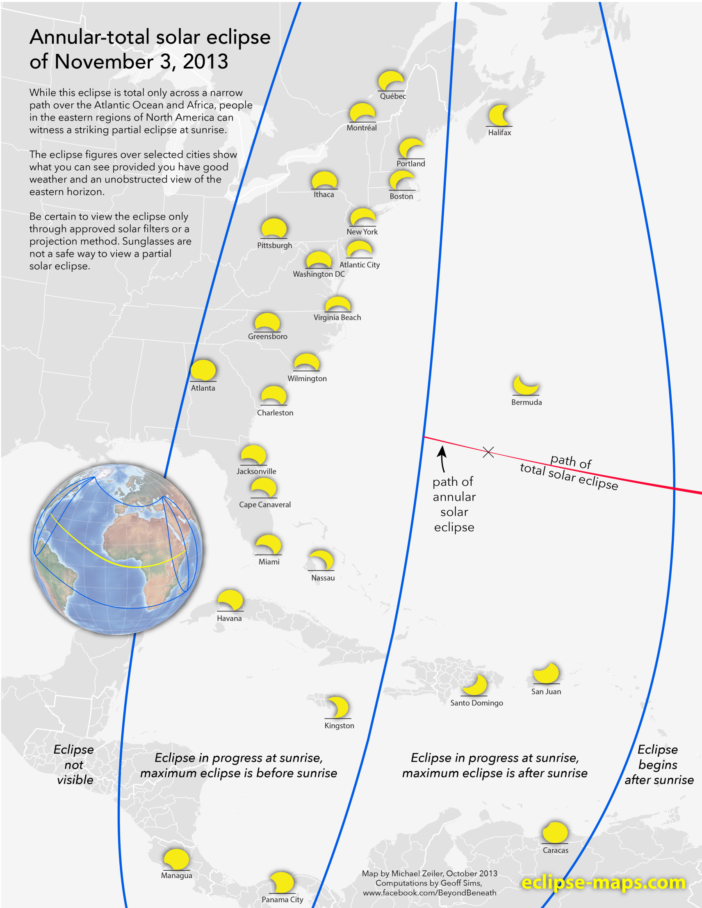

Slide 21
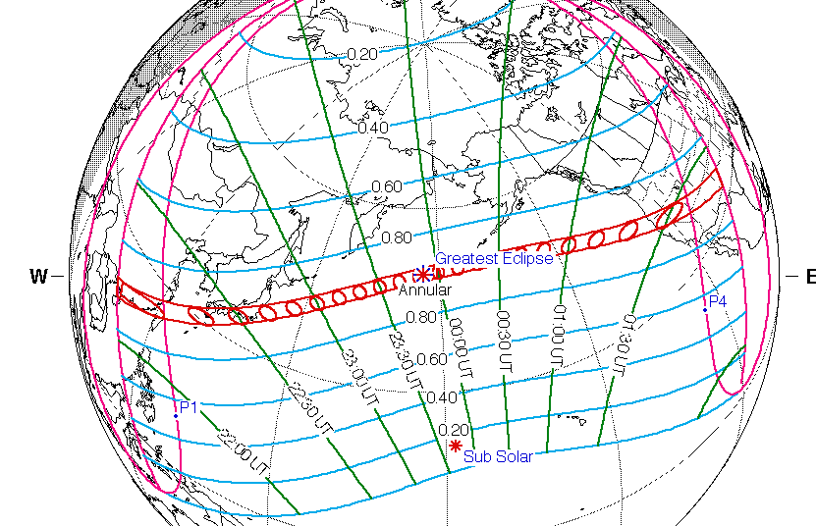

Slide 22
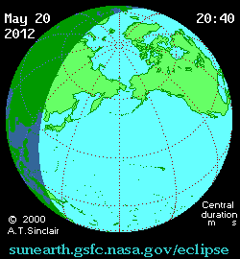

Slide 23
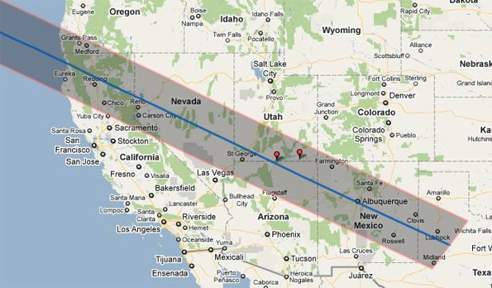

Slide 24
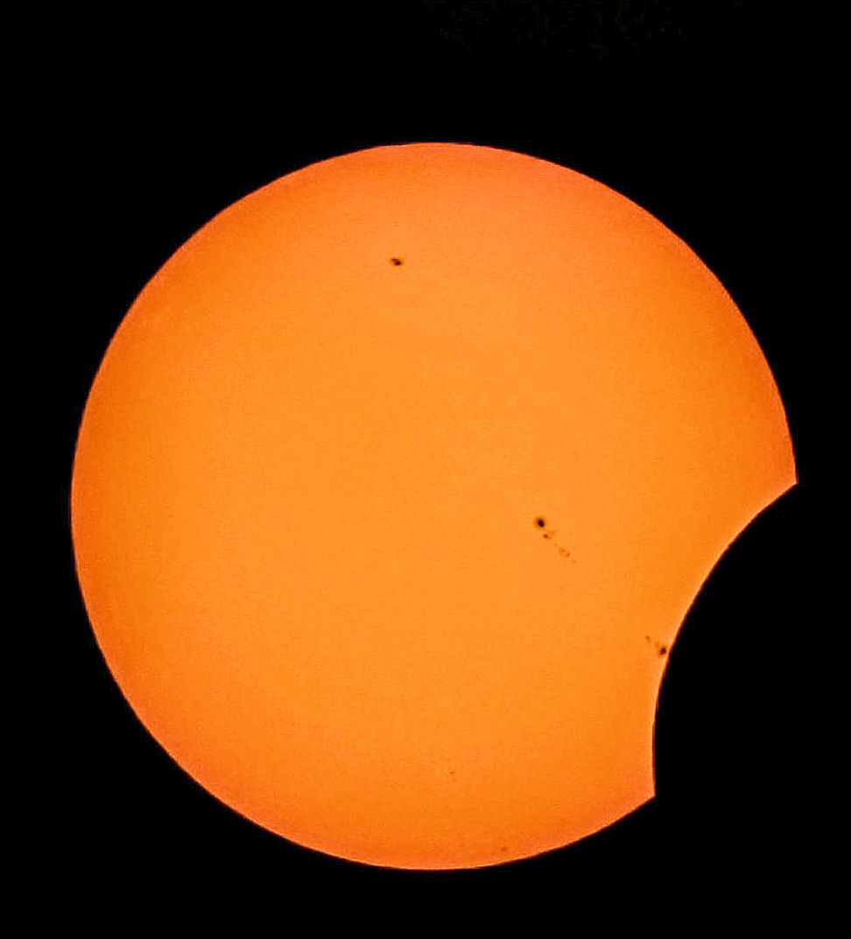

Slide 25
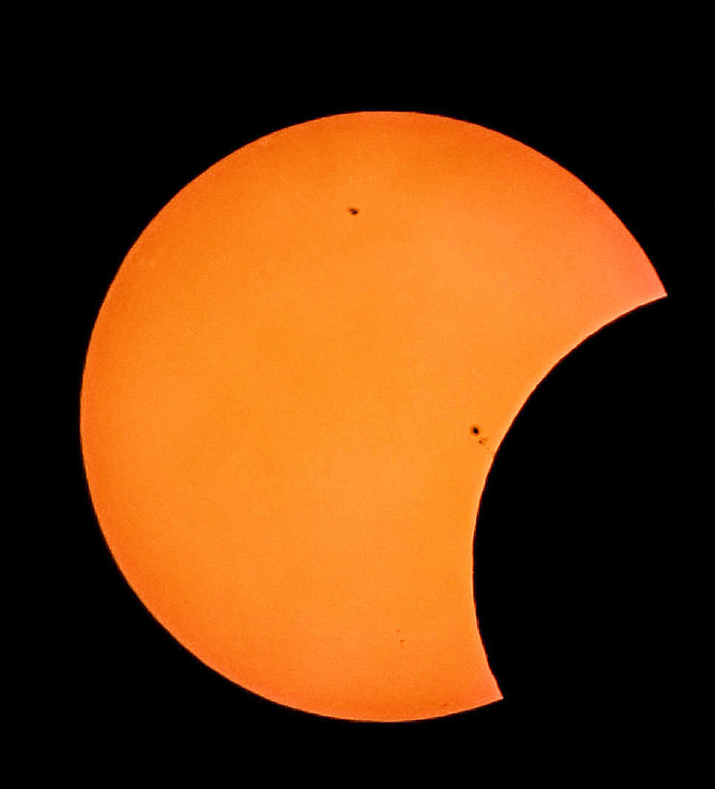

Slide 26
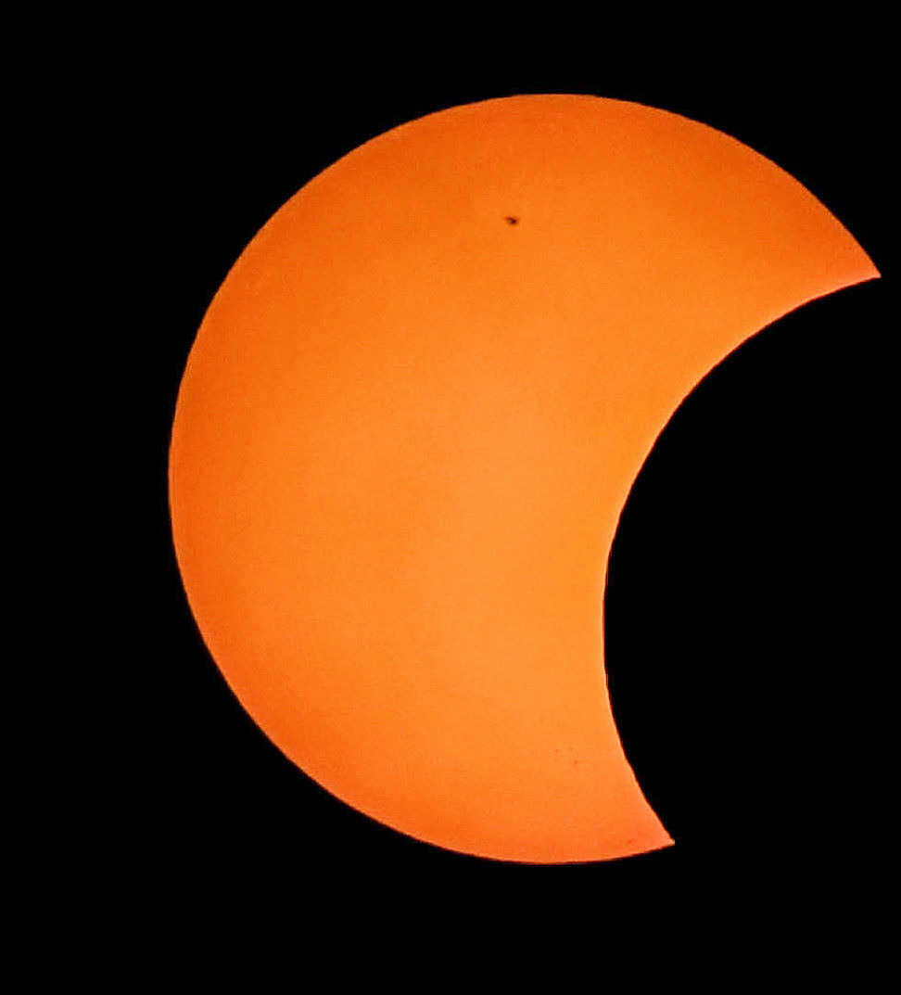

Slide 27
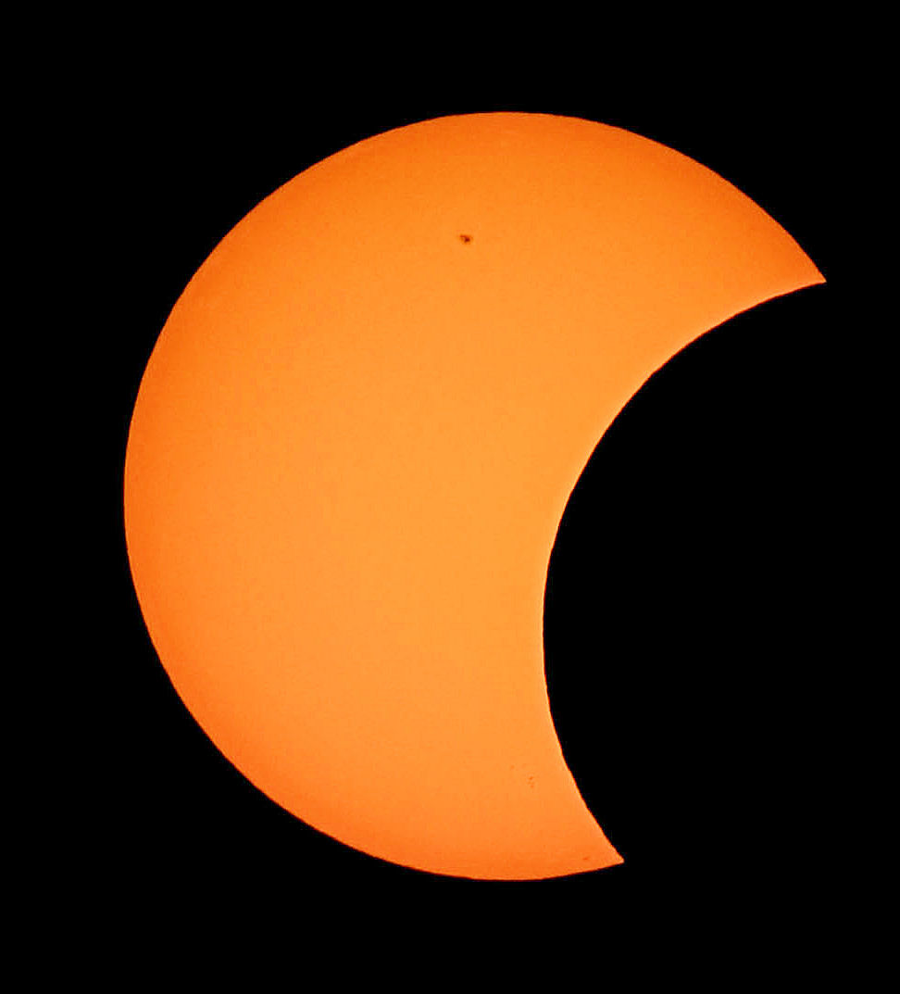

Slide 28
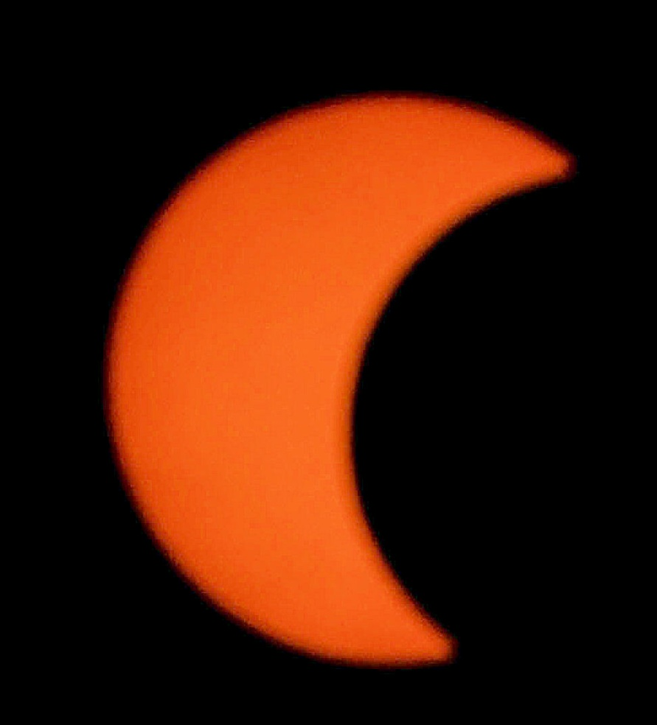

Slide 29
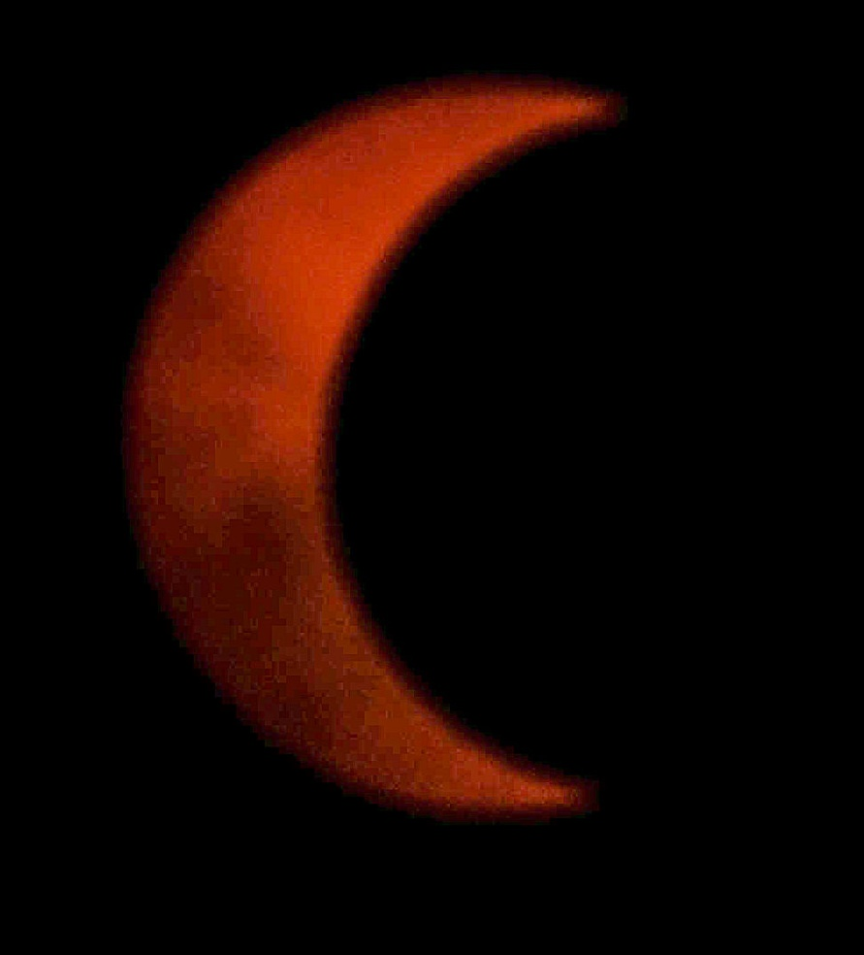

Slide 30
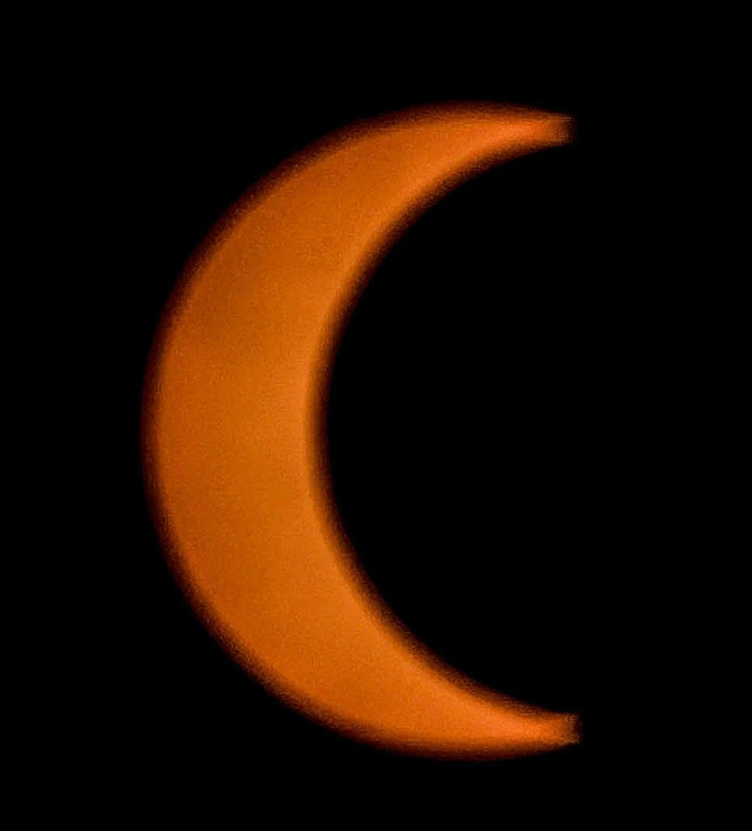

Slide 31
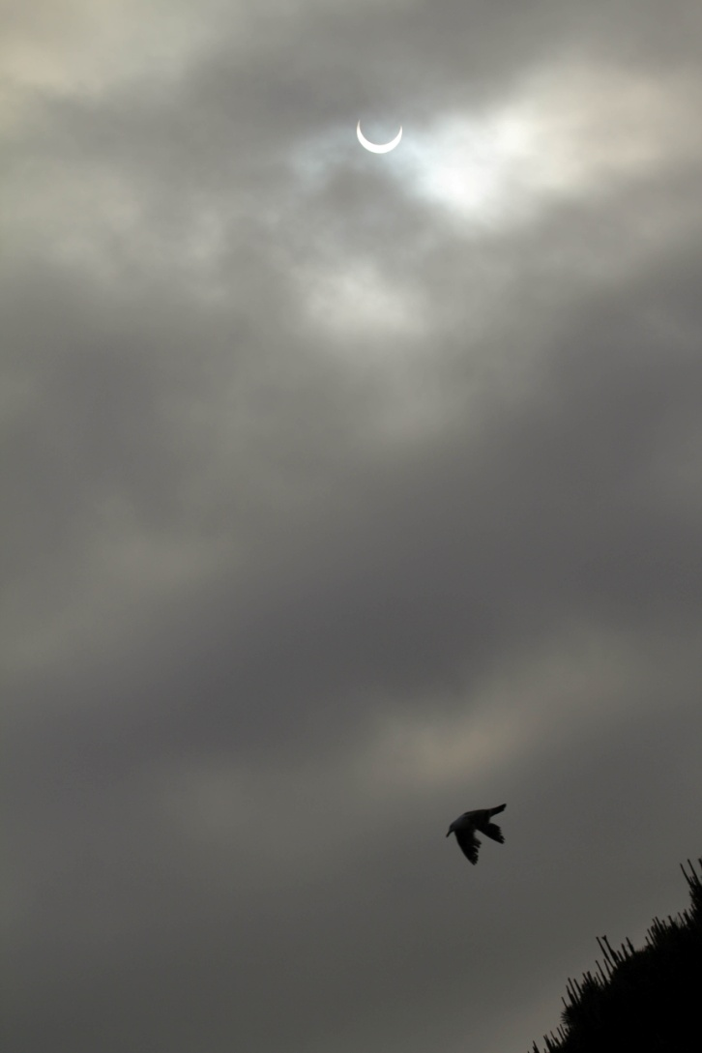

Slide 32
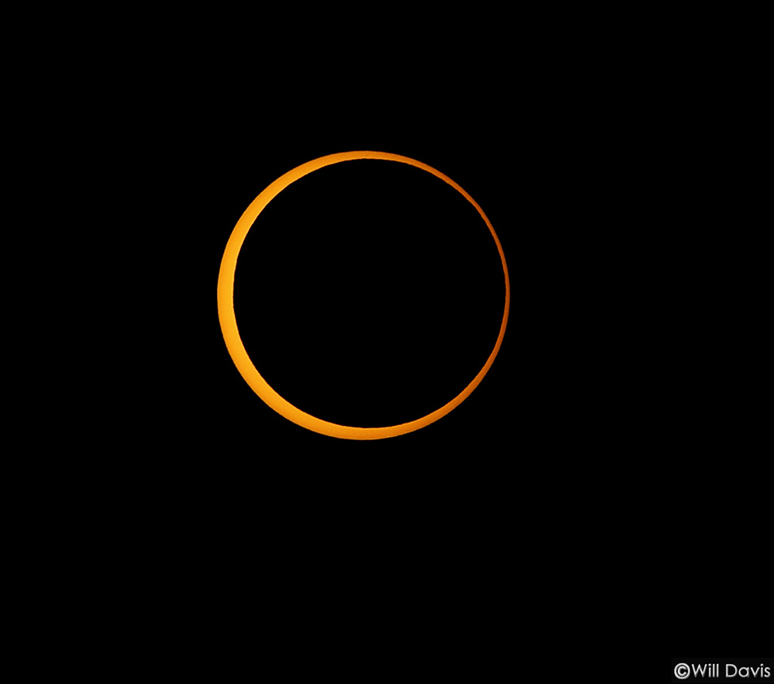

Slide 33
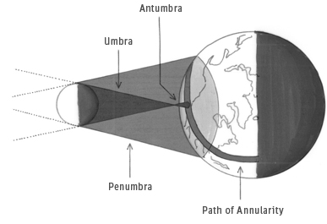

Slide 34
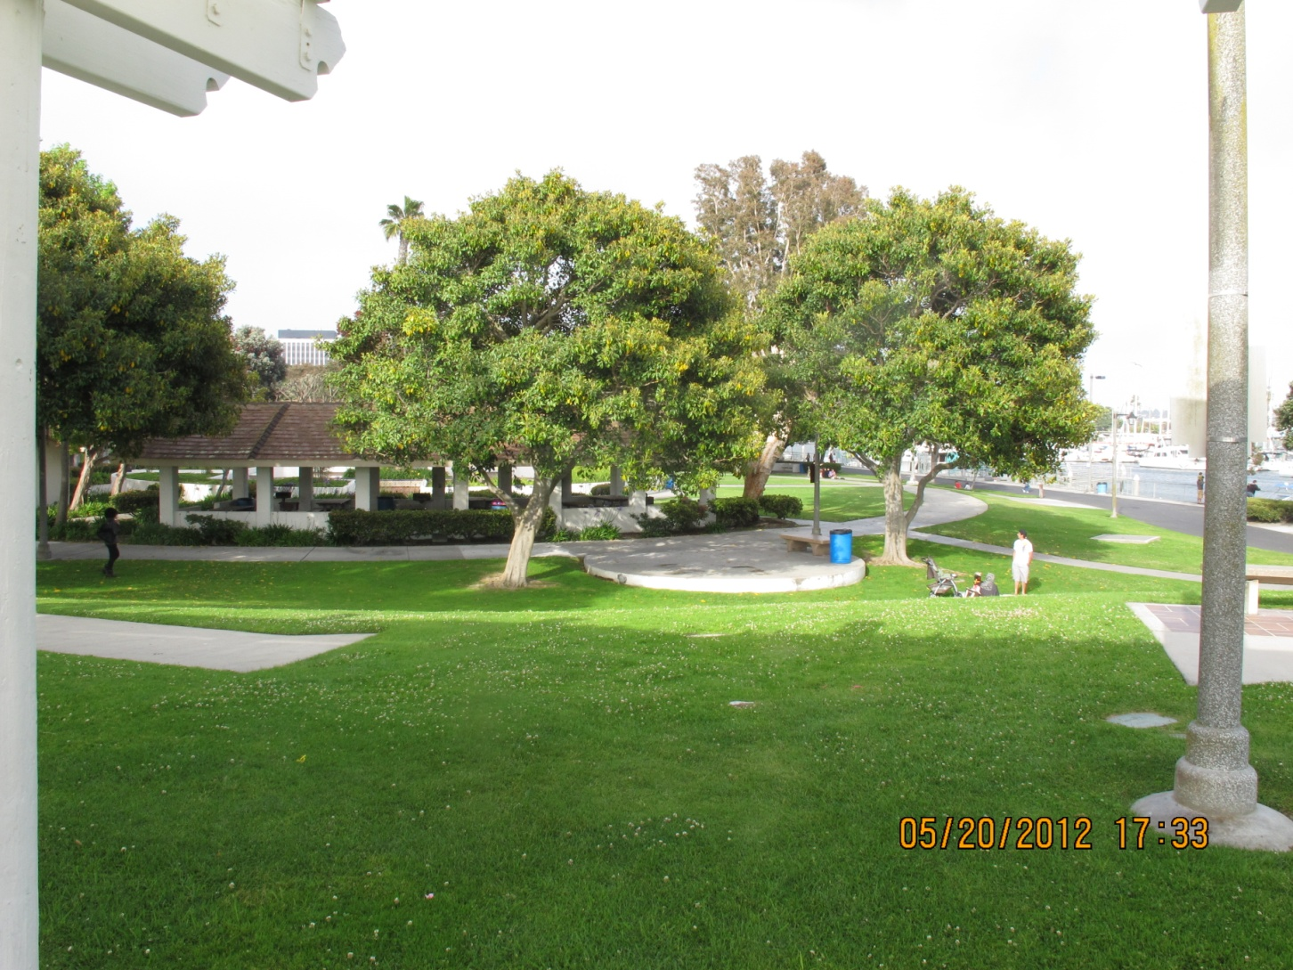

Slide 35
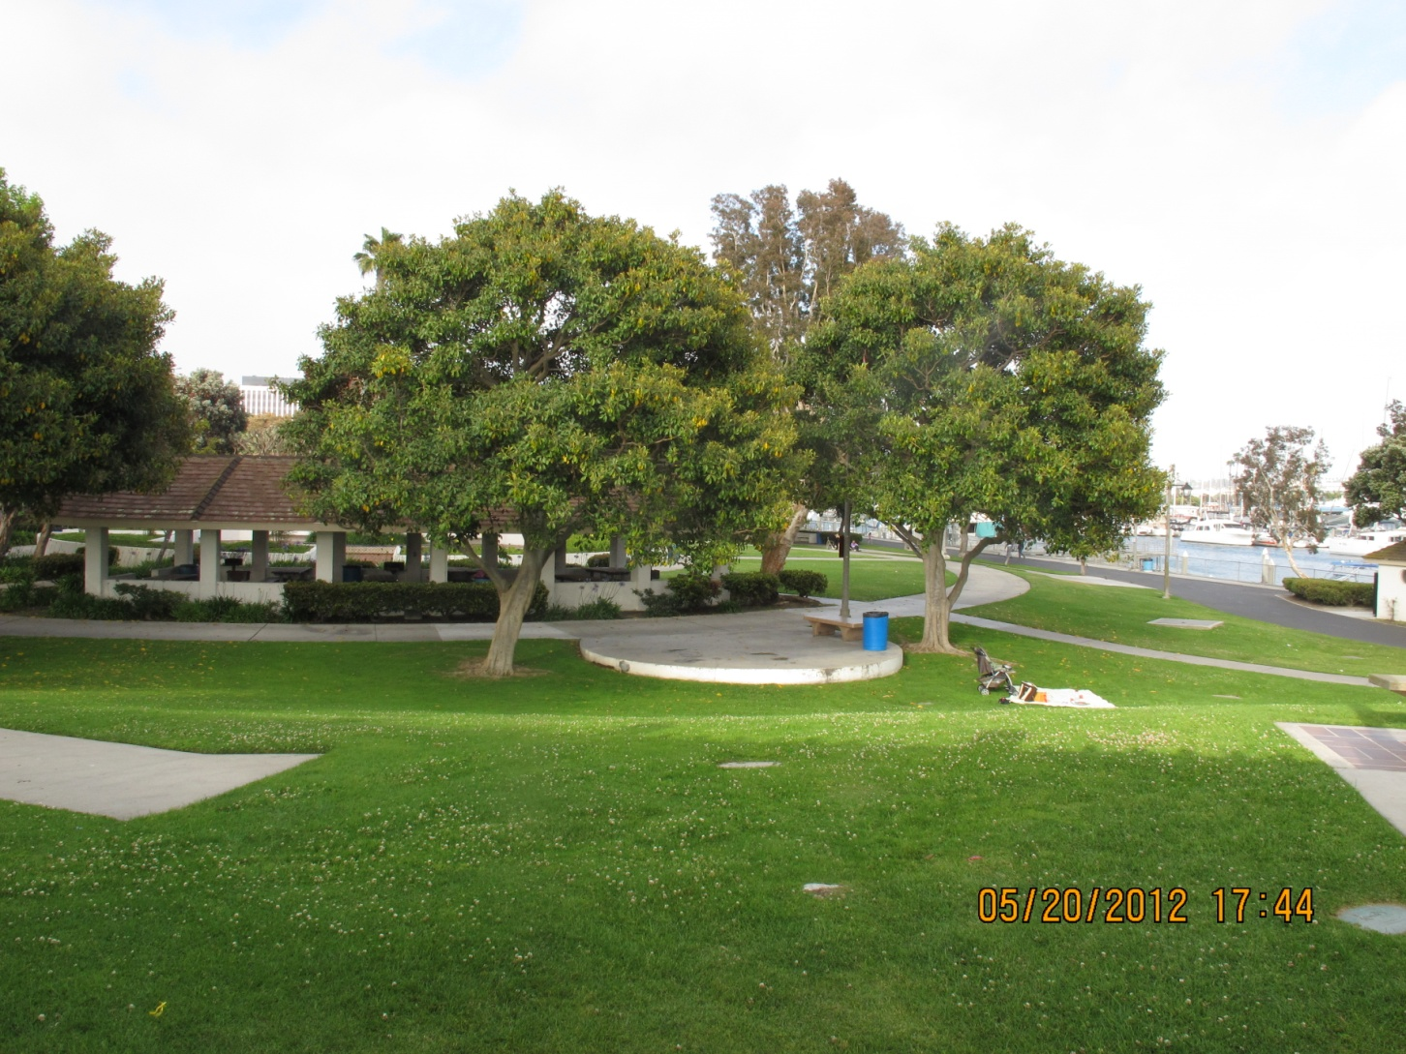

Slide 36
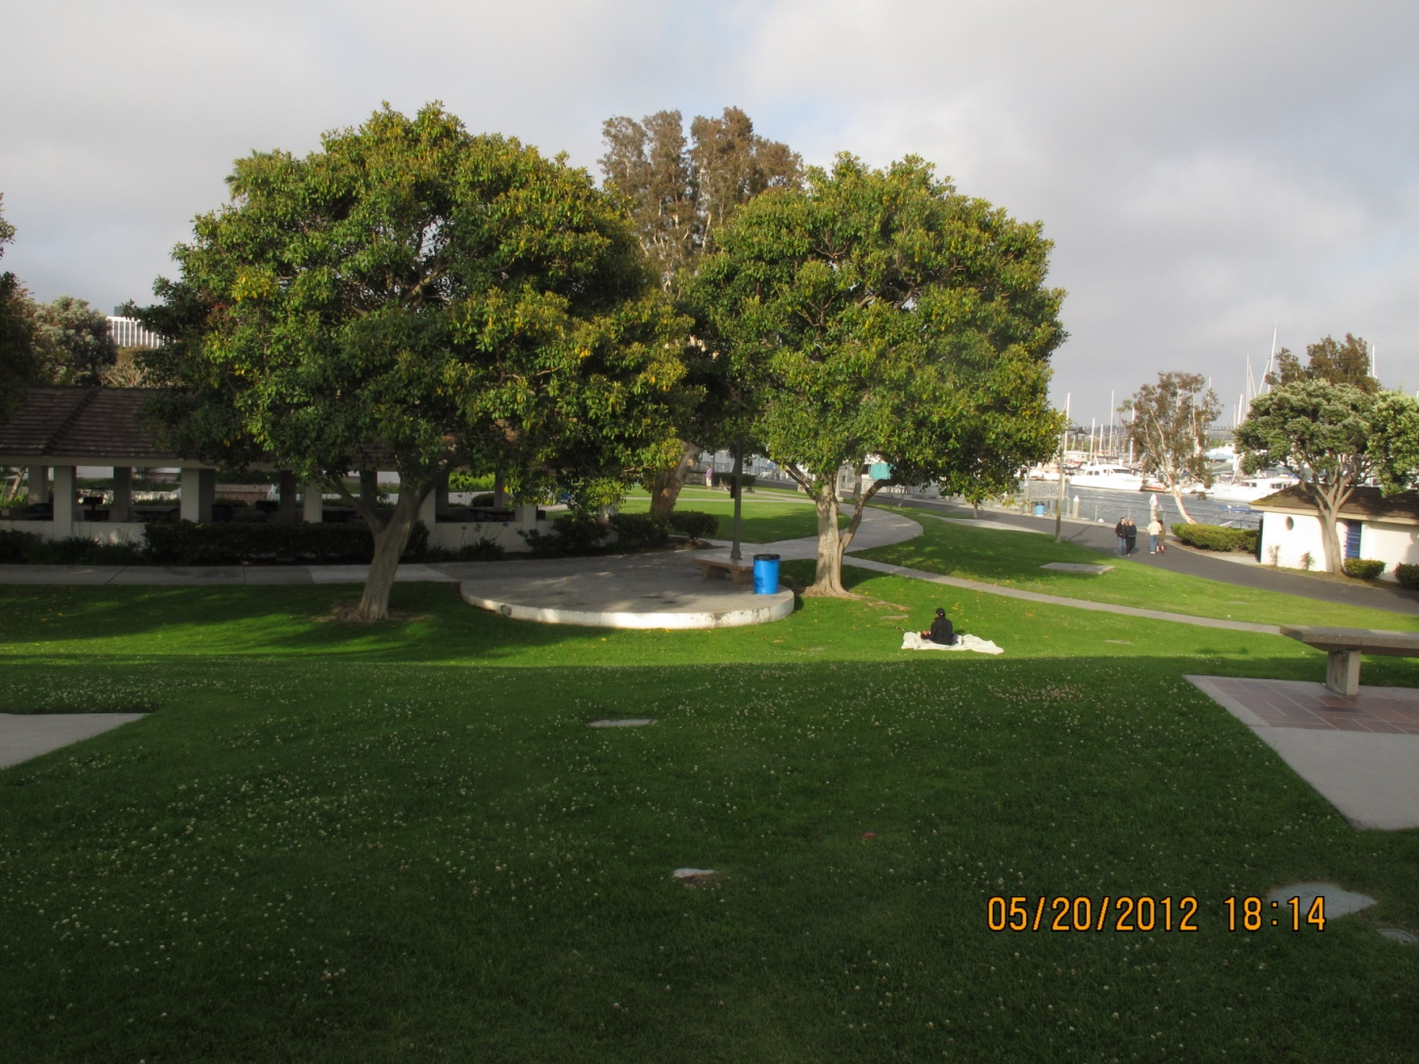

Slide 37
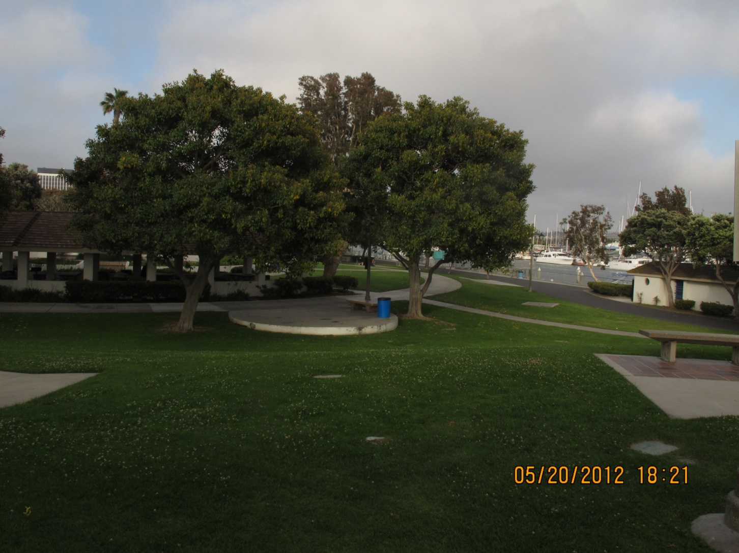

Slide 38
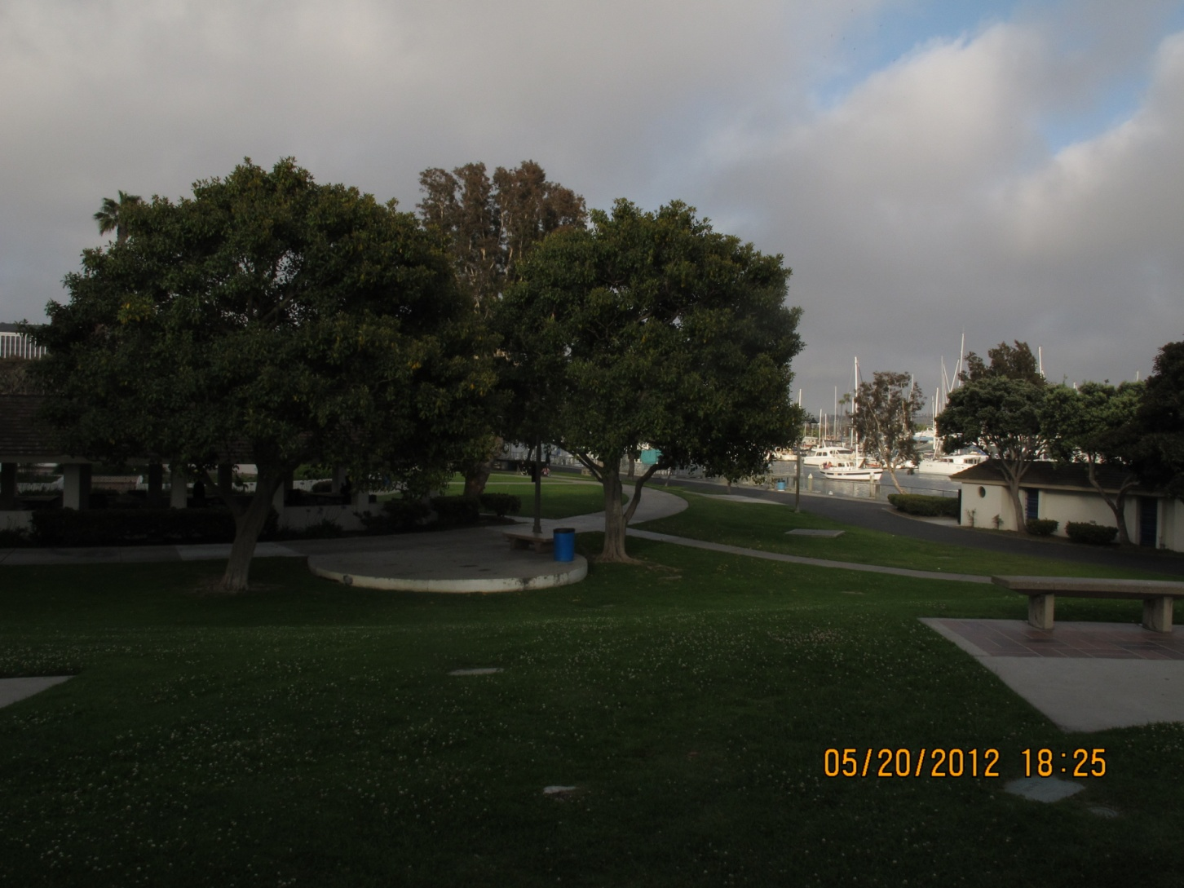

Slide 39
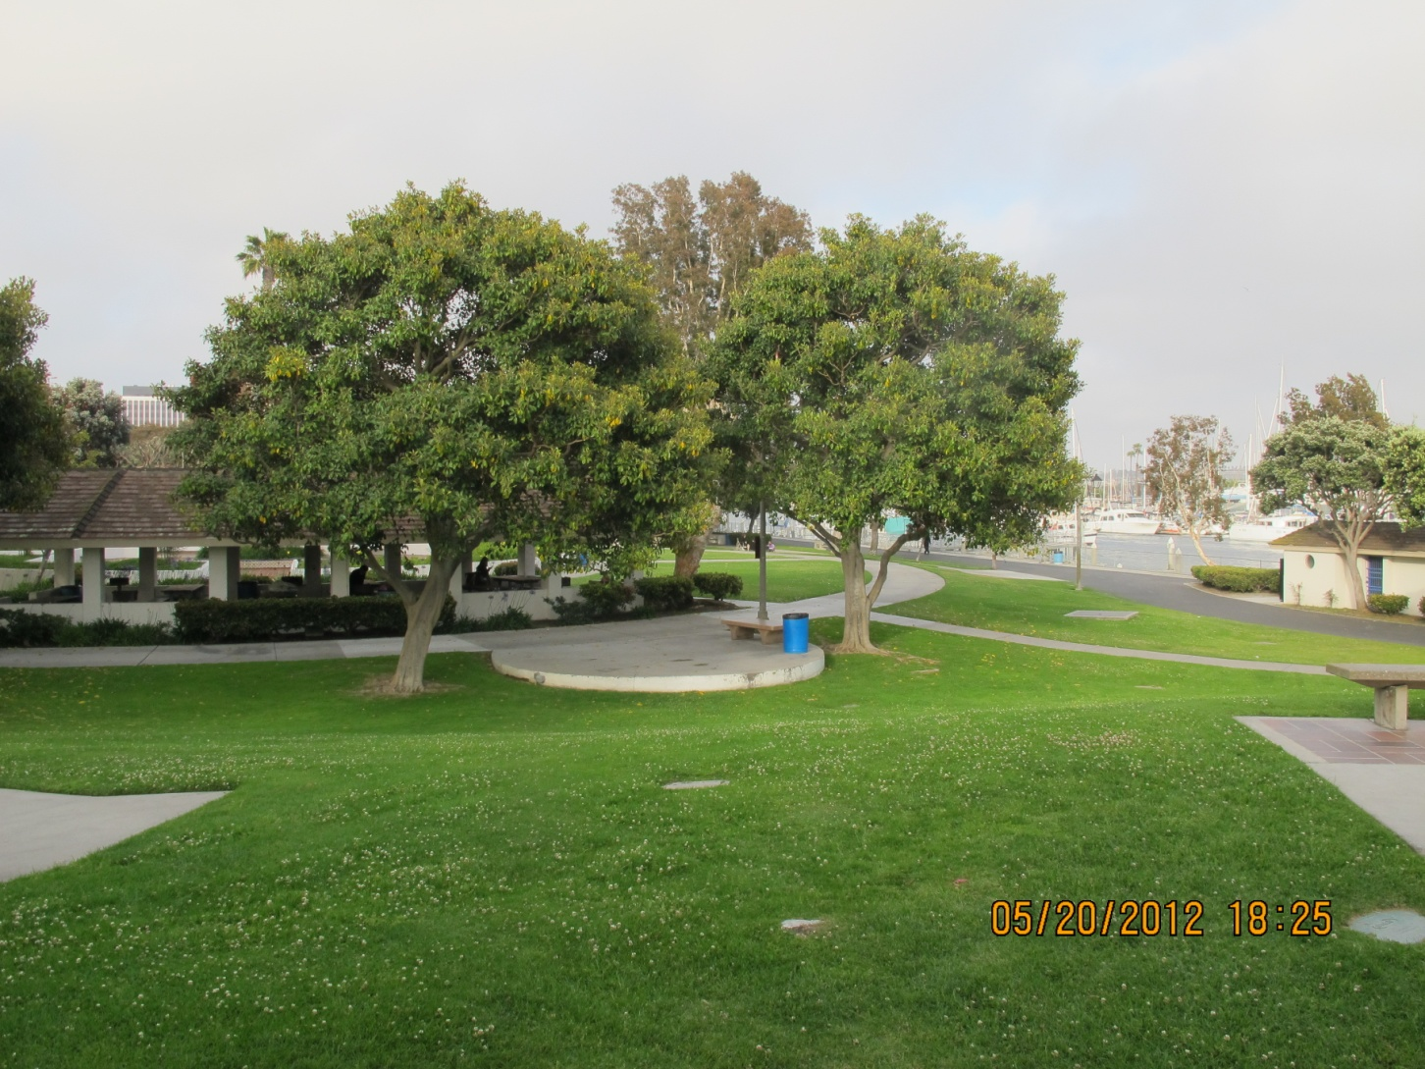

Slide 40



Slide 41
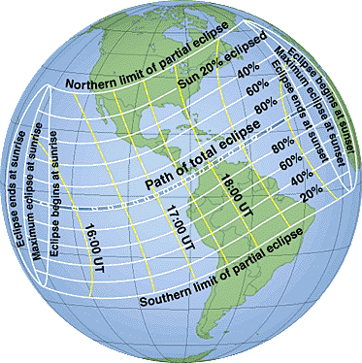

Slide 42
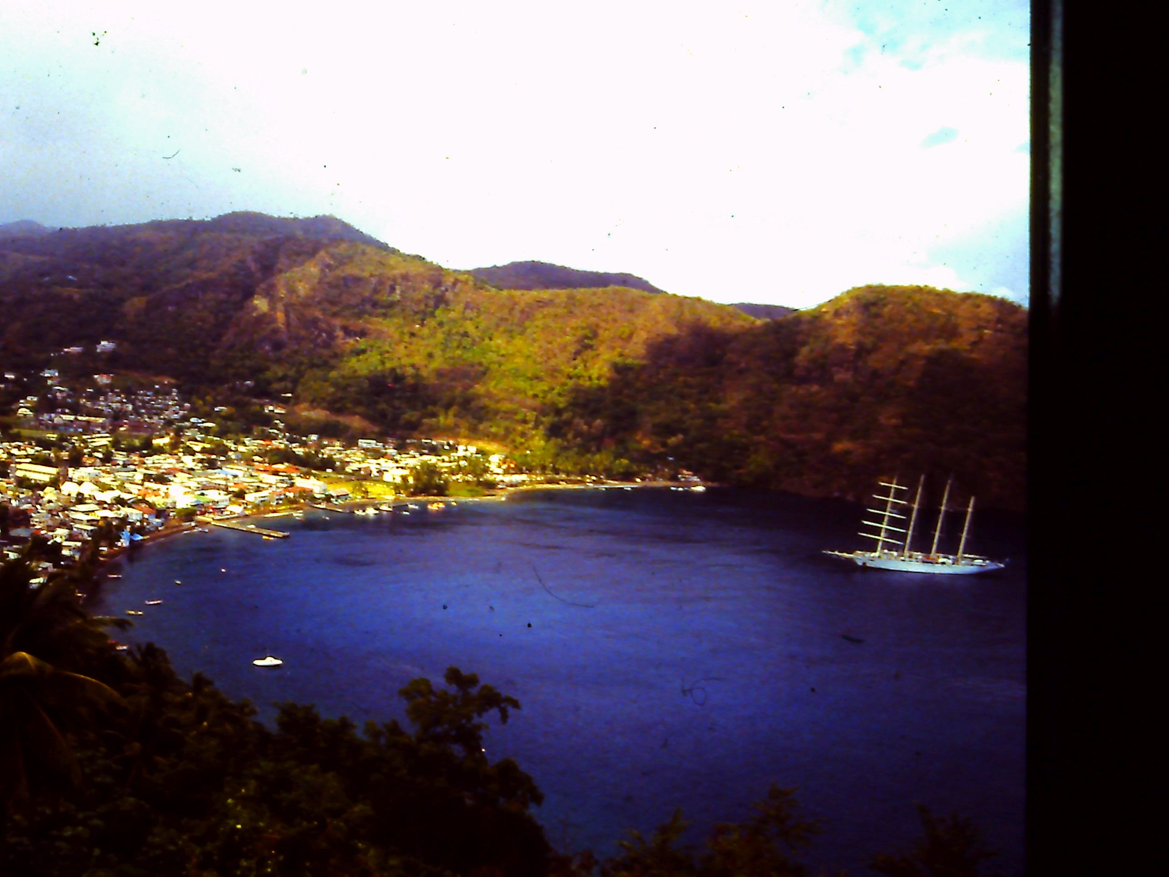

Slide 43
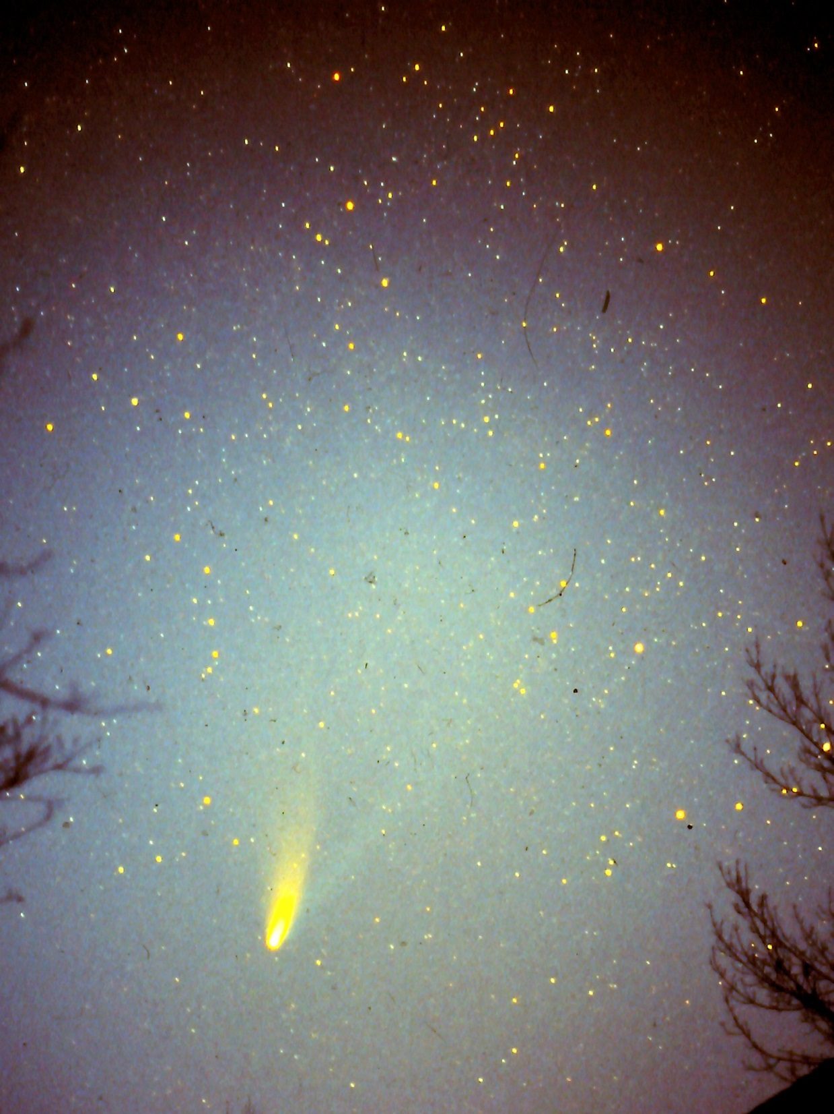

Slide 44
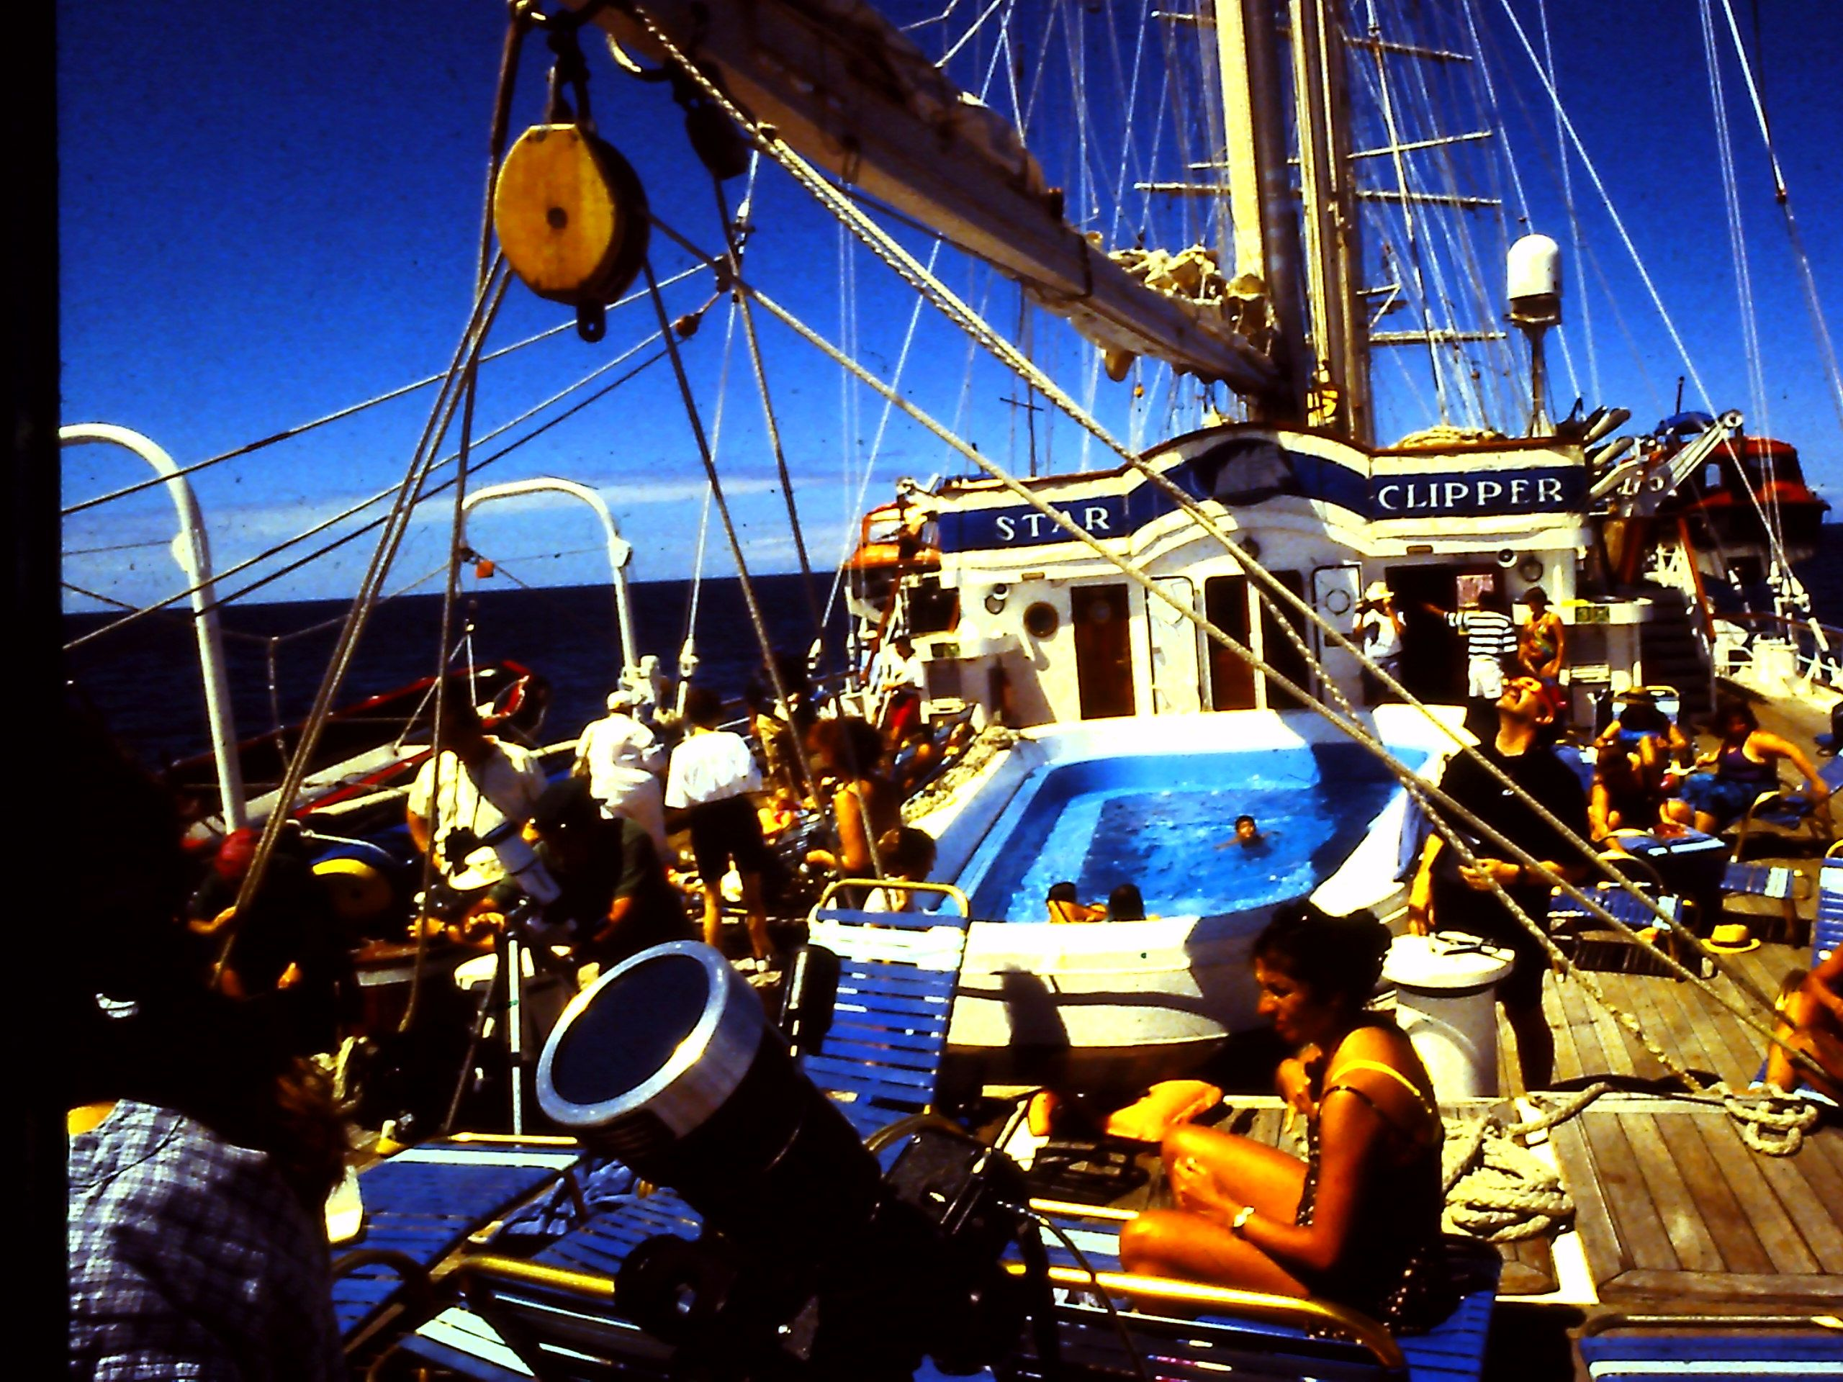

Slide 45
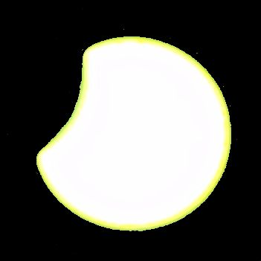

Slide 46
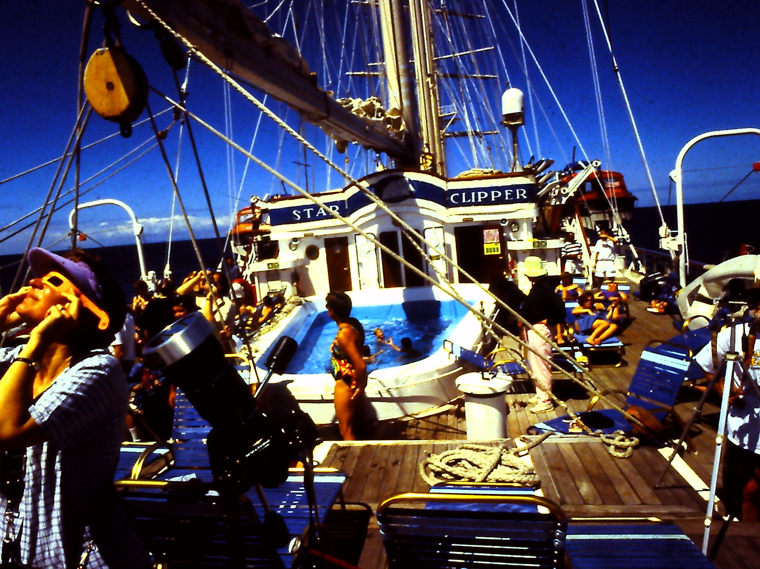

Slide 47
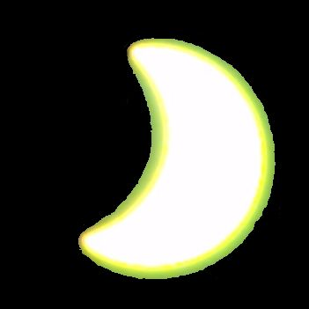

Slide 48
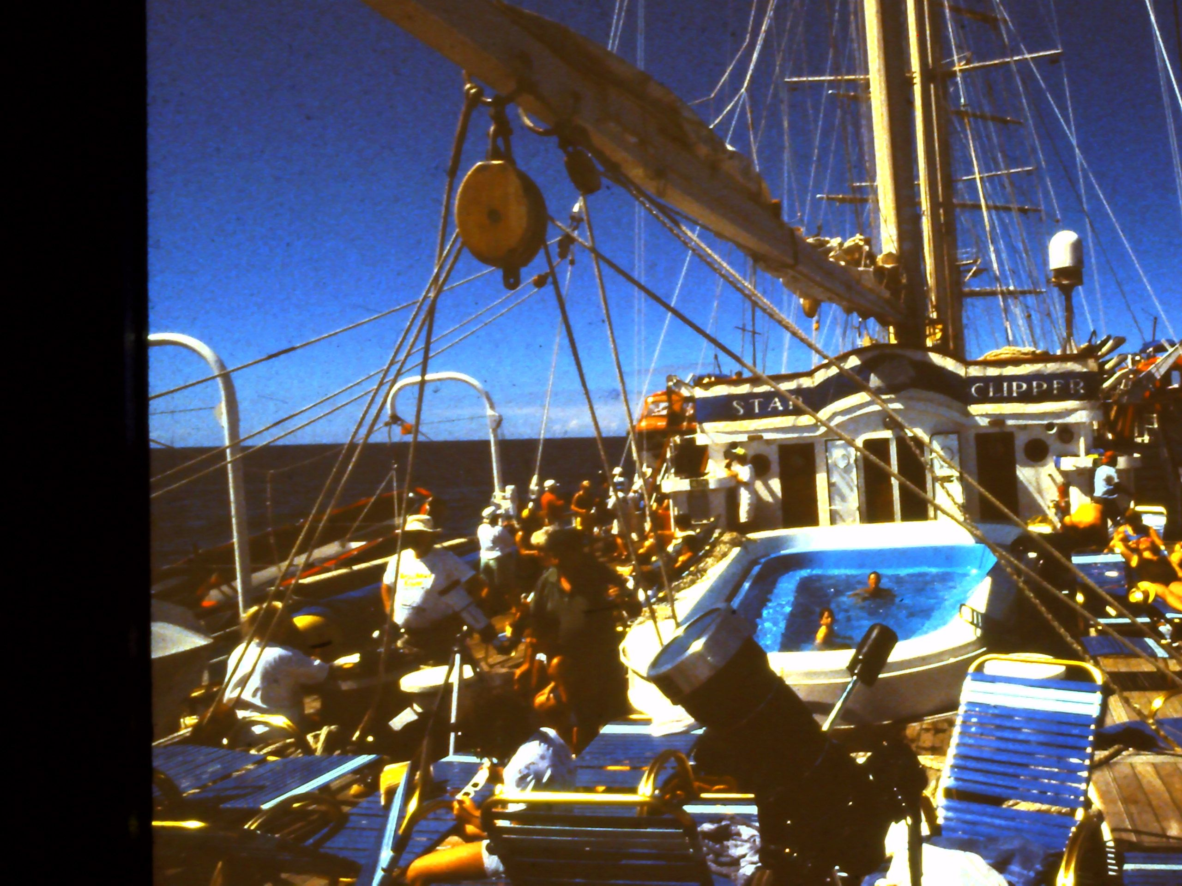

Slide 49
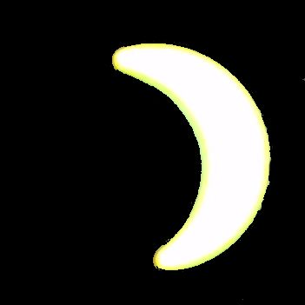

Slide 50
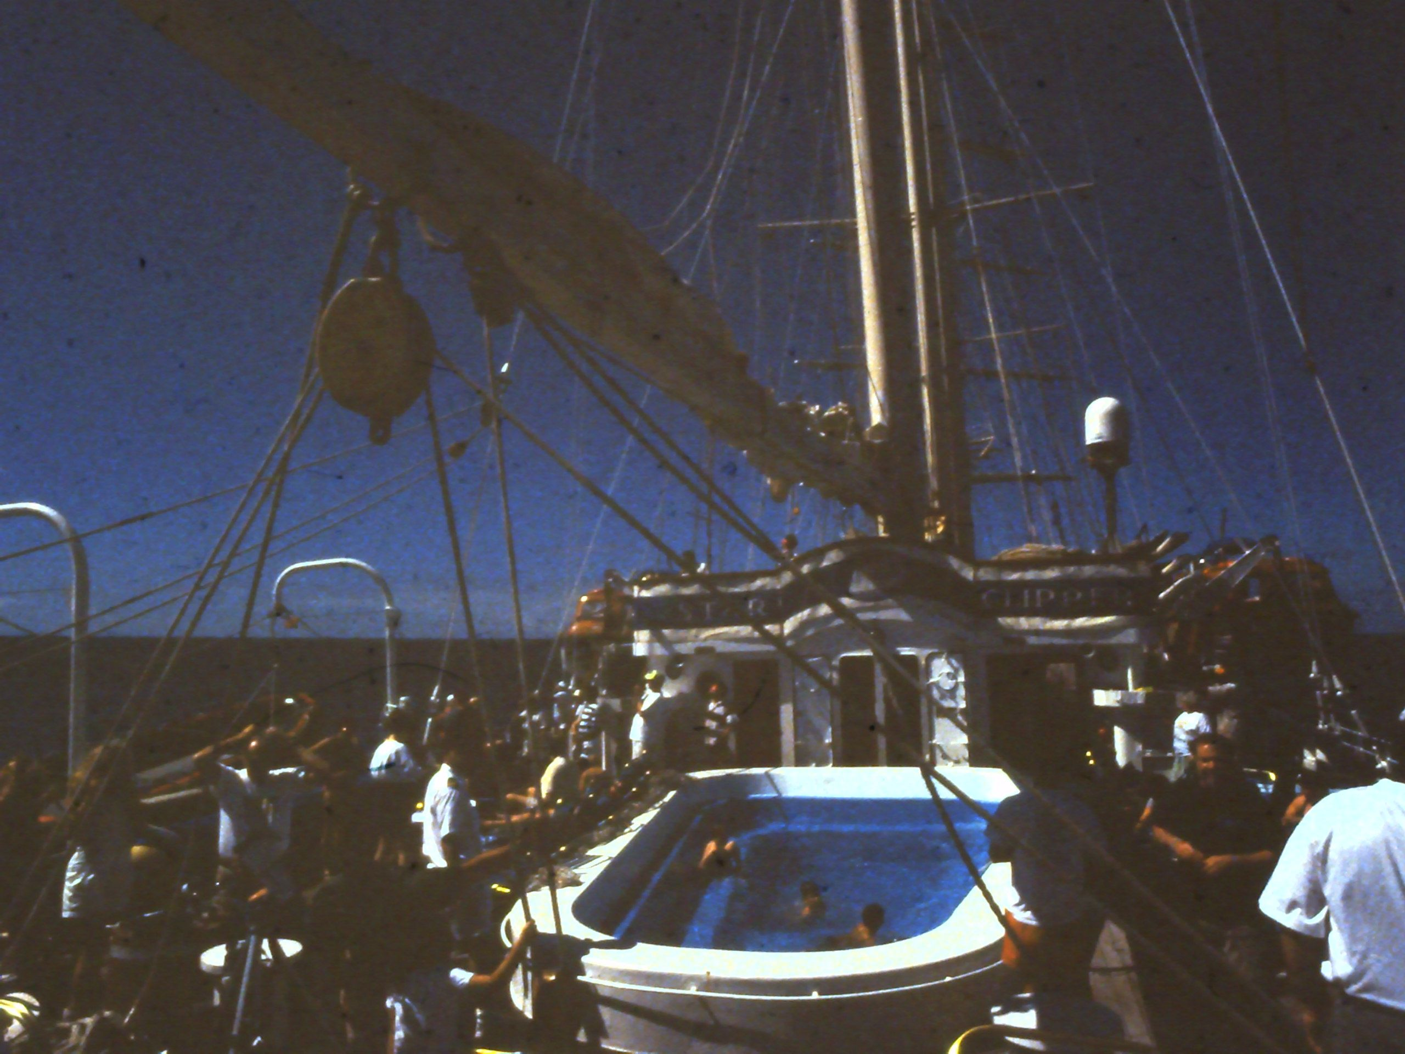

Slide 51


Slide 52
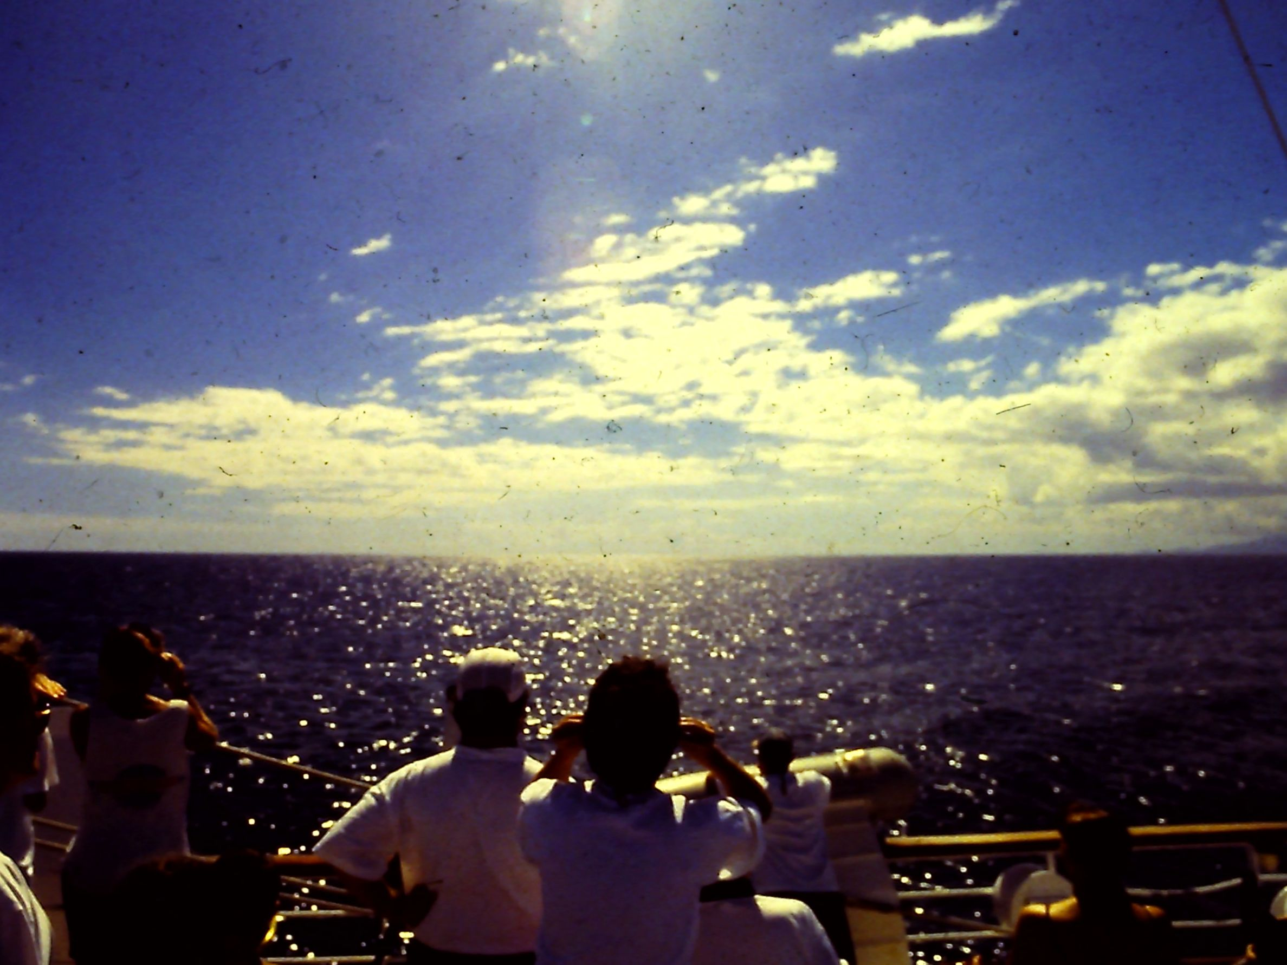

Slide 53
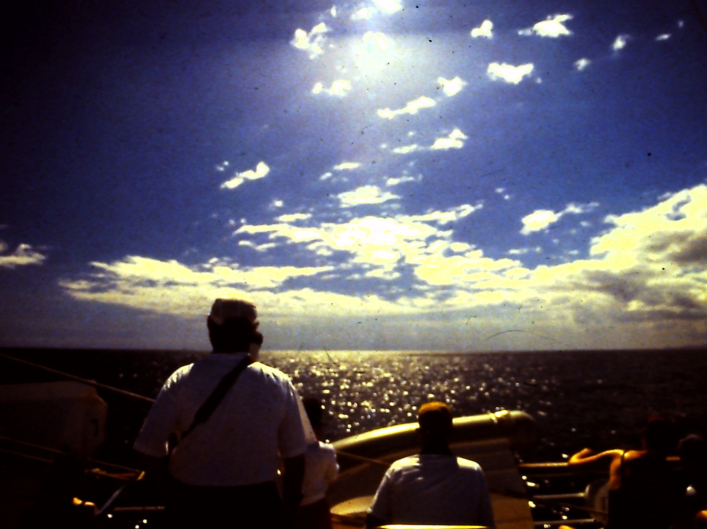

Slide 54
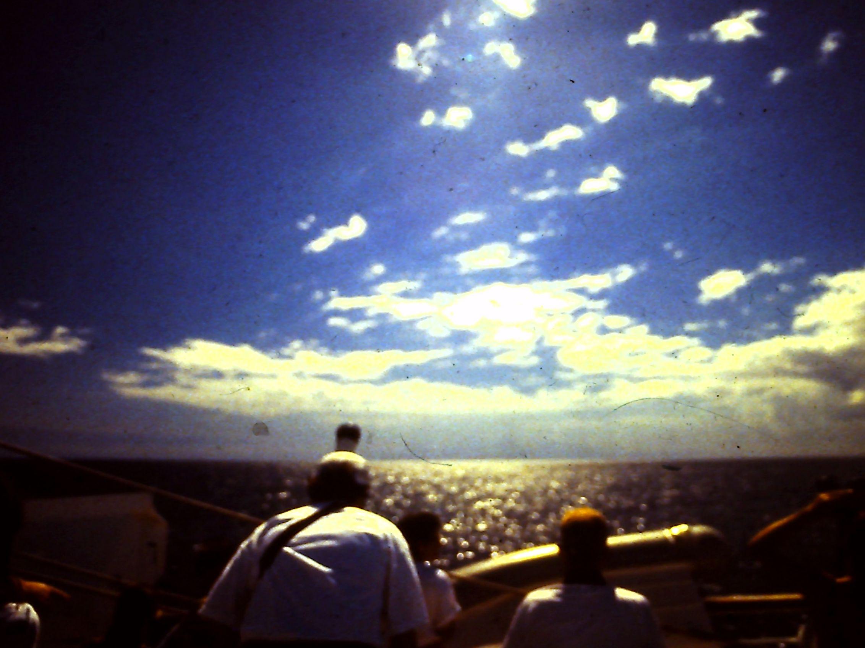

Slide 55


Slide 56


Slide 57


Slide 58


Slide 59


