Slide 1
VENUS AND JUPITER

Slide 2
MARCH 3RD

Slide 3
MARCH 4TH

Slide 4
MARCH 5TH

Slide 5
MARCH 6TH

Slide 6
MARCH 7TH

Slide 7
MARCH 8TH

Slide 8
MARCH 9TH

Slide 9
MARCH 10TH

Slide 10
MARCH 11TH

Slide 11
MARCH 12TH

Slide 12
MARCH 13TH

Slide 13
MARCH 15TH

Slide 14
MARCH 17TH

Slide 15
MARCH 18TH

Slide 16
MARCH 19TH

Slide 17
MARCH 20TH

Slide 18
MARCH 21ST

Slide 19
MARCH 22ND

Slide 20
MARCH 23RD

Slide 21
MARCH 26TH

Slide 22
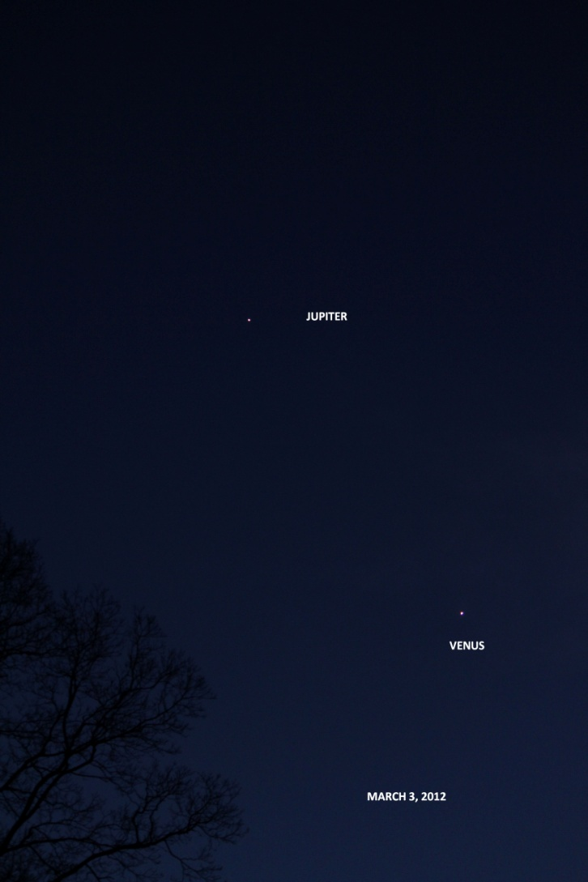
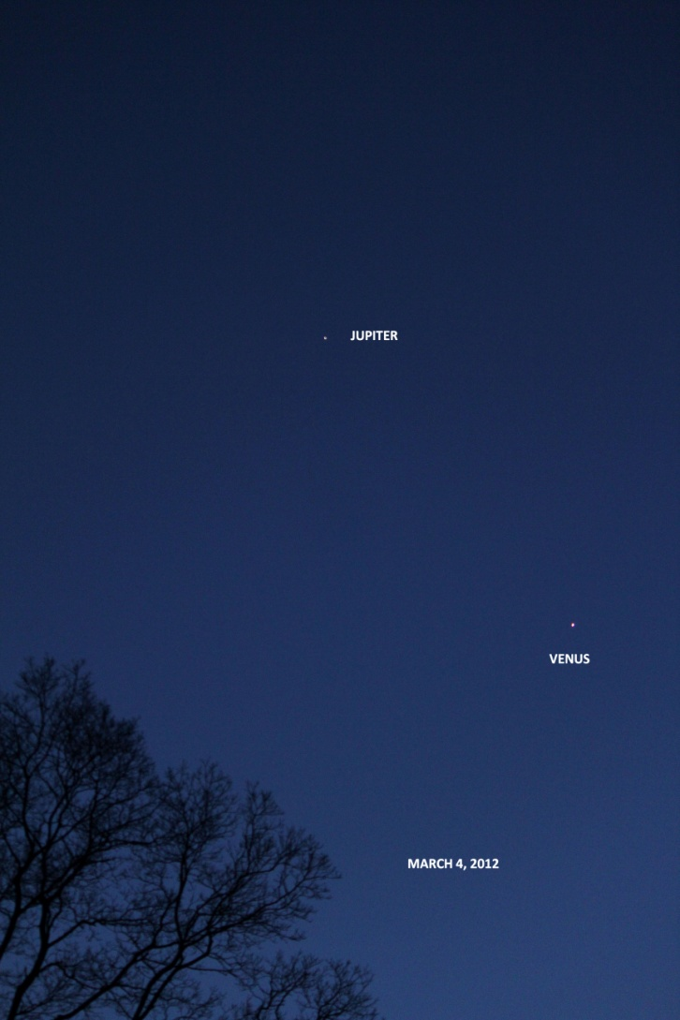
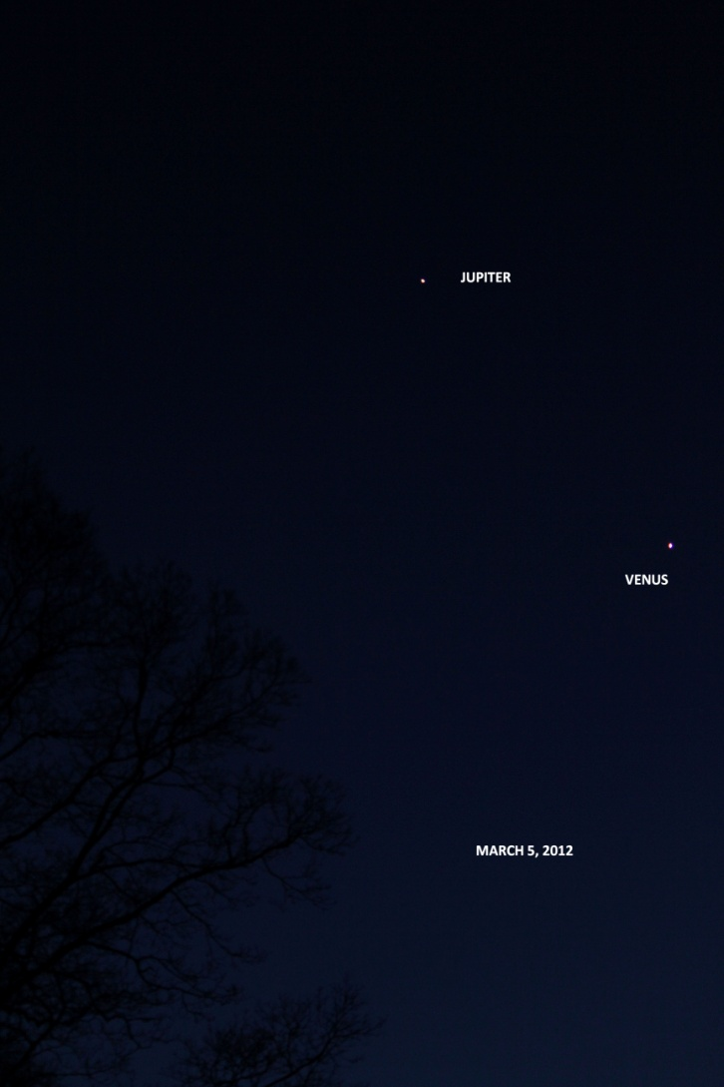
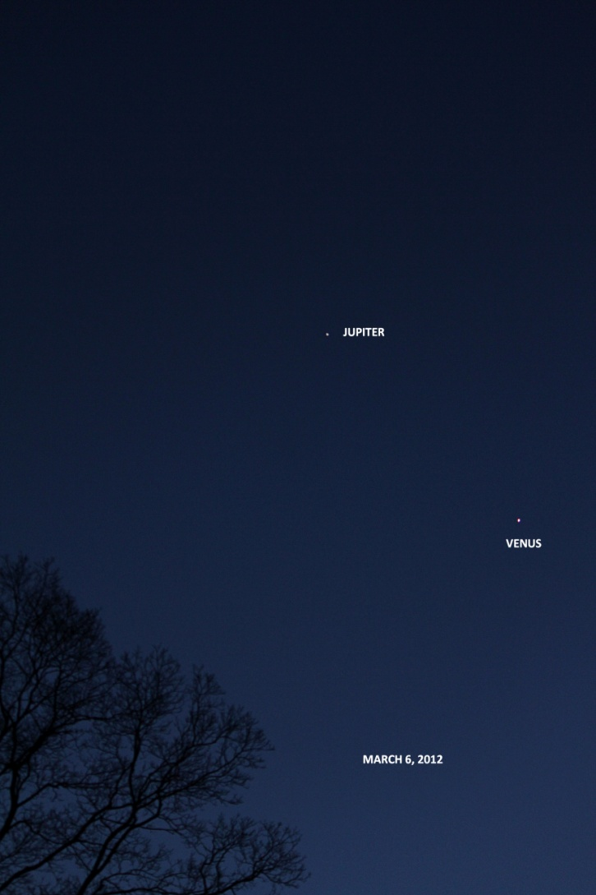
MARCH 3 - 7
MARCH 3 MARCH 4 MARCH 5 MARCH 6 MARCH 7
THESE FIVE IMAGES WERE TAKEN AT ABOUT 6:00 P.M. EST WITH A 55MM LENS.

Slide 23
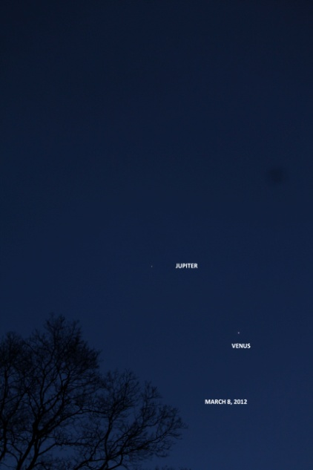
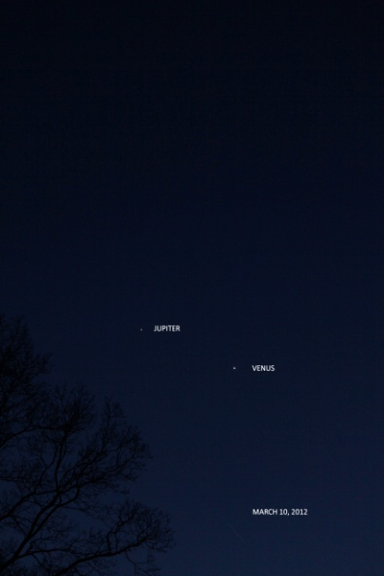
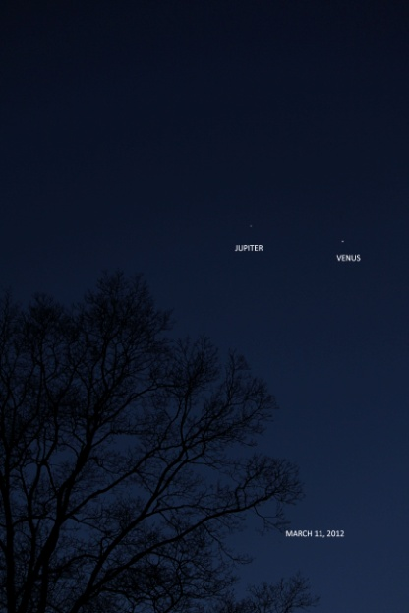
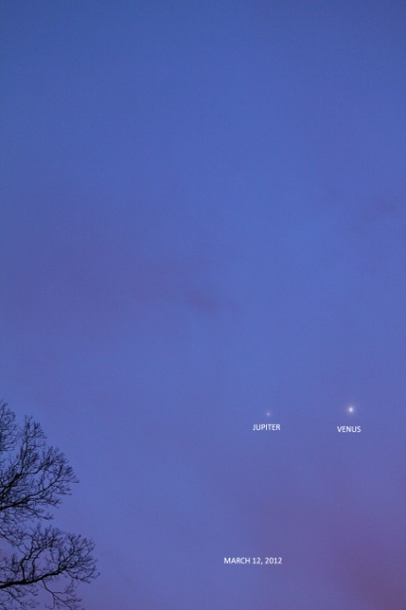
MARCH 8 - 12
MARCH 8 MARCH 9 MARCH 10 MARCH 11 MARCH 12
THESE IMAGES WERE TAKEN AT ABOUT 6:00 P.M. EST WITH THE EXCEPTION OF
THE MARCH 9TH IMAGE, THAT WAS TAKEN LATER. STARTING WITH MARCH 11TH,
THE IMAGES WERE TAKEN AT ABOUT 7:00 P.M. EDT USING THE SAME 55MM LENS.

Slide 24
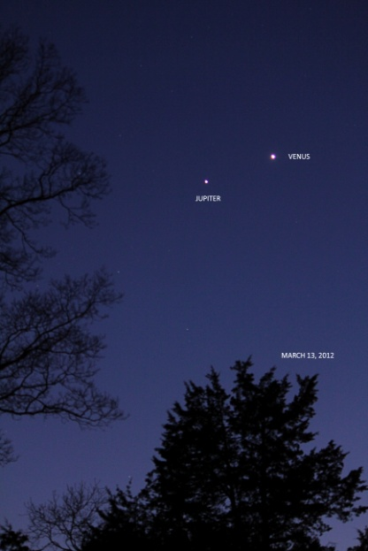
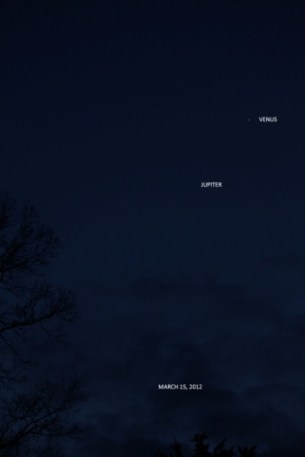
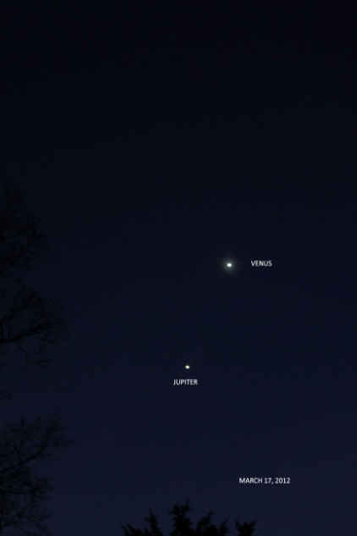
MARCH 13 - 17
CLOUDY
CLOUDY
MARCH 13 MARCH 14 MARCH 15 MARCH 16 MARCH 17
THESE IMAGES WERE TAKEN AT ABOUT 7:00 P.M. EDT USING THE SAME 55MM LENS.

Slide 25
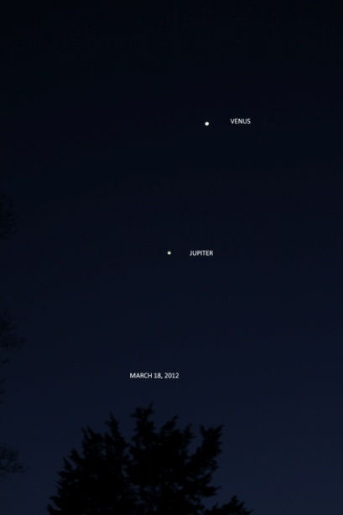
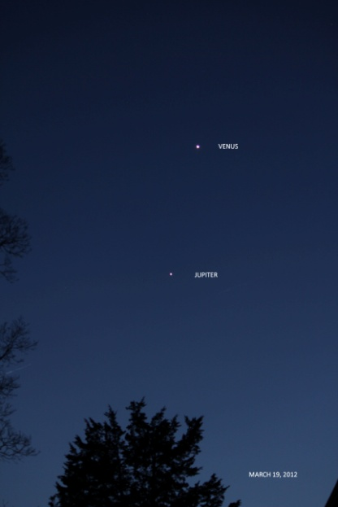
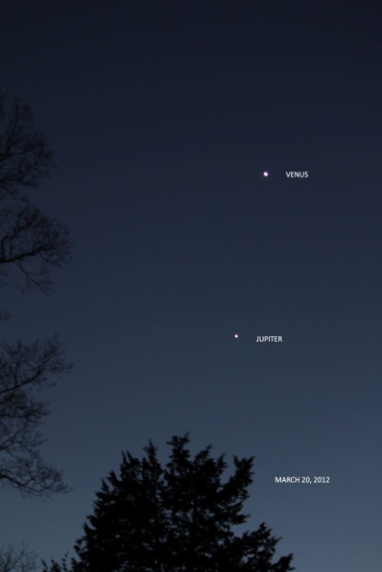
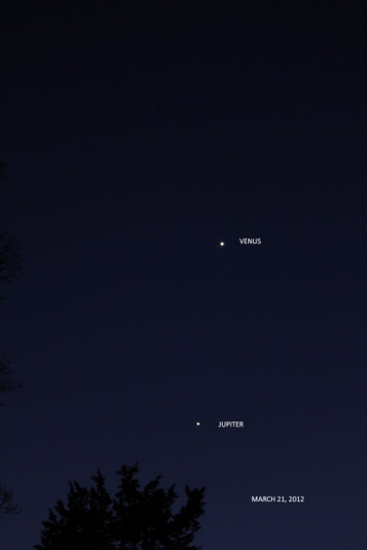
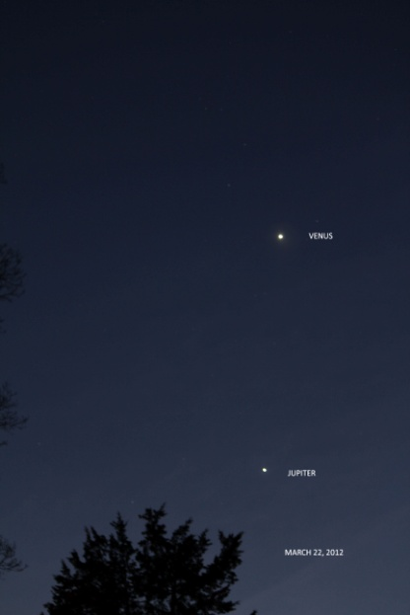
MARCH 18 - 22
MARCH 18 MARCH 19 MARCH 20 MARCH 21 MARCH 22
THESE IMAGES WERE TAKEN AT ABOUT 7:30 P.M. EDT USING THE SAME 55MM LENS.

Slide 26
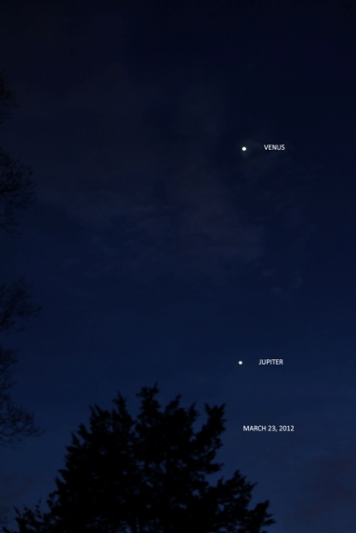
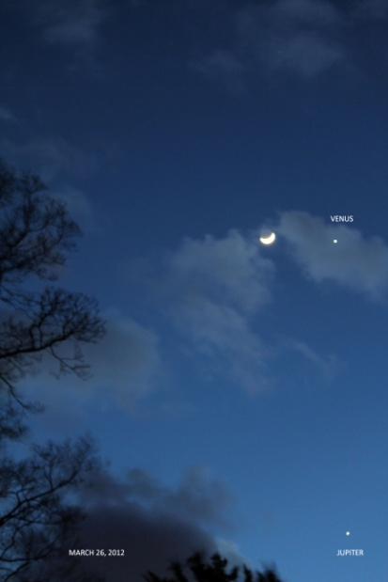
MARCH 23 - 27
CLOUDY
CLOUDY
MARCH 23 MARCH24 MARCH 25 MARCH 26 MARCH 27
THESE IMAGES WERE TAKEN AT ABOUT 7:30 P.M. EDT USING THE SAME 55MM LENS.

Slide 27
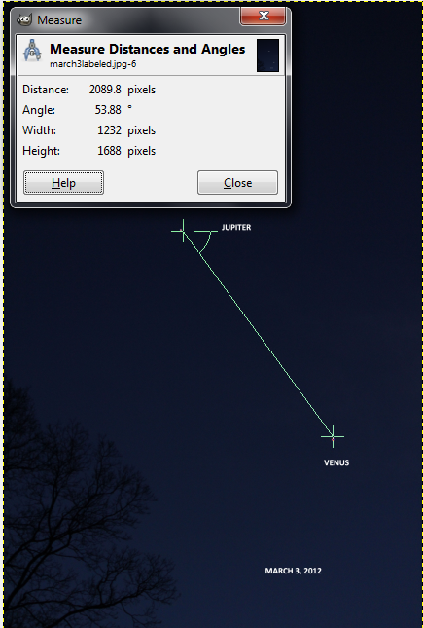
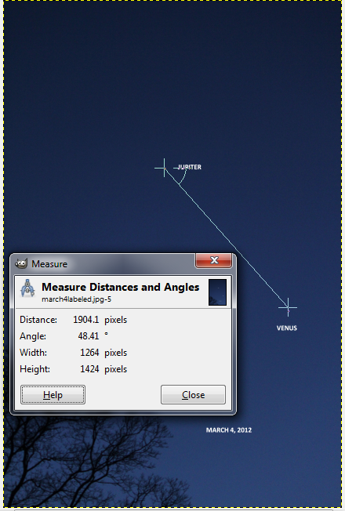
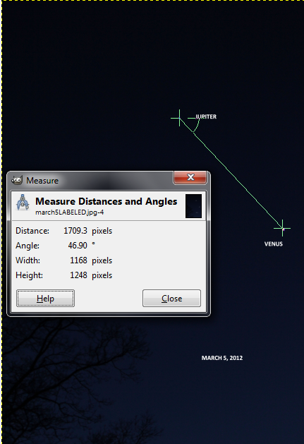
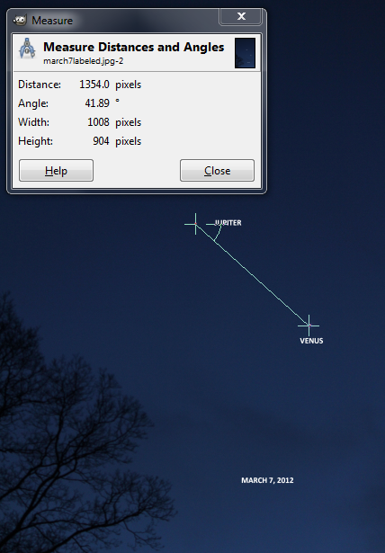
MARCH 3 - 7
MARCH 3 MARCH 4 MARCH 5 MARCH 6 MARCH 7
2089.8 1904.1 1709.3 1539.0 1354.0
ALL FIVE IMAGES WERE TAKEN AT ABOUT 6:00 P.M. EST WITH A 55MM LENS. THE
DISTANCE BETWEEN THE PLANETS WAS MEASURED TO THE NEAREST 0.1 OF A PIXEL.

Slide 28
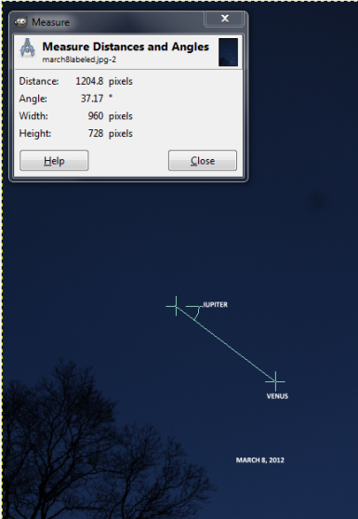
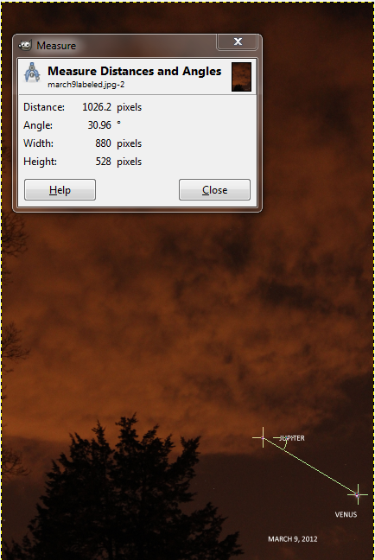
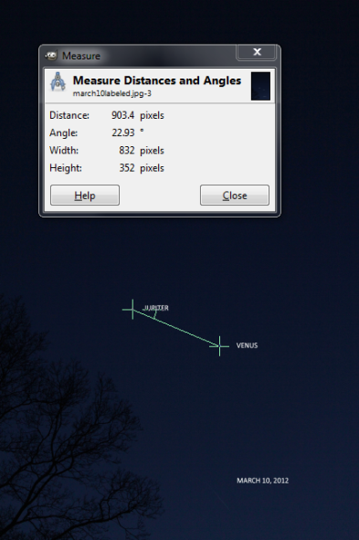
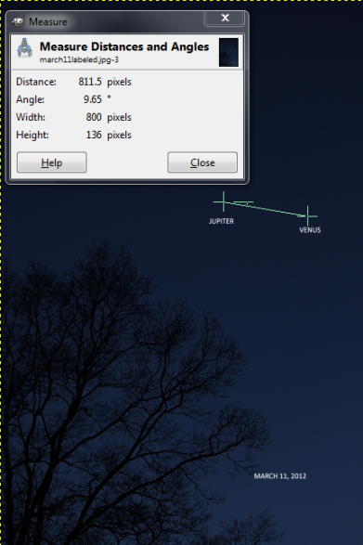
MARCH 8 - 12
MARCH 8 MARCH 9 MARCH 10 MARCH 11 MARCH 12
1204.8 1026.2 903.4 811.5 697.7
THESE IMAGES WERE TAKEN AT ABOUT 6:00 P.M. EST WITH THE EXCEPTION OF
THE MARCH 9TH IMAGE, THAT WAS TAKEN LATER. STARTING WITH MARCH 11TH,
THE IMAGES WERE TAKEN AT ABOUT 7:00 P.M. EDT USING THE SAME 55MM LENS. THE
DISTANCE BETWEEN THE PLANETS WAS MEASURED TO THE NEAREST 0.1 OF A PIXEL.

Slide 29
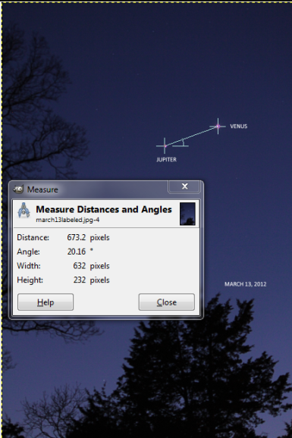
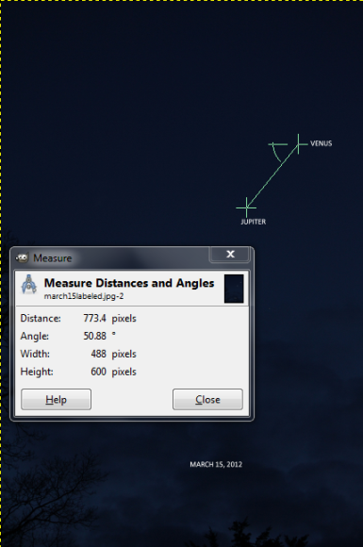
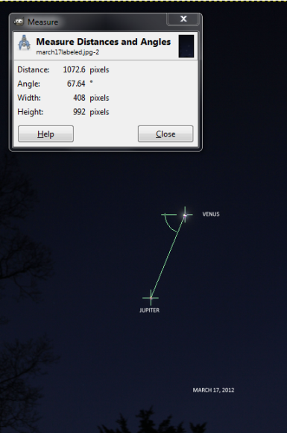
MARCH 13 - 17
MARCH 13 MARCH 14 MARCH 15 MARCH 16 MARCH 17
637.2 CLOUDY 773.4 CLOUDY 1072.6
THESE IMAGES WERE TAKEN AT ABOUT 7:00 P.M. EDT USING THE SAME 55MM LENS. THE
DISTANCE BETWEEN THE PLANETS WAS MEASURED TO THE NEAREST 0.1 OF A PIXEL.

Slide 30
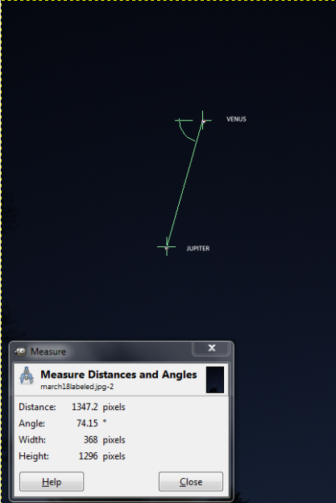
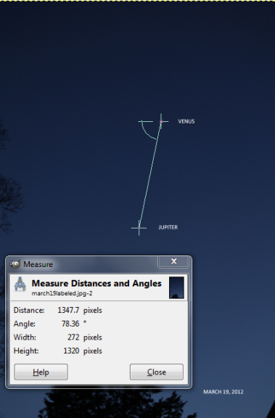
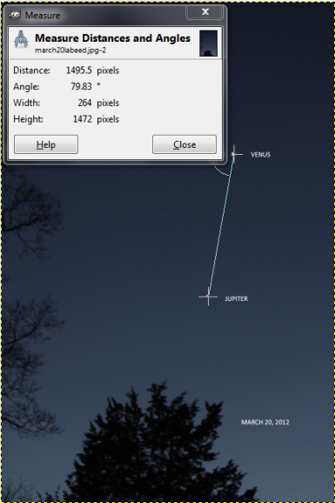
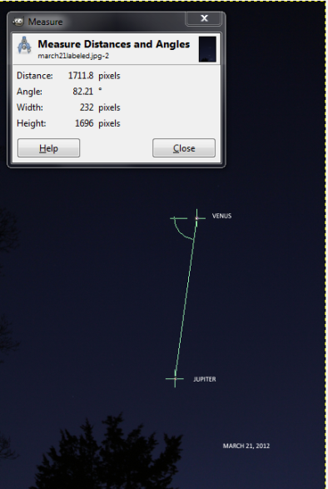
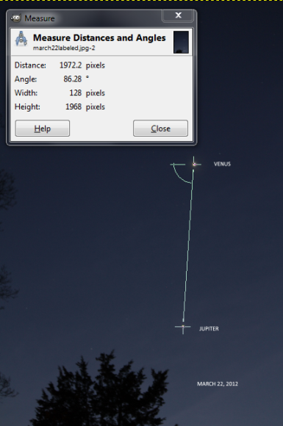
MARCH 18 - 22
MARCH 18 MARCH 19 MARCH 20 MARCH 21 MARCH 22
1347.2 1347.7 1495.5 1711.8 1972.2
THESE IMAGES WERE TAKEN AT ABOUT 7:30 P.M. EDT USING THE SAME 55MM LENS. THE
DISTANCE BETWEEN THE PLANETS WAS MEASURED TO THE NEAREST 0.1 OF A PIXEL.

Slide 31
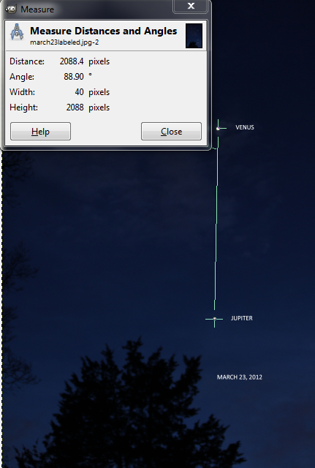
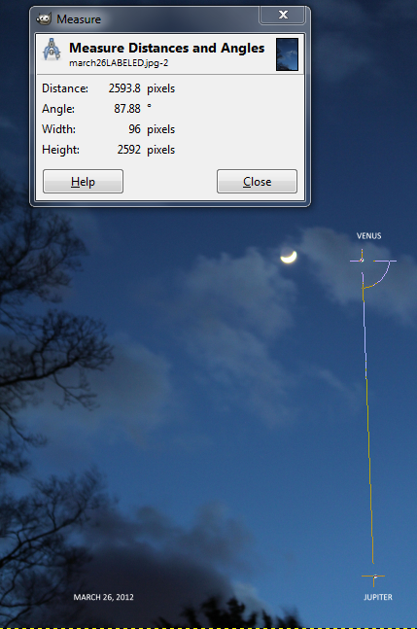
MARCH 23 - 27
MARCH 23 MARCH 24 MARCH 25 MARCH 26 MARCH 27
2088.4 CLOUDY CLOUDY 2593.8
THESE IMAGES WERE TAKEN AT ABOUT 7:30 P.M. EDT USING THE SAME 55MM LENS. THE
DISTANCE BETWEEN THE PLANETS WAS MEASURED TO THE NEAREST 0.1 OF A PIXEL.

Slide 32
MARCH | DISTANCE APART IN PIXELS | MARCH | DISTANCE APART IN PIXELS
3 | 2089.8 | 19 | 1347.7
4 | 1904.1 | 20 | 1495.5
5 | 1709.3 | 21 | 1711.8
6 | 1539.0 | 22 | 1972.2
7 | 1354.0 | 23 | 2088.4
8 | 1204.8 | 24 | CLOUDY
9 | 1026.2 | 25 | CLOUDY
10 | 903.4 | 26 | 2593.8
11 | 811.5
12 | 697.7
13 | 637.2
14 | CLOUDY
15 | 773.4
16 | CLOUDY
17 | 1072.6
18 | 1347.2*

