Slide 1
ROCK TEST

Slide 2
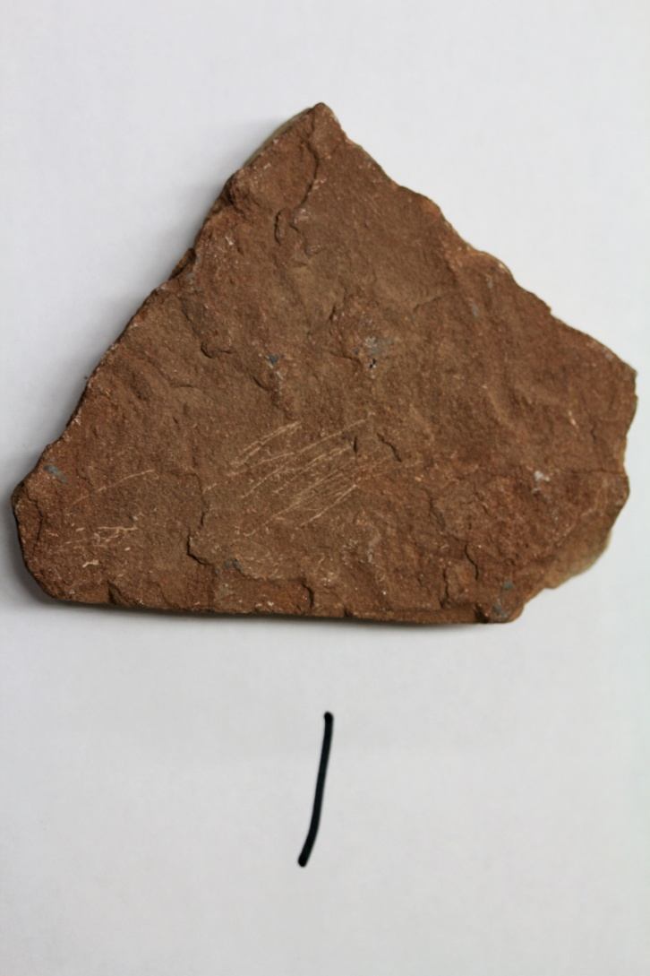

Slide 3
SEDIMENTARY

Slide 4
SEDIMENTARY SANDSTONE – 84%

Slide 5
SEDIMENTARY SANDSTONE – 84%
CLUES: GRITTY FEEL,
AND LAYERS

Slide 6
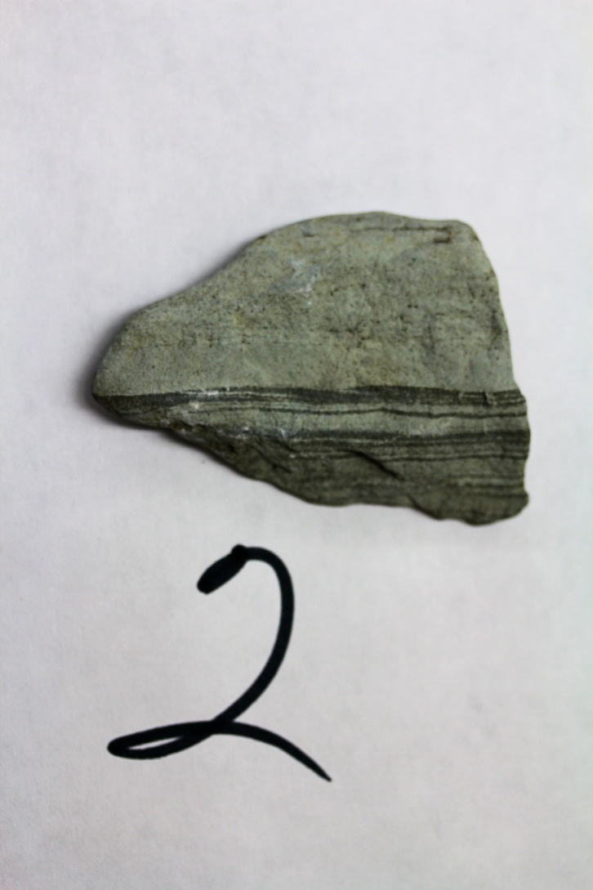

Slide 7
SEDIMENTARY

Slide 8
SEDIMENTARY – SHALE/LIMESTONE – 84%

Slide 9
SEDIMENTARY – SHALE/LIMESTONE – 84%
CLUES: LAYERS, SMOOTH
TEXTURE

Slide 10
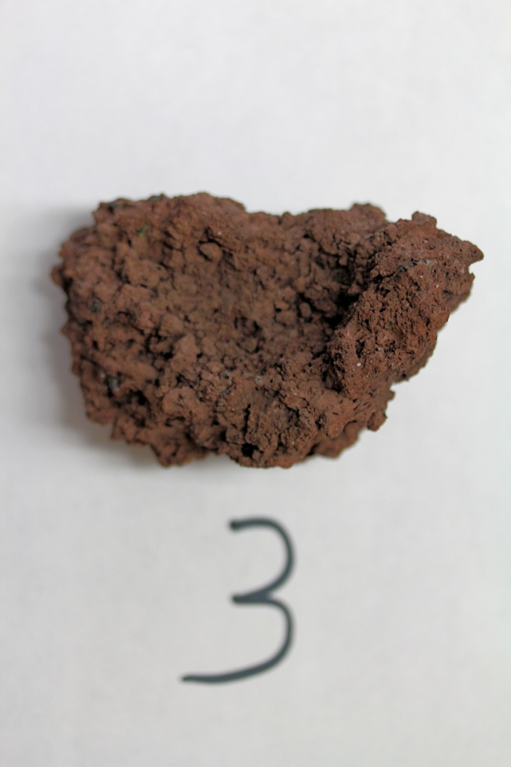

Slide 11
IGNEOUS

Slide 12
IGNEOUS – LAVA – 87%

Slide 13
IGNEOUS – LAVA – 87%
CLUES: UNUSUAL SURFACE

Slide 14
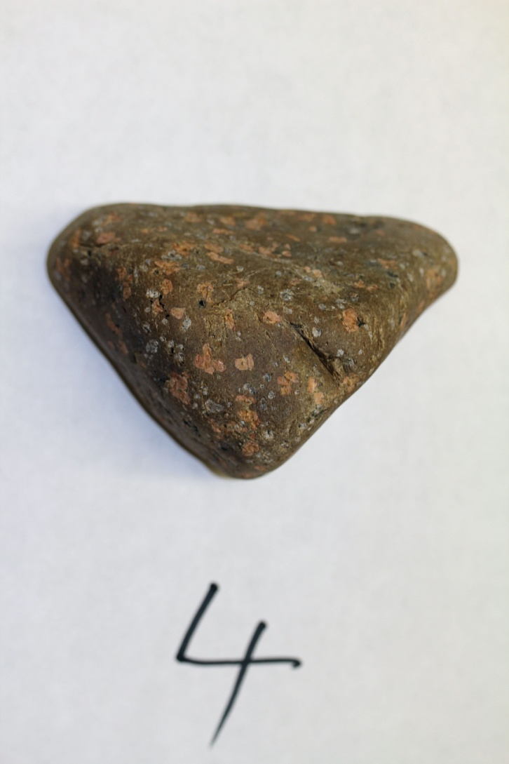

Slide 15
IGNEOUS

Slide 16
IGNEOUS – PORPHYRY – 73%

Slide 17
IGNEOUS – PORPHYRY – 73%
CLUES: CRYSTALS
SCATTERED AT RANDOM
SURROUNDED BY FINE
MATERIAL

Slide 18
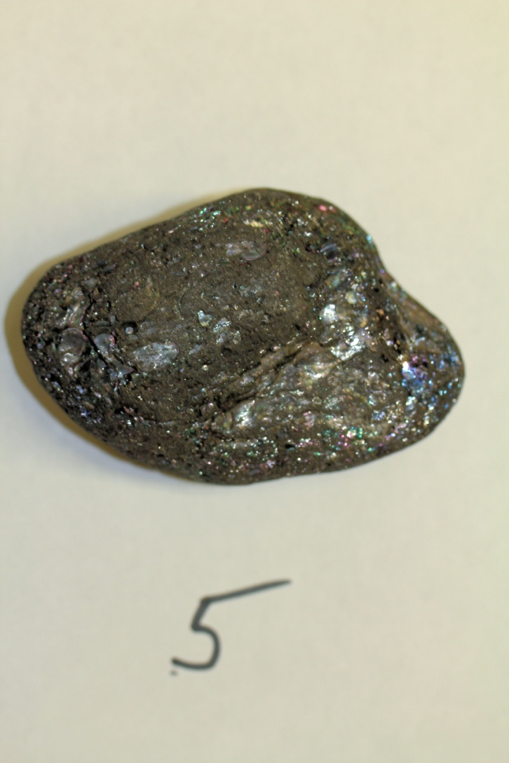

Slide 19
METAMORPHIC

Slide 20
METAMORPHIC – ANTHRACITE COAL – 73%

Slide 21
METAMORPHIC – ANTHRACITE COAL – 73%
CLUES: HIGH SHEEN.
SHEEN COLORS LOOK
LIKE ENGINE OIL IN A
PUDDLE.

Slide 22
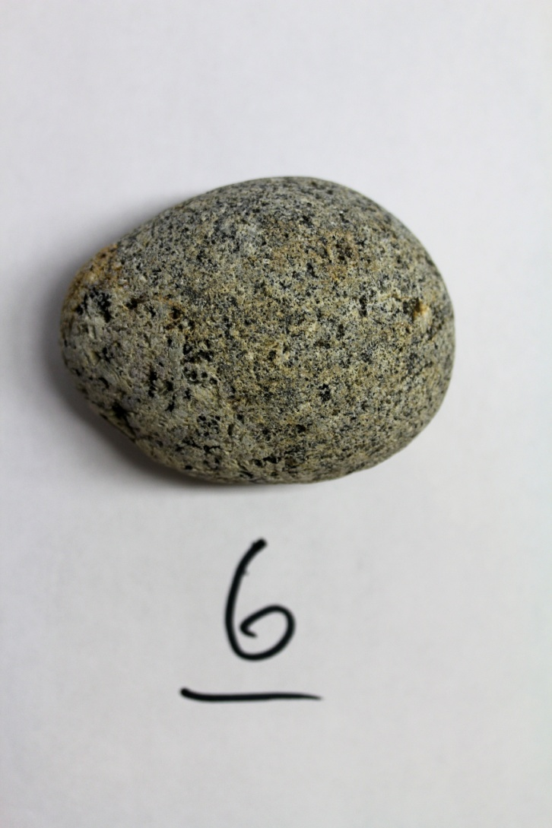

Slide 23
IGNEOUS

Slide 24
IGNEOUS – DIORITE – 78%

Slide 25
IGNEOUS – DIORITE – 78%
CLUES: BLACK & WHITE
CRYSTALS SCATTERED AT
RANDOM

Slide 26
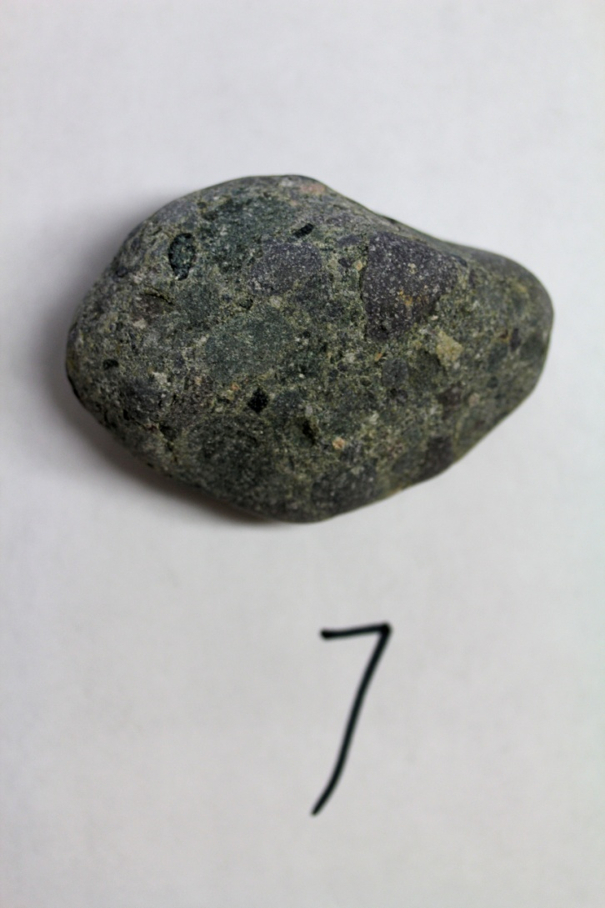

Slide 27
SEDIMENTARY

Slide 28
SEDIMENTARY – CONGLOMERATE – 84% (NICELY DONE!!)

Slide 29
SEDIMENTARY – CONGLOMERATE – 84% (NICELY DONE!!)
CLUES: ROUNDED ROCKS
SCATTERED AT RANDOM

Slide 30
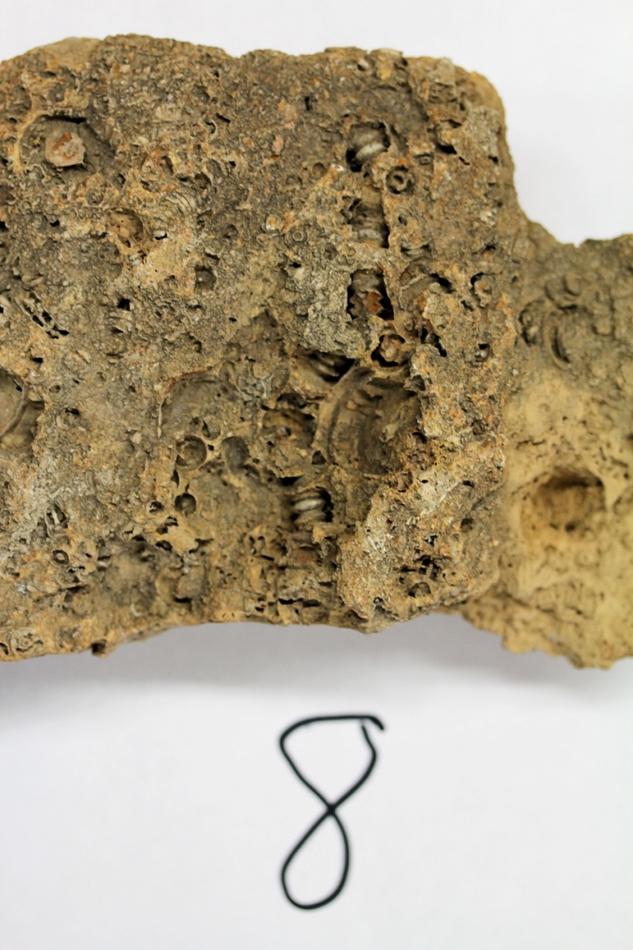

Slide 31
SEDIMENTARY

Slide 32
SEDIMENTARY – LIMESTONE OR CRINOID STEMS OR SHALE – 78%

Slide 33
SEDIMENTARY – LIMESTONE OR CRINOID STEMS OR SHALE – 78%
CLUE: DEAD GUYS AND
SMOOTH BACKGROUND

Slide 34
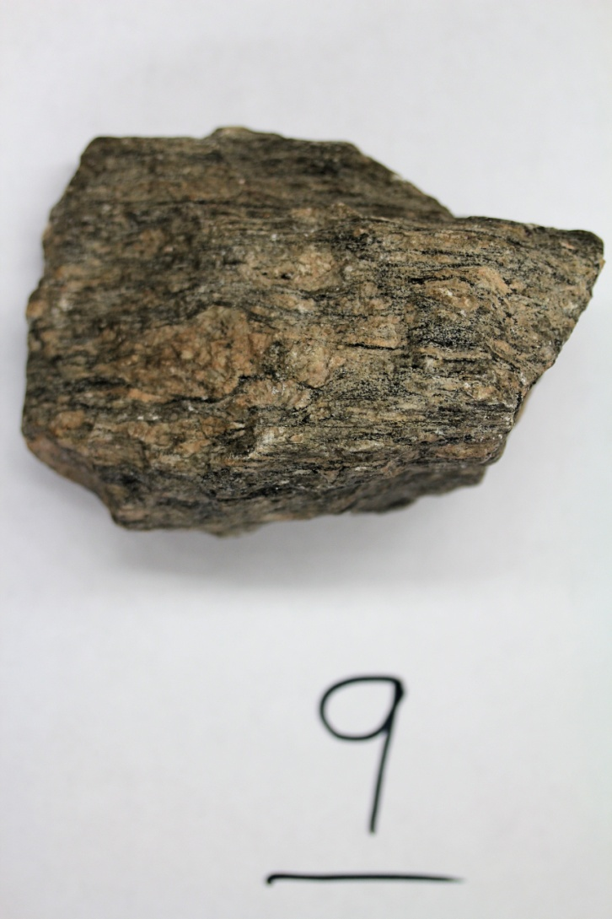

Slide 35
METAMORPHIC

Slide 36
METAMORPHIC – GNEISS – 55% (SHAME ON YOU!!)

Slide 37
METAMORPHIC – GNEISS – 55% (SHAME ON YOU!!)
CLUES: CRSYTALS IN
BANDS OR LAYERS

Slide 38
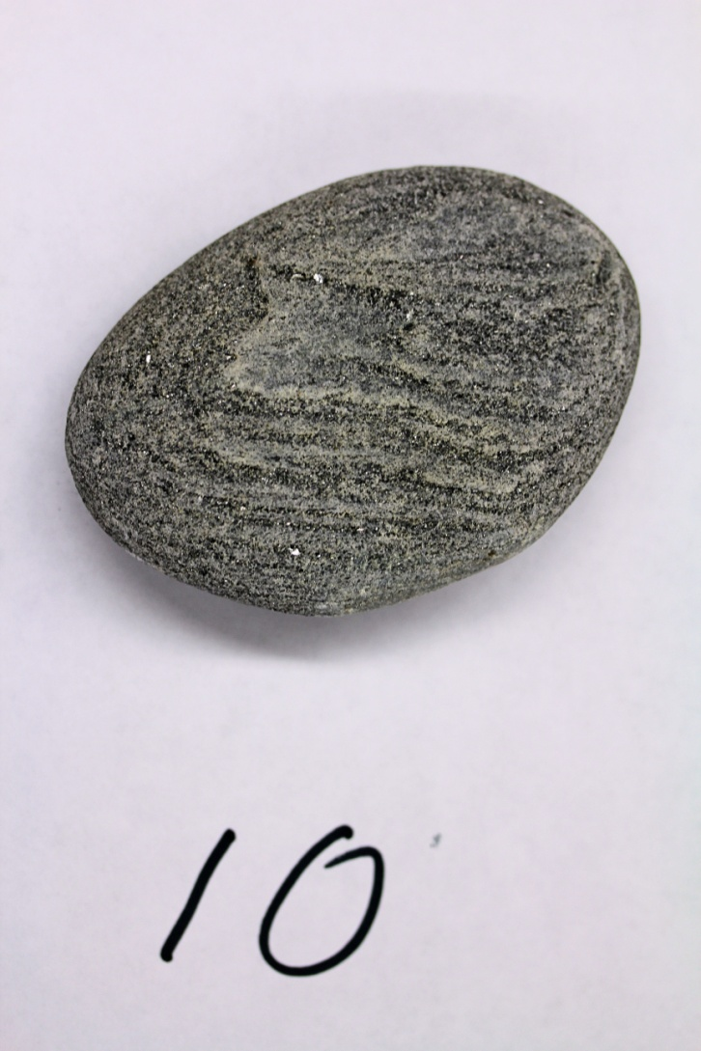

Slide 39
METAMORPHIC

Slide 40
METAMORPHIC – SCHIST – 66%

Slide 41
METAMORPHIC – SCHIST – 66%
CLUES: VERY TIGHT
LAYERS OF CRYSTALS,
A LOT OF MICA

Slide 42
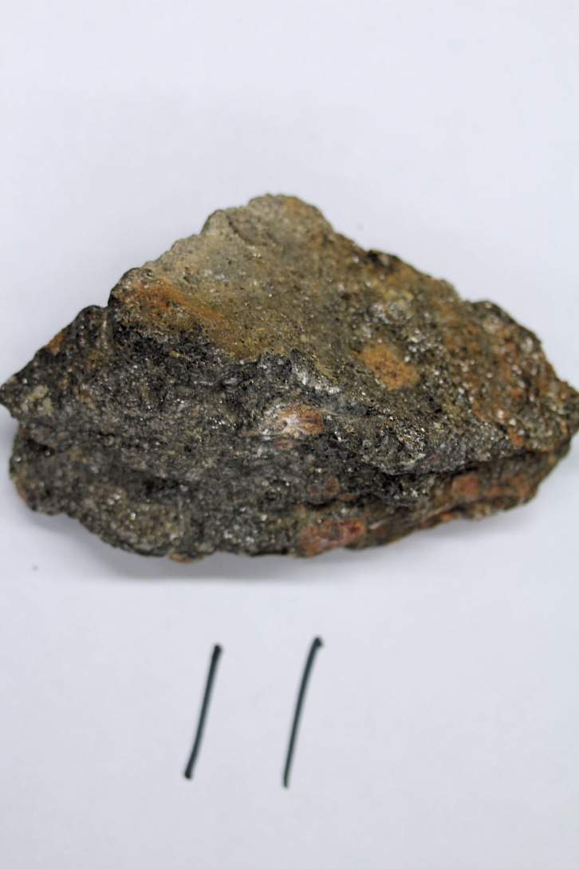

Slide 43
METAMORPHIC

Slide 44
METAMORPHIC – SCHIST – 63%

Slide 45
METAMORPHIC – SCHIST – 63%
CLUES: SHEEN, PURPLE
CRYSTALS, MICA

Slide 46
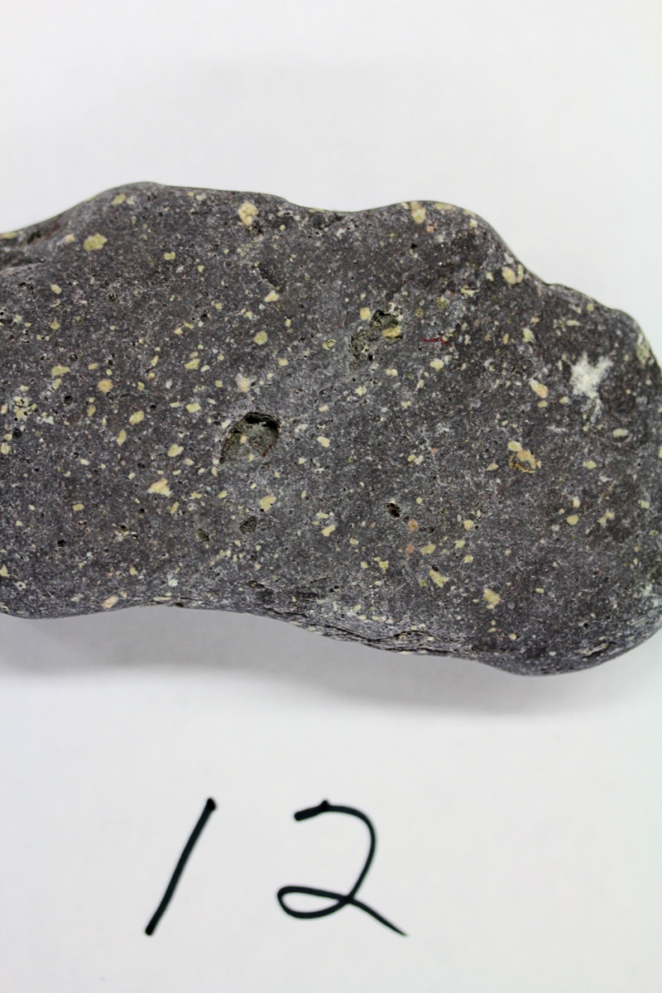

Slide 47
IGNEOUS

Slide 48
IGNEOUS – BASALT PORPHYRY – 84% (NICELY DONE!!)

Slide 49
IGNEOUS – BASALT PORPHYRY – 84% (NICELY DONE!!)
CLUES: LARGE CRYSTALS
SCATTERED AT RANDOM
IN A DARK MATRIX

Slide 50
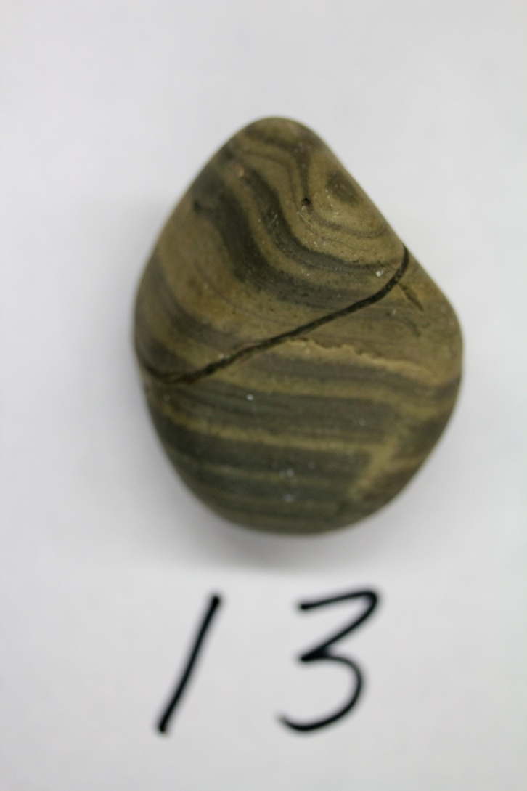

Slide 51
SEDIMENTARY

Slide 52
SEDIMENTARY – SHALE/LIMESTONE – 75% (SHAME ON YOU!!)

Slide 53
SEDIMENTARY – SHALE/LIMESTONE – 75% (SHAME ON YOU!!)
CLUES: ALTERNATING
LAYERS, FINE MATERIAL

Slide 54
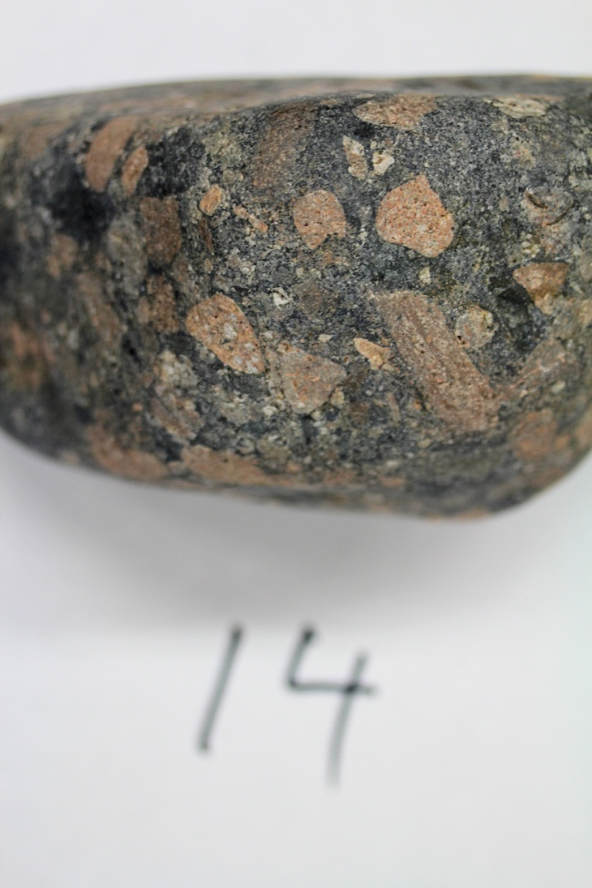

Slide 55
IGNEOUS!!!

Slide 56
IGNEOUS!!! – PORPHORY – 27% (I’M SORRY)

Slide 57
IGNEOUS!!! – PORPHORY – 27% (I’M SORRY)
CLUES: YEAH, RIGHT –
ONE COLOR CRYSTALS
SCATTERED AT RANDOM.
THIS WAS ACTUALLY A
GRANITE PORPHORY
(LARGE CRYSTALS
SURROUNDED BY
SMALL)

Slide 58
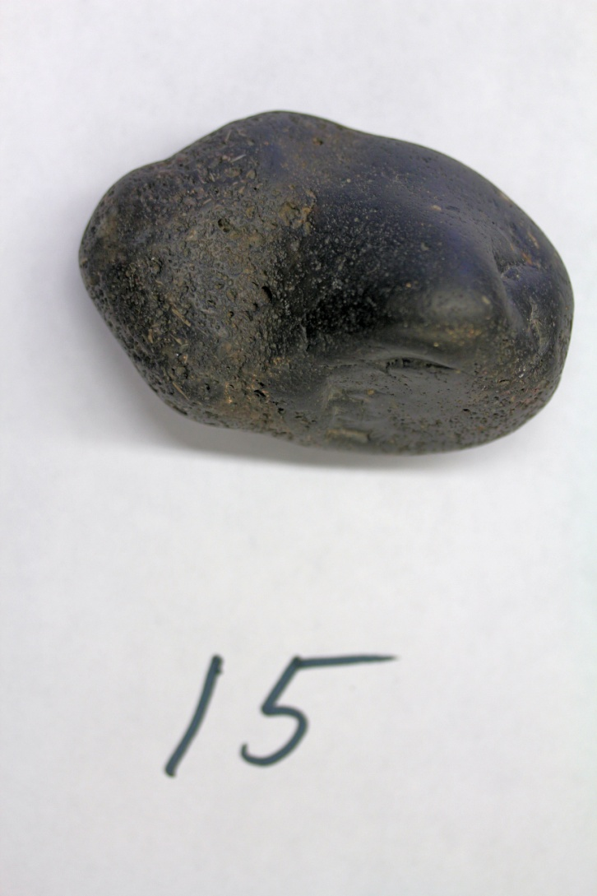

Slide 59
IGNEOUS

Slide 60
IGNEOUS – BASALT – 80% (NOT BAD)

Slide 61
IGNEOUS – BASALT – 80% (NOT BAD)
CLUES: DARK, ONE
COLOR, MASSIVE,
HOLES)

Slide 62
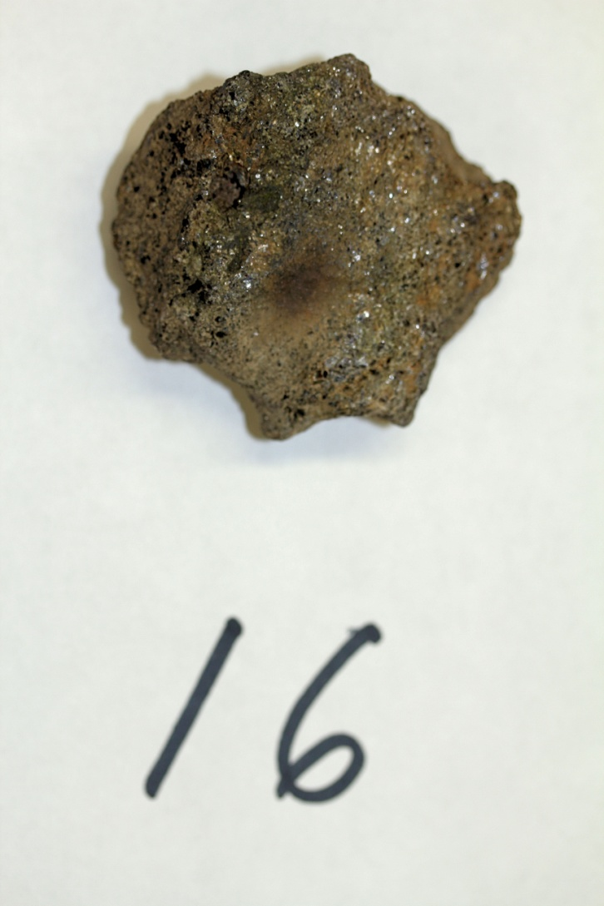

Slide 63
METAMORPHIC

Slide 64
METAMORPHIC – SCHIST – 41%

Slide 65
METAMORPHIC – SCHIST – 41%
CLUES: LINES OF DARK
AND LIGHT MICA
CRYSTALS

Slide 66
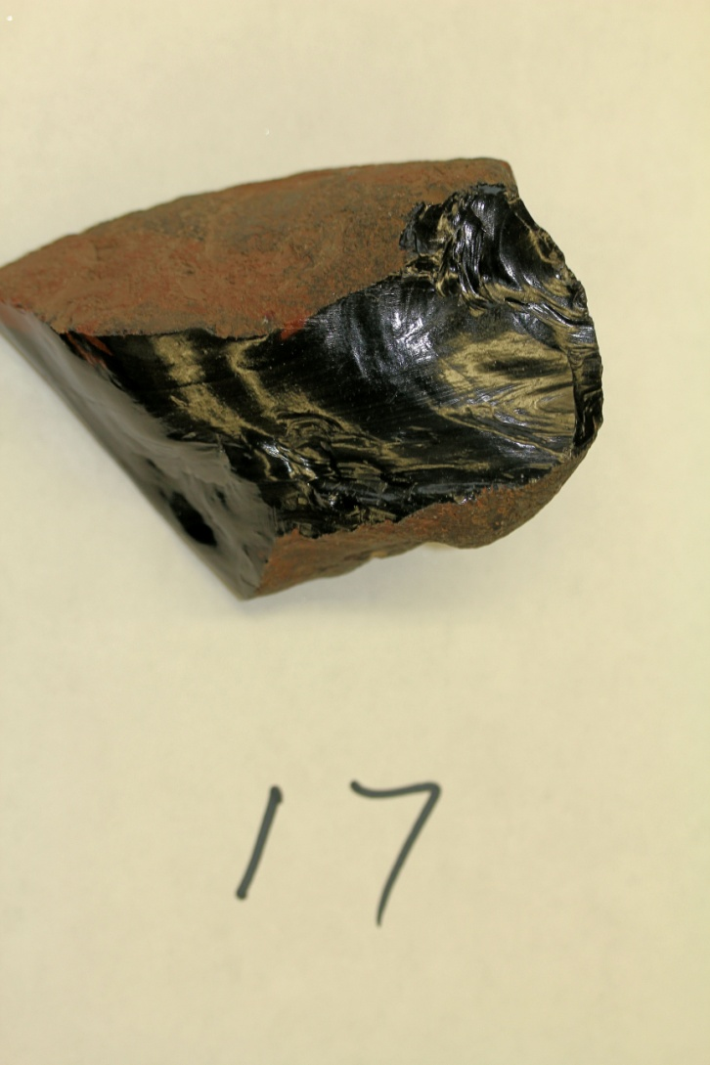

Slide 67
IGNEOUS

Slide 68
IGNEOUS – OBSIDIAN – 62% (SHAME ON YOU!!! IT SHOULD HAVE BEEN AT LEAST 90%)

Slide 69
IGNEOUS – OBSIDIAN – 62% (SHAME ON YOU!!! IT SHOULD HAVE BEEN AT LEAST 90%)
CLUES: OH PLEASE!!!
WHAT ELSE COULD IT
BE?

Slide 70
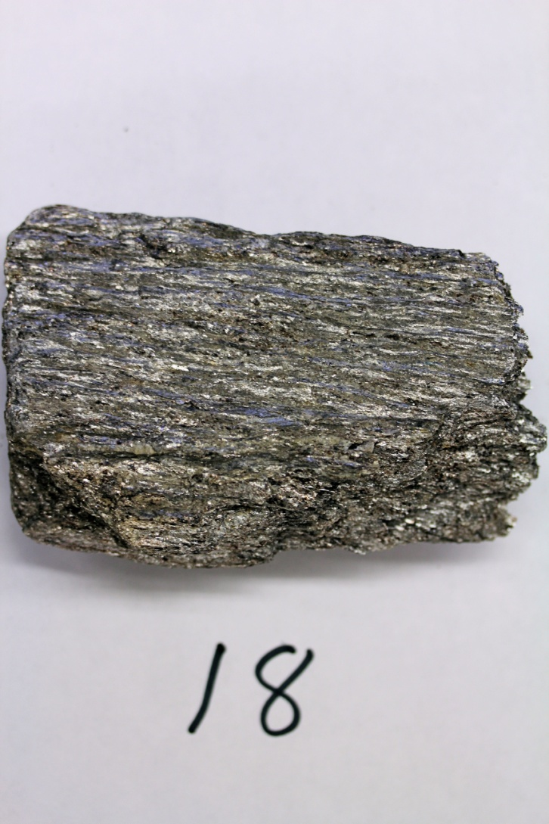

Slide 71
METAMOPHIC

Slide 72
METAMOPHIC – SCHIST – 81% (NICELY DONE!!)

Slide 73
METAMOPHIC – SCHIST – 81% (NICELY DONE!!)
CLUES: VERY HIGH
SHEEN. MICA CRYSTALS
IN BANDS

Slide 74
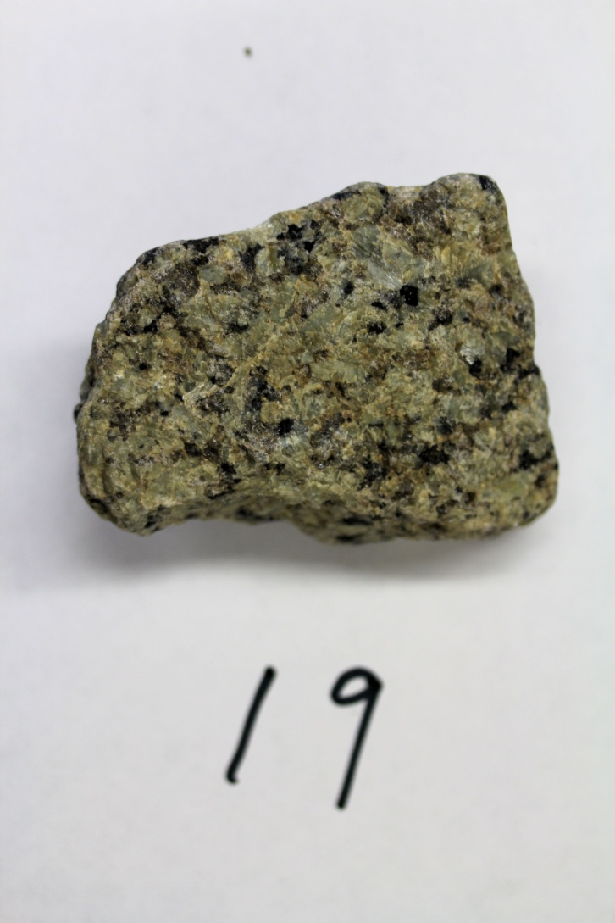

Slide 75
IGNEOUS

Slide 76
IGNEOUS – DIORITE – 67% (SHAME ON YOU!!)

Slide 77
IGNEOUS – DIORITE – 67% (SHAME ON YOU!!)
CLUES: DARK AND LIGHT
CRYSTALS SCATTEREDMAT
RANDOM

Slide 78
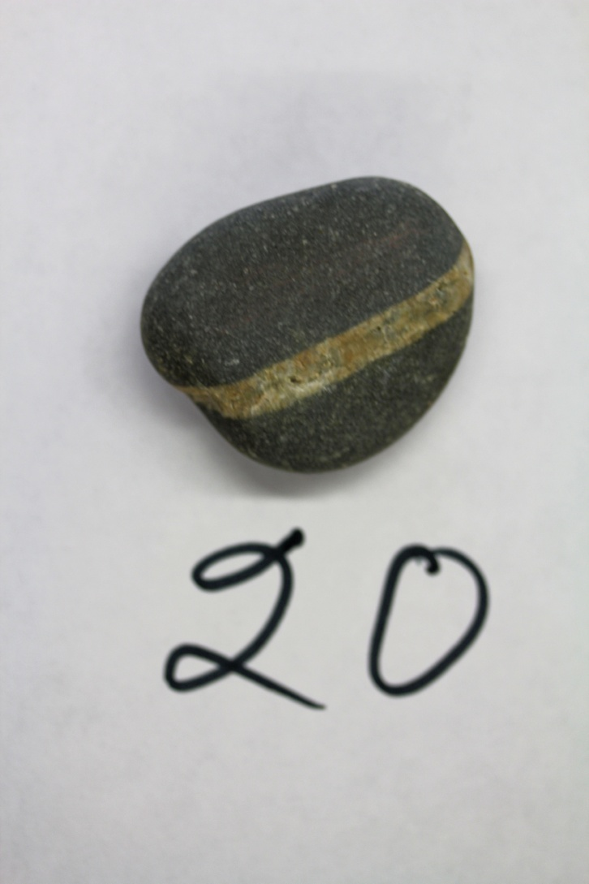

Slide 79
IGNEOUS

Slide 80
IGNEOUS – BASALT – 48% (THIS WAS A SHOCK!! IT MUST HAVE BEEN THE QUARTZ VEIN)

Slide 81
IGNEOUS – BASALT – 48% (THIS WAS A SHOCK!! IT MUST HAVE BEEN THE QUARTZ VEIN)
CLUES: DARK, MASSIVE,
NO DETAIL

Slide 82
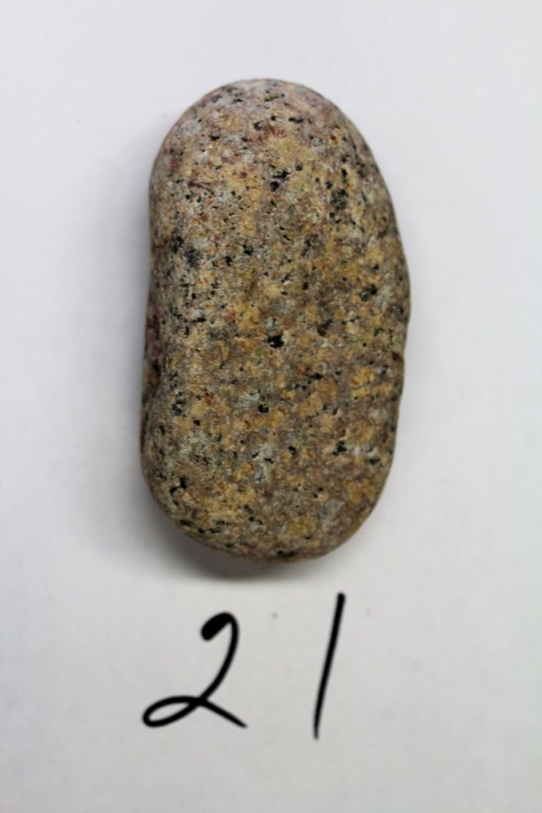

Slide 83
IGNEOUS

Slide 84
IGNEOUS – GRANITE – 72% (WHY DID YOU MISS THIS ONE??)

Slide 85
IGNEOUS – GRANITE – 72% (WHY DID YOU MISS THIS ONE??)
CLUES: LIGHT AND
DARK CRYSTALS
SCATTERED AT RANDOM
WITH MANY TAN
FELDSPAR CRYSTALS

Slide 86
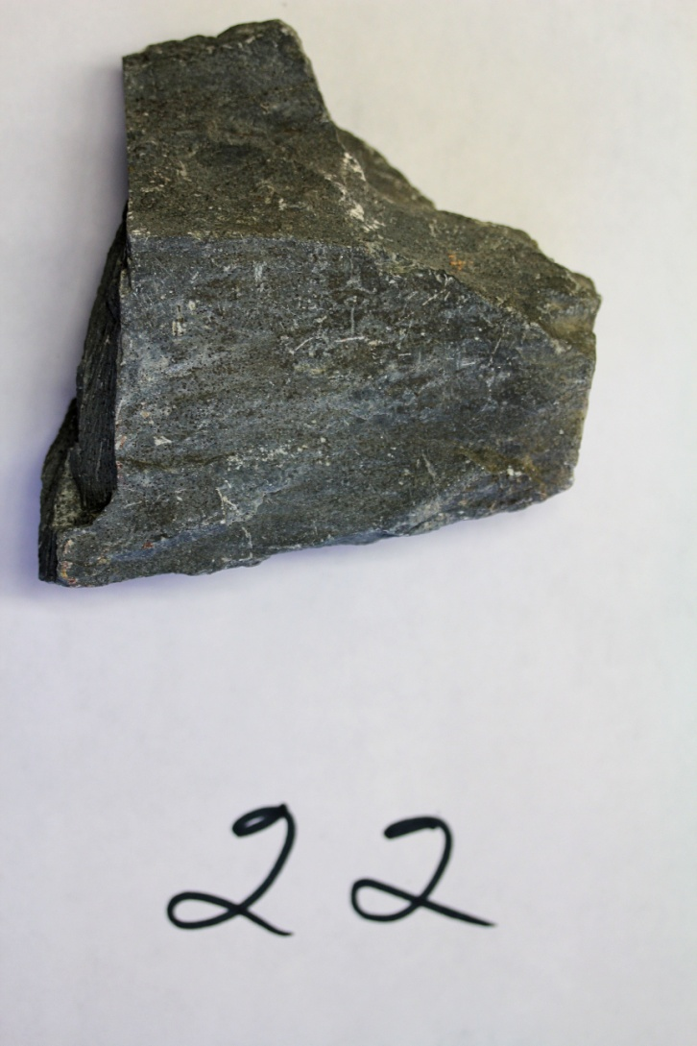

Slide 87
METAMORPHIC

Slide 88
METAMORPHIC – SLATE/PHYLLITE – 29% (HOW DID YOU MISS THIS??)

Slide 89
METAMORPHIC – SLATE/PHYLLITE – 29% (HOW DID YOU MISS THIS??)
CLUES: ONE COLOR,
FOLITATED WITH A LOW
SHEEN. HOW DID YOU
MISS THIS ONE?????

Slide 90
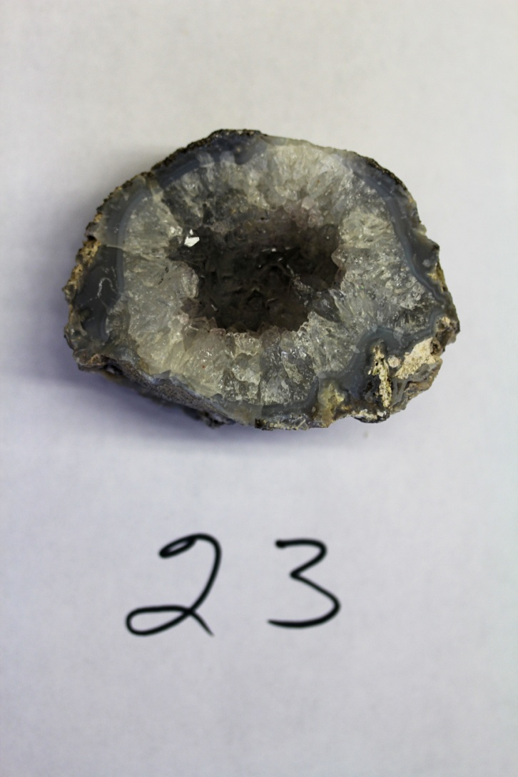

Slide 91
SEDIMENTARY

Slide 92
SEDIMENTARY – GEODE – 71% (SHOULD HAVE DONE BETTER)

Slide 93
SEDIMENTARY – GEODE – 71% (SHOULD HAVE DONE BETTER)
CLUES: SPHERE WITH
CRYSTALS ALL HEADING
TOWARD THE CENTER

Slide 94
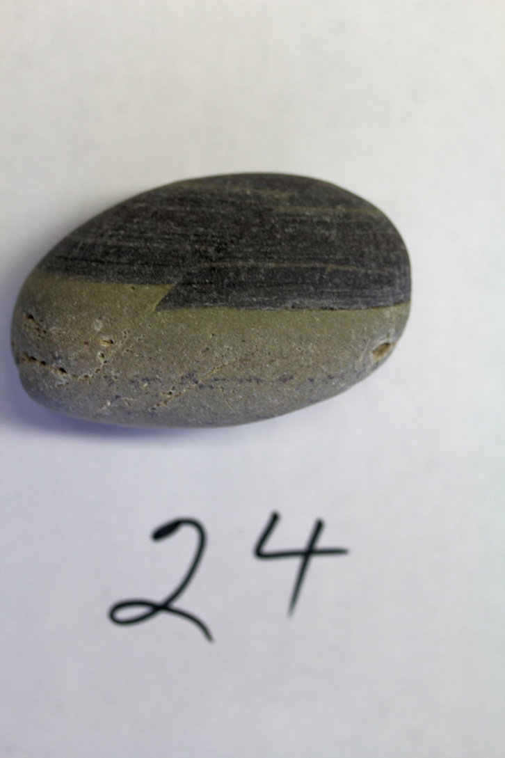

Slide 95
SEDIMENTARY

Slide 96
SEDIMENTARY – SHALE/LIMESTONE – 54% (OH COME ON!!!! HOW COULD YOU MISS THIS ONE???)

Slide 97
SEDIMENTARY – SHALE/LIMESTONE – 54% (OH COME ON!!!! HOW COULD YOU MISS THIS ONE???)
CLUES: ALTERNATING
LAYERS, LOOK! LOOK!
THERE WAS AN EARTH-
QUAKE AND THE LAYERS
SHIFTED! REMEMBER I
MADE A BIG DEAL OUT
OF THAT? I CAN’T BE-
LIEVE YOU MISSED THIS
ONE THAT BADLY.)

Slide 98
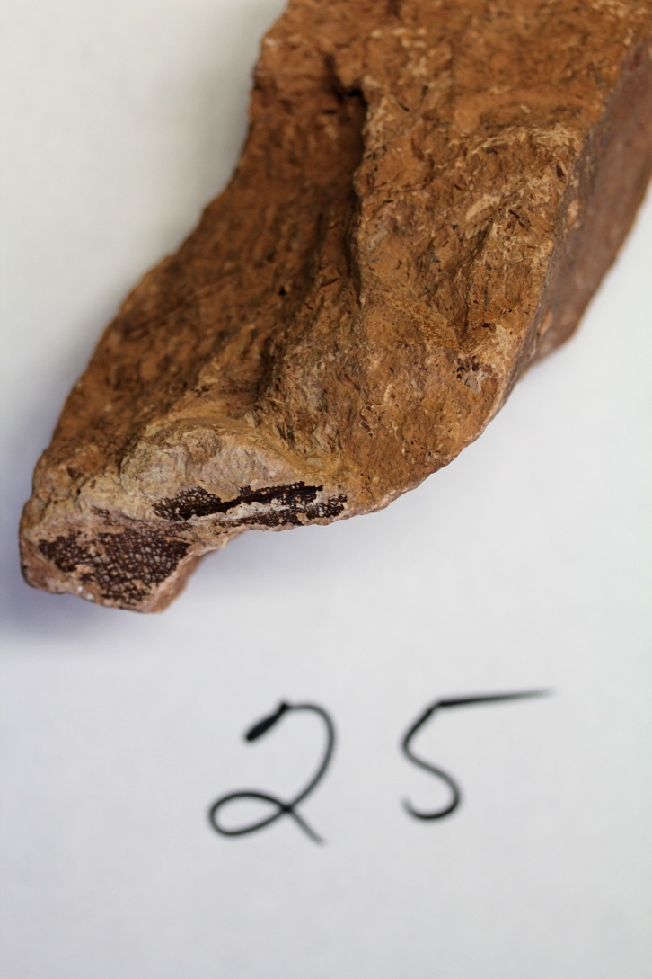

Slide 99
SEDIMENTARY

Slide 100
SEDIMENTARY – SHALE/LIMESTONE – 40% (I’M AT A LOSS HERE)

Slide 101
SEDIMENTARY – SHALE/LIMESTONE – 40% (I’M AT A LOSS HERE)
CLUES: DEAD LEAF AT
THE BOTTOM OF THE
SAMPLE. WHAT DID
YOU THINK THAT WAS?
SHAME ON YOU! ALL ONE
COLOR WITH A HINT OF
LAYERS

