Slide 1
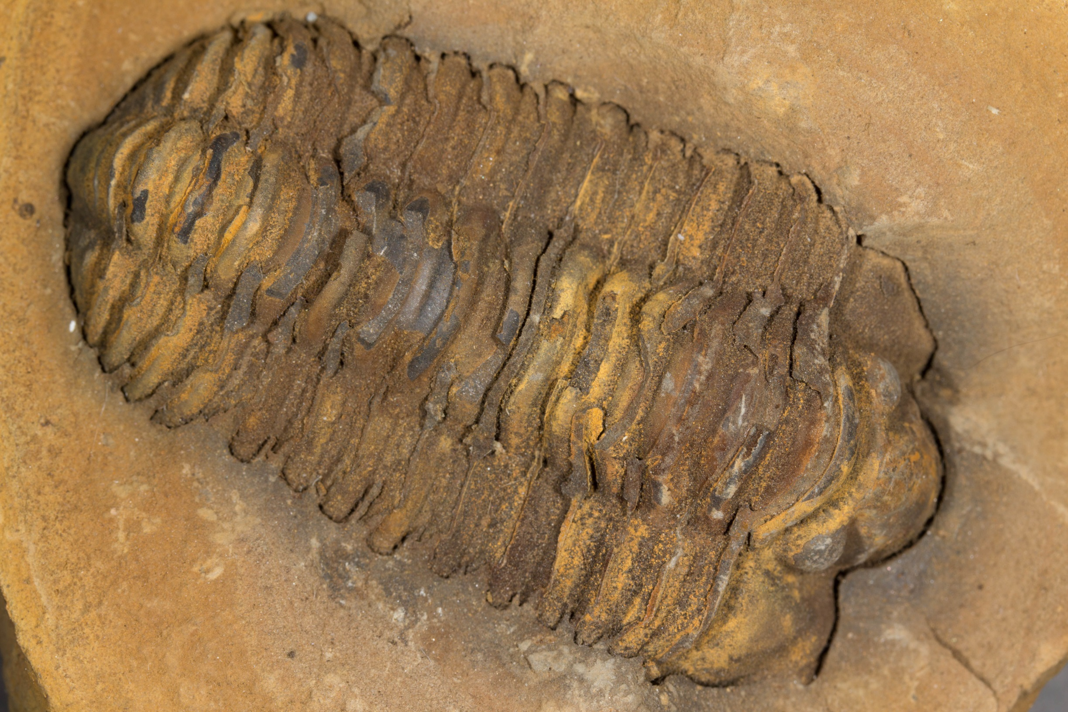
FOSSILS
The Most Important Story

Slide 2
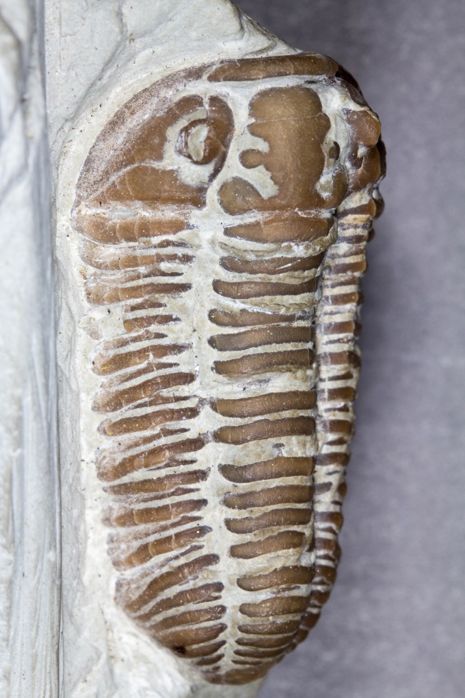
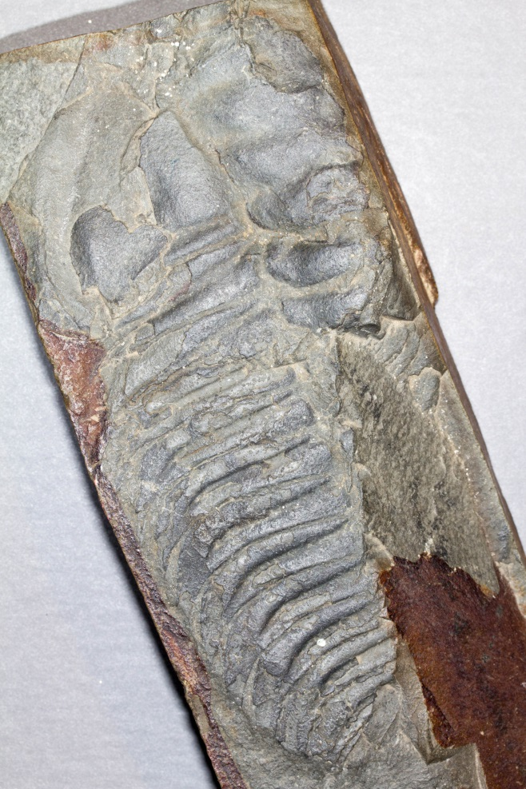
TRILOBITES (CAMBRIAN – PERMIAN 541 – 252 MILLION YEARS AGO)

Slide 3
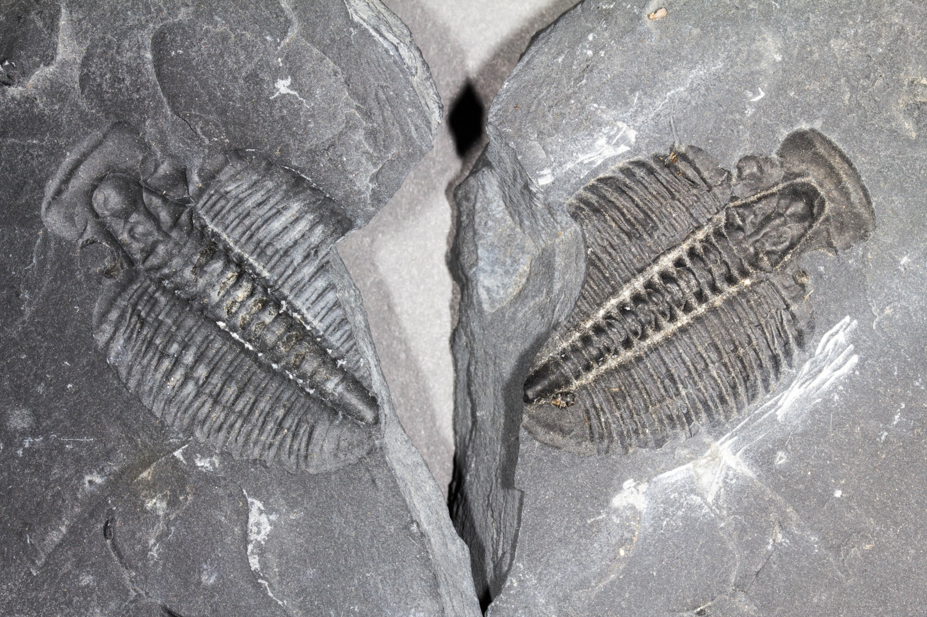
TRILOBITES (CAMBRIAN – PERMIAN)

Slide 4
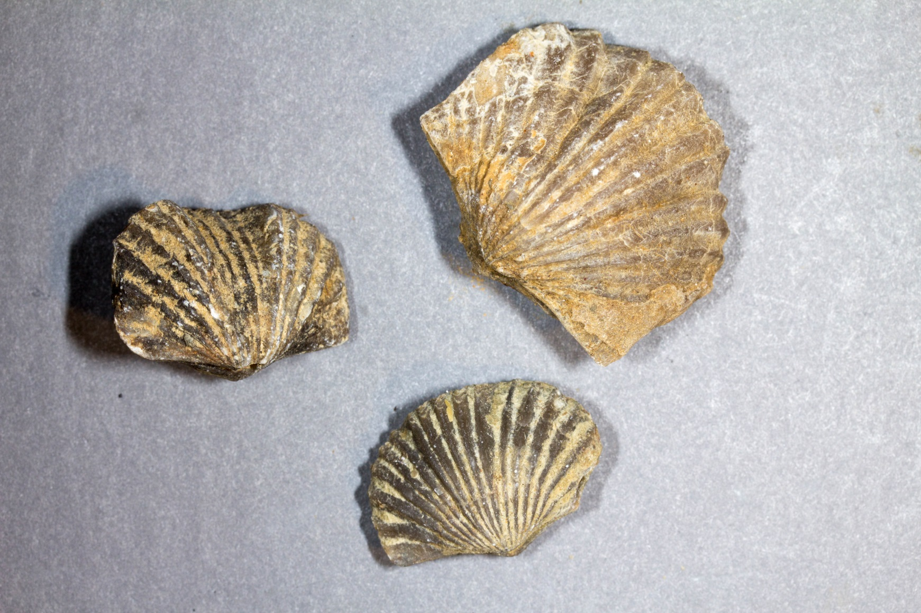
BRACHIOPODS (CAMBRIAN – PRESENT)

Slide 5
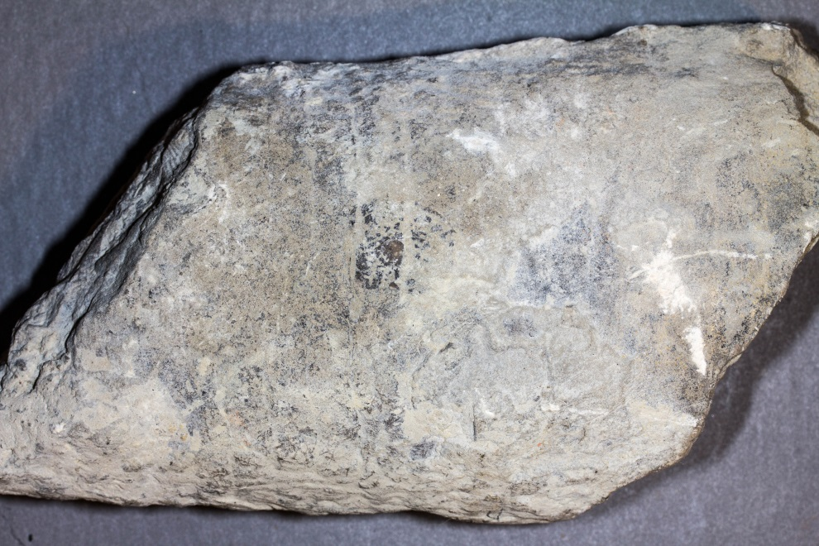
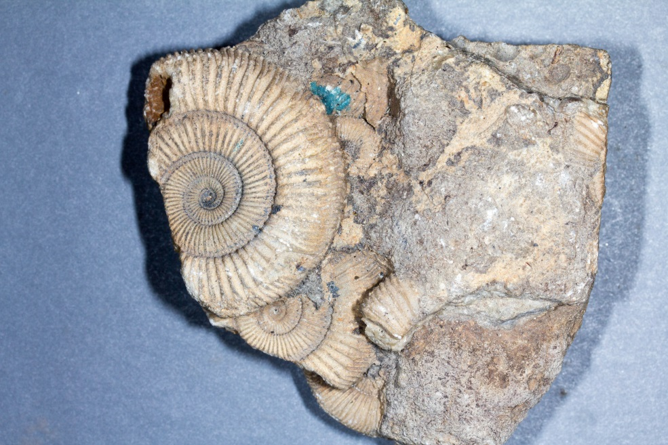
STRAIGHT & COILED SHELLED CEPHALOPODS (ORDOVICIAN 485 MYA – PRESENT)

Slide 6
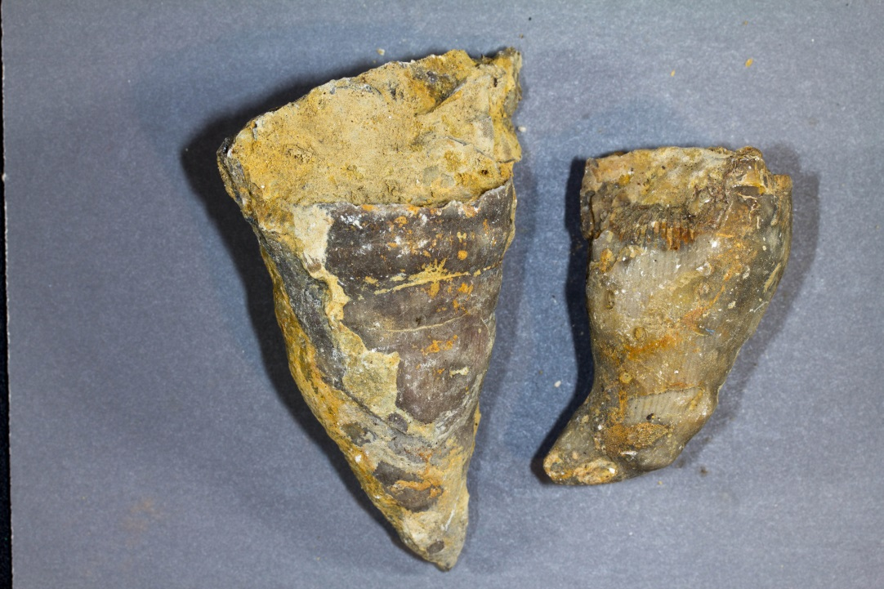
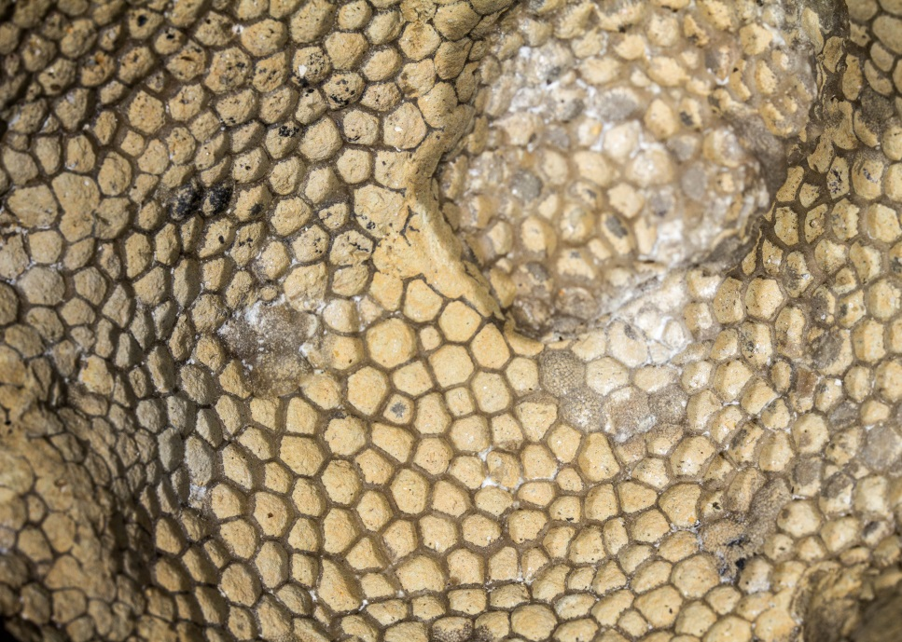
CORAL (CAMBRIAN – PRESENT)

Slide 7
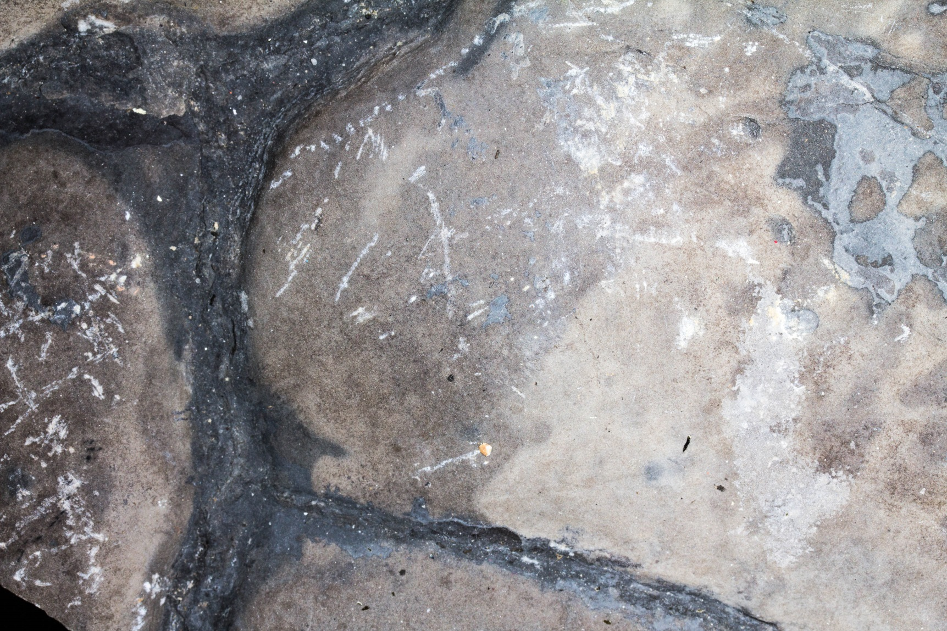
MYSTERY SAMPLE #1

Slide 8
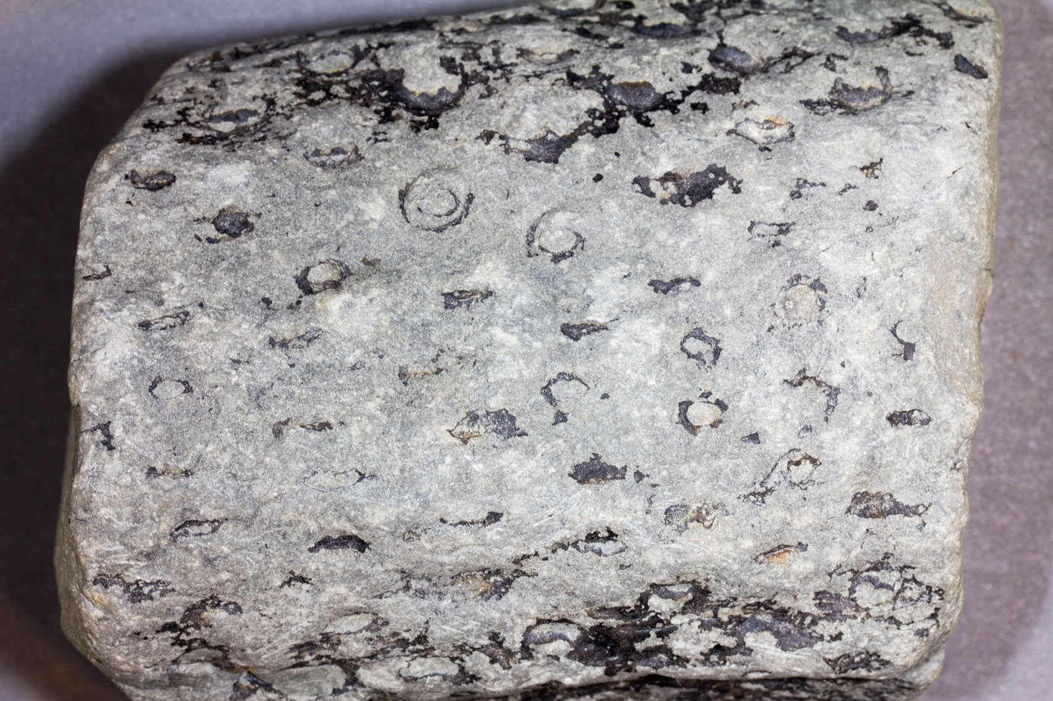
LEPIDODENDRON – CARBONIFEROUS (359 – 299 MILLION YEARS AGO)

Slide 9
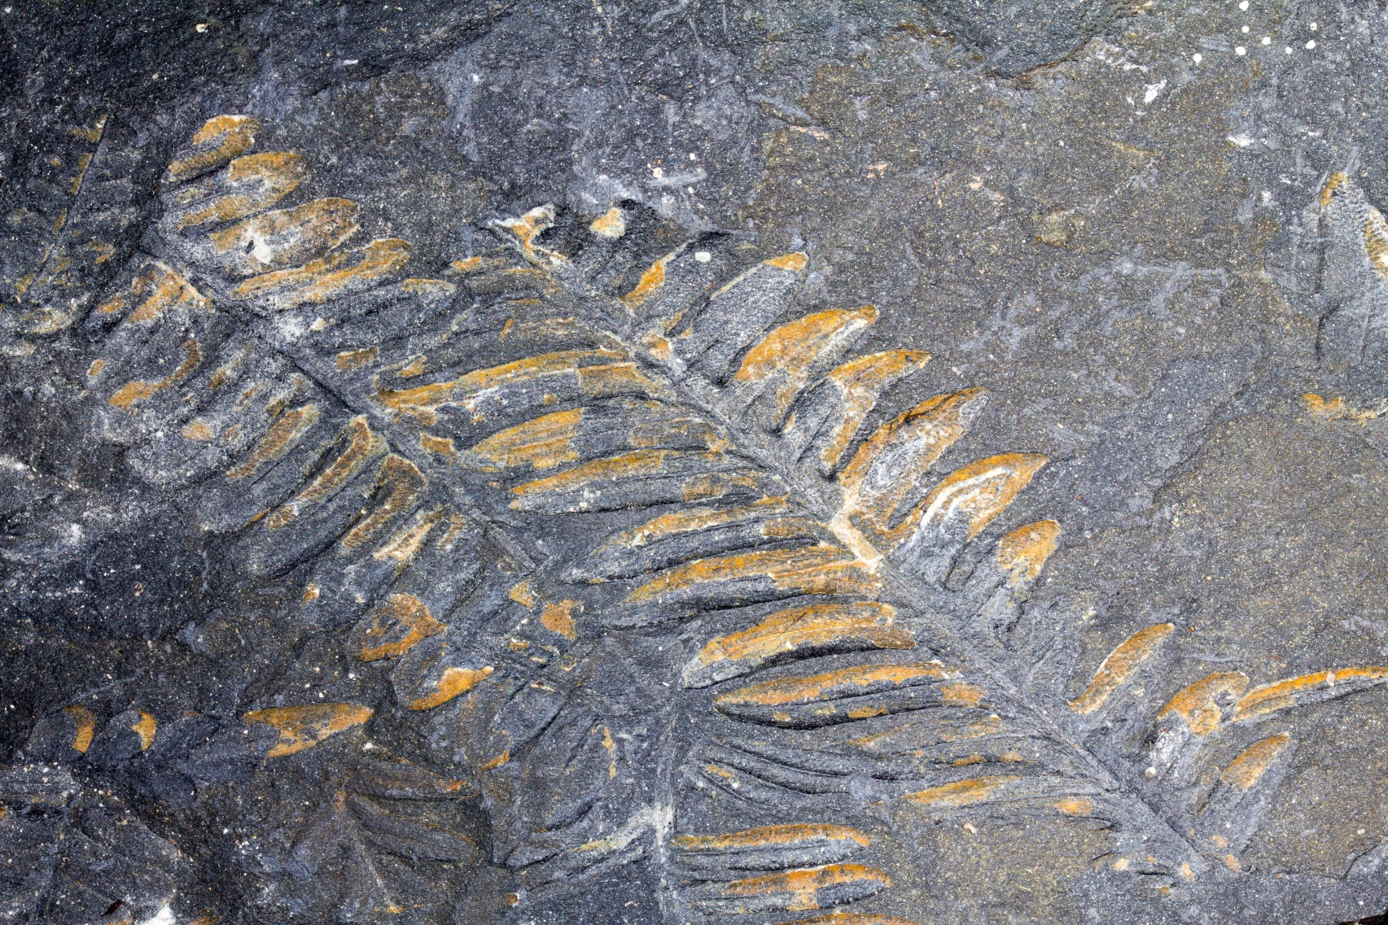
FERNS PERMIAN (?) - PRESENT(299 -NOW)

Slide 10
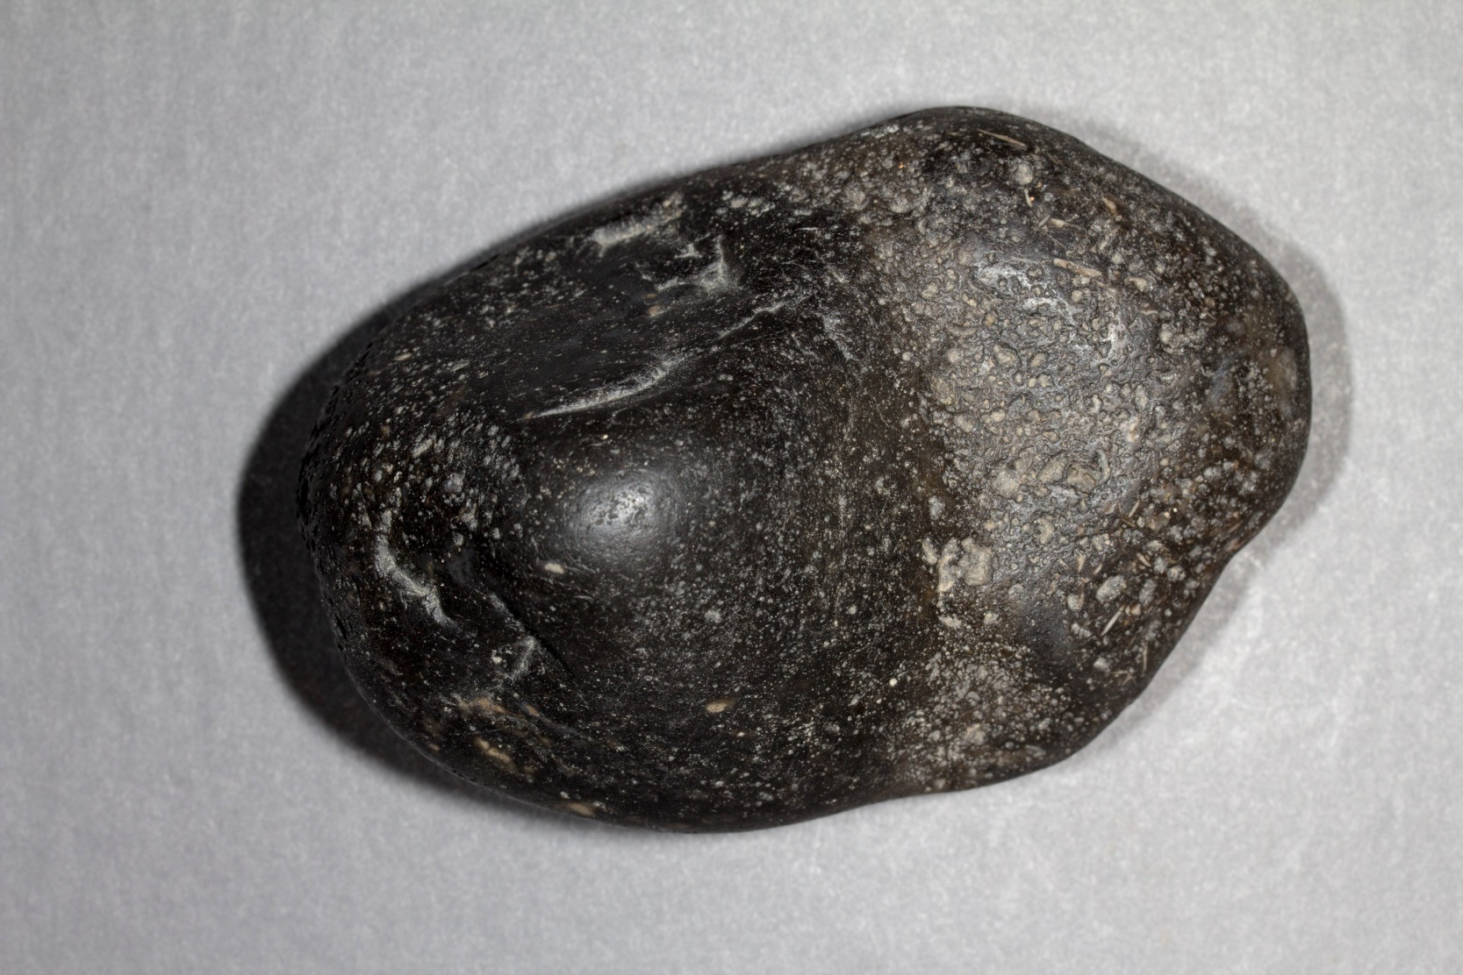
MYSTERY SAMPLE #2 – JURASSIC (?) (201 -145 MILLION YEARS AGO)

Slide 11
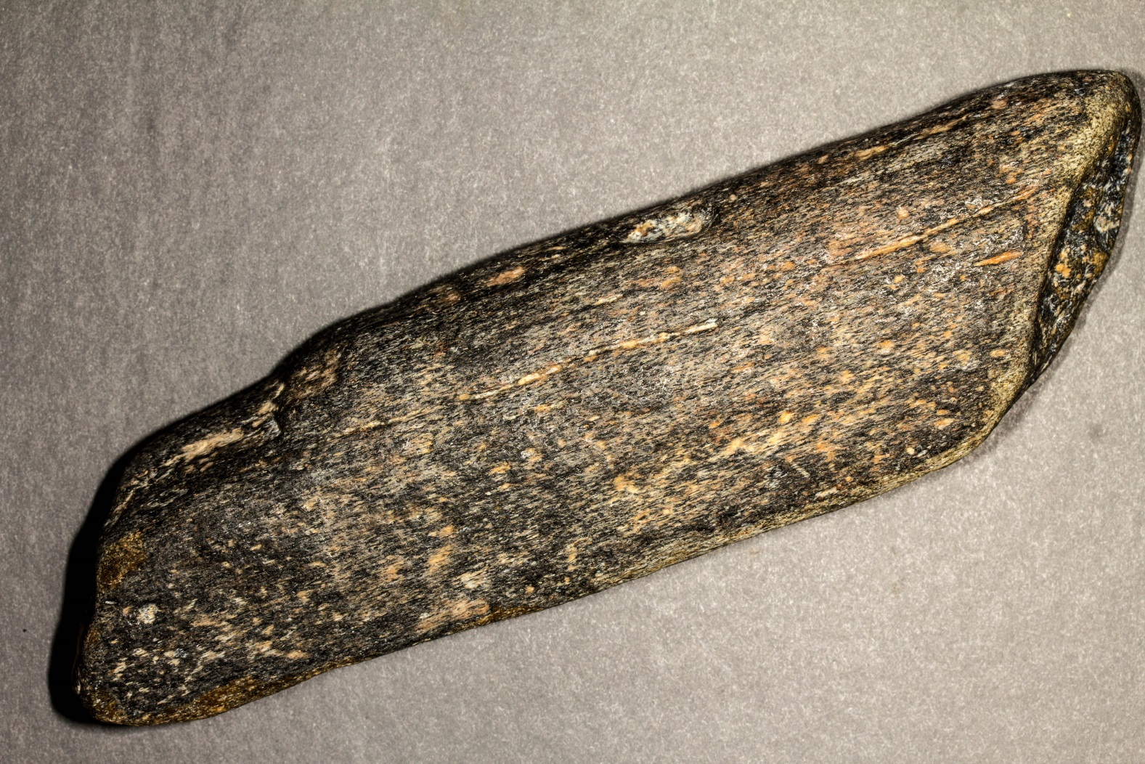
MYSTERY SAMPLE #3 - JURASSIC

Slide 12
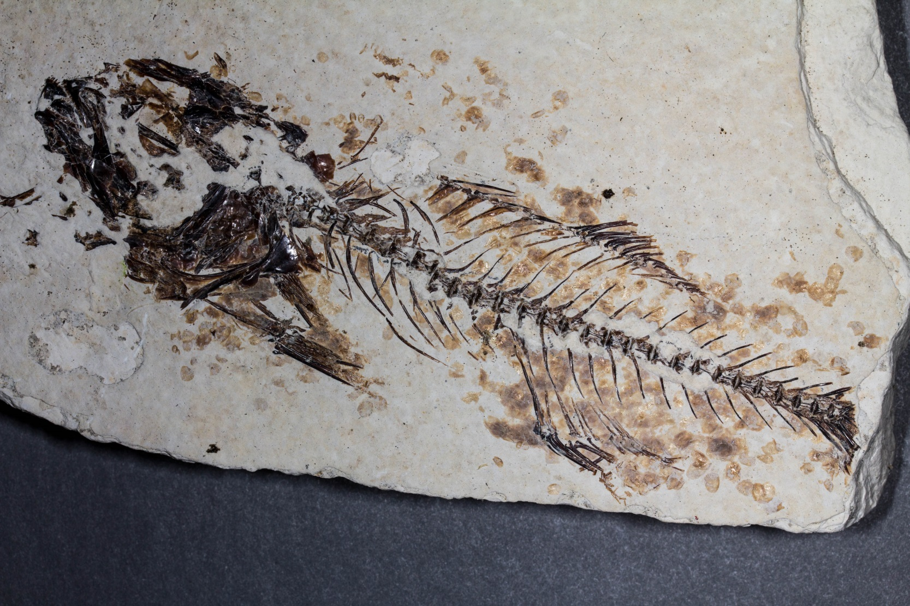
FISH – GREEN RIVER SHALE (EOCENE 56.0 – 33.9 MILLION YEARS AGO)

Slide 13
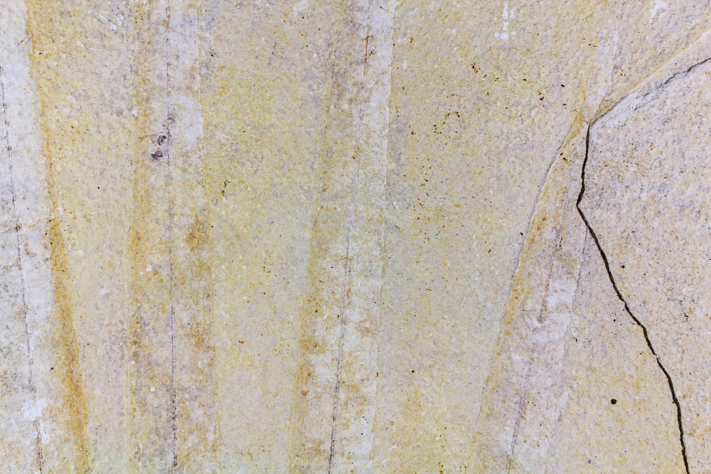
PALM FROND – GREEN RIVER SHALE (EOCENE 56.0 – 33.9 MYA)

Slide 14
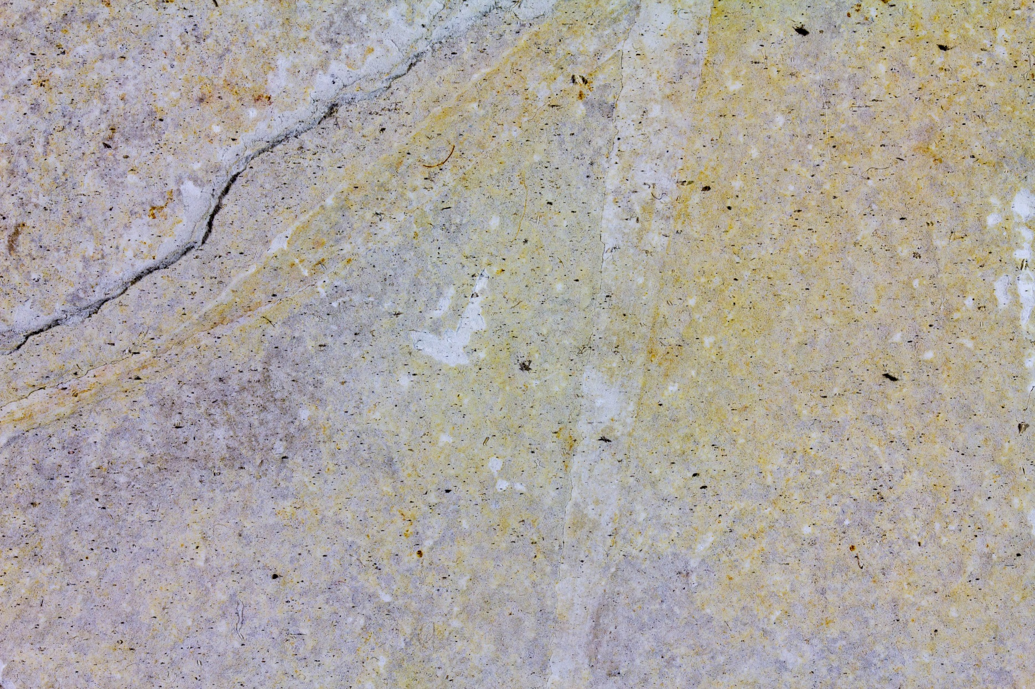
PALM FROND – GREEN RIVER SHALE (EOCENE 56.0 – 33.9 MYA)

Slide 15
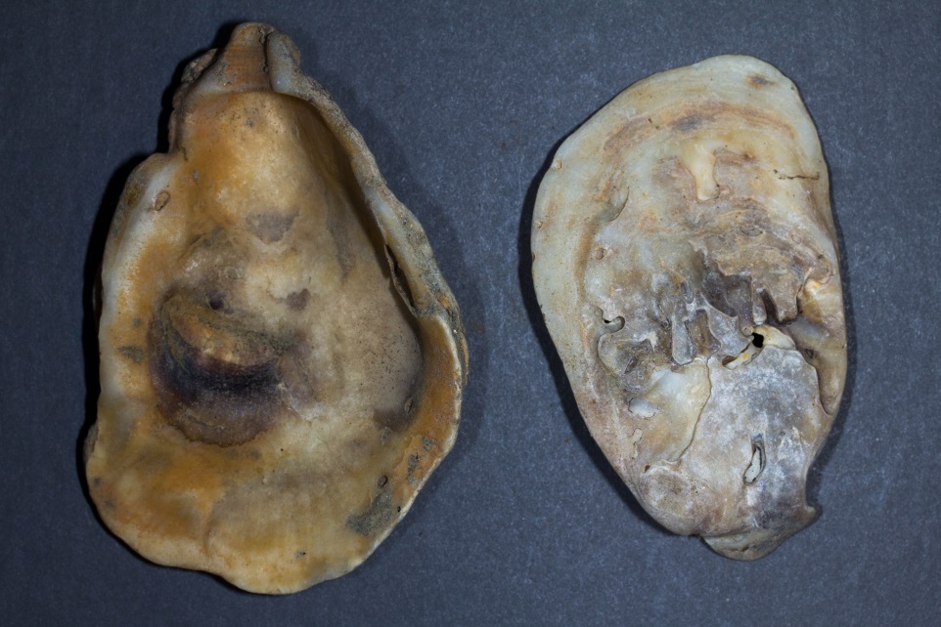
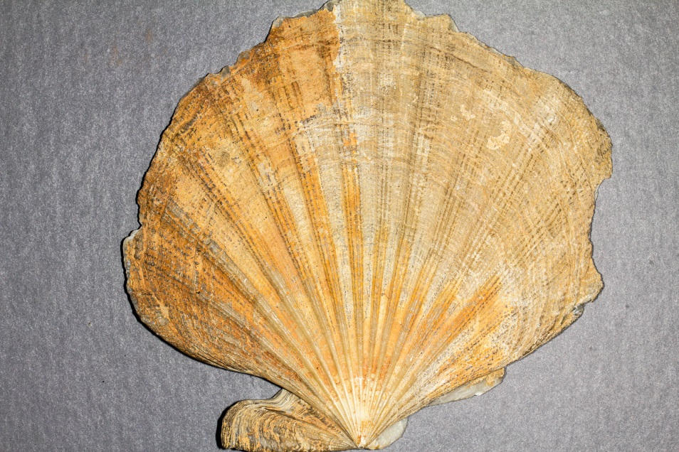
CALVERT CLIFF SHELLS – MIOCENE (23.0 – 5.3 MILLION YEARS AGO)

Slide 16
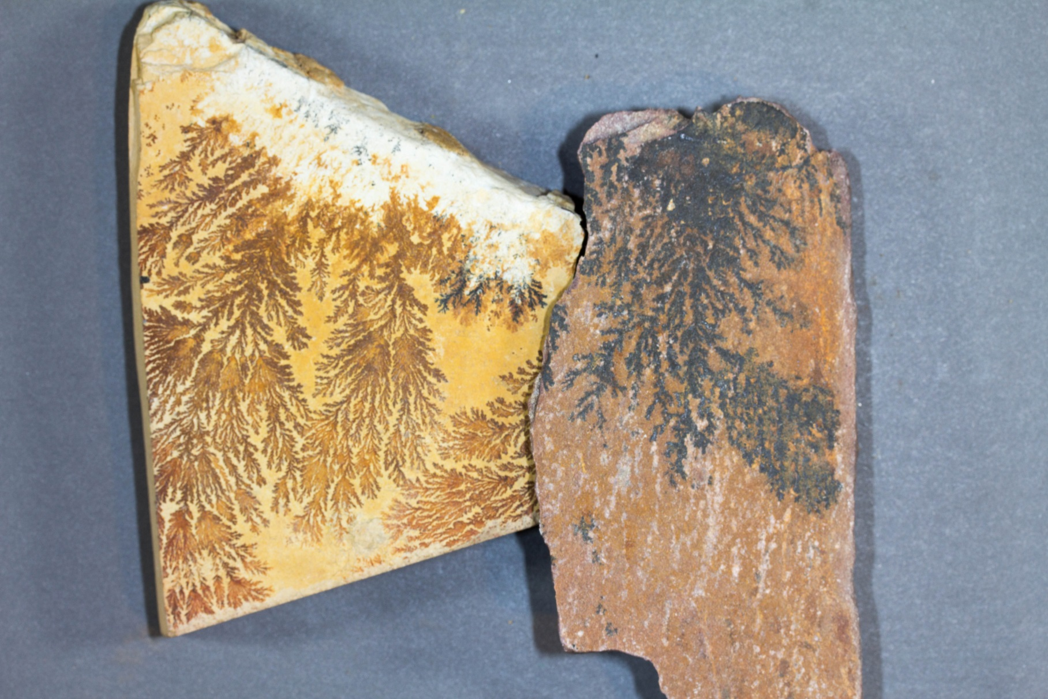
MYSTERY SAMPLE #4

Slide 17
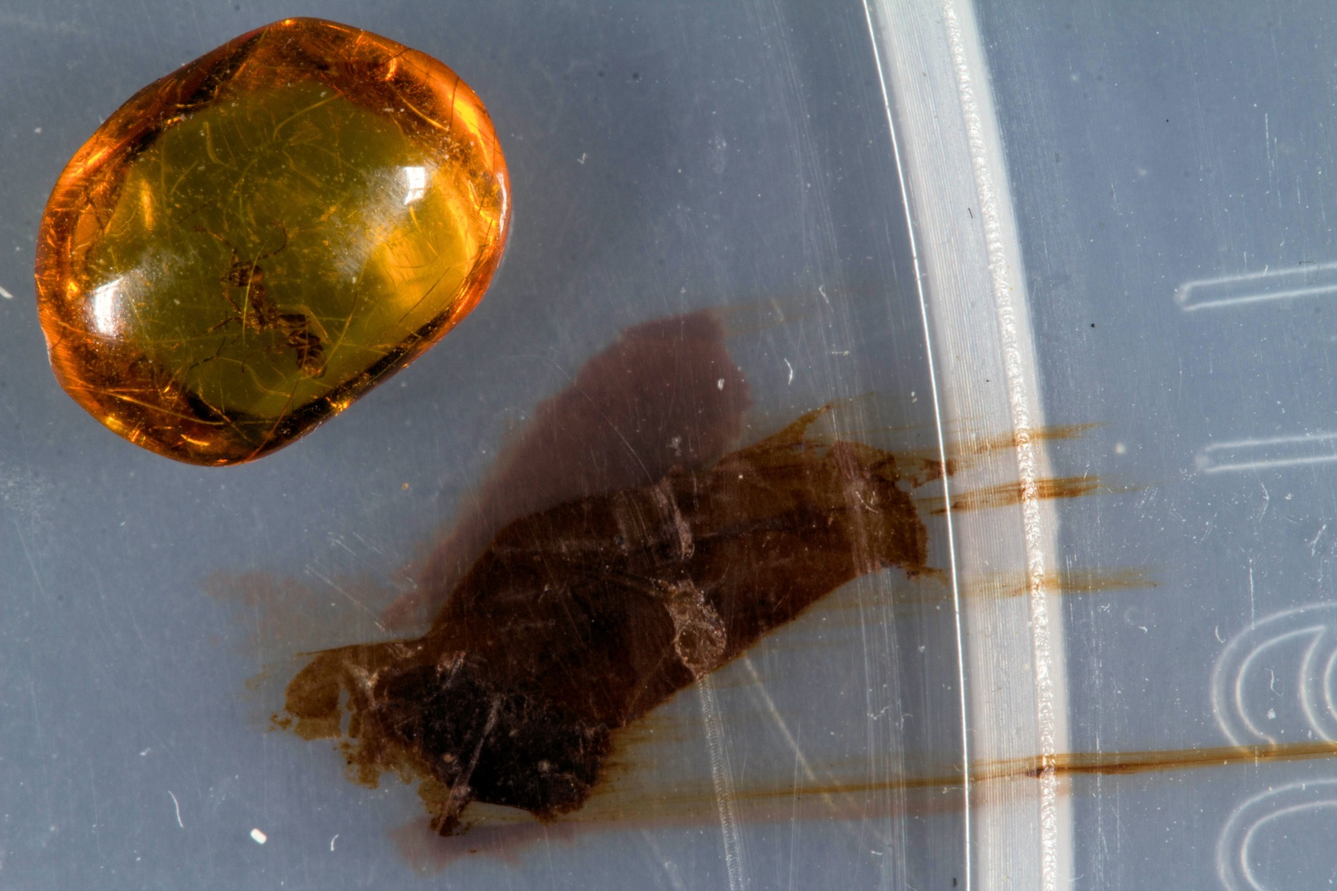
ACTUAL PRESERVATION (AMBER – MIOCENE 23.0-5.3 MYA) MUSHED ICKY IN PLASTIC - RECENT

