Slide 1
Metamorphic Lab

Slide 2
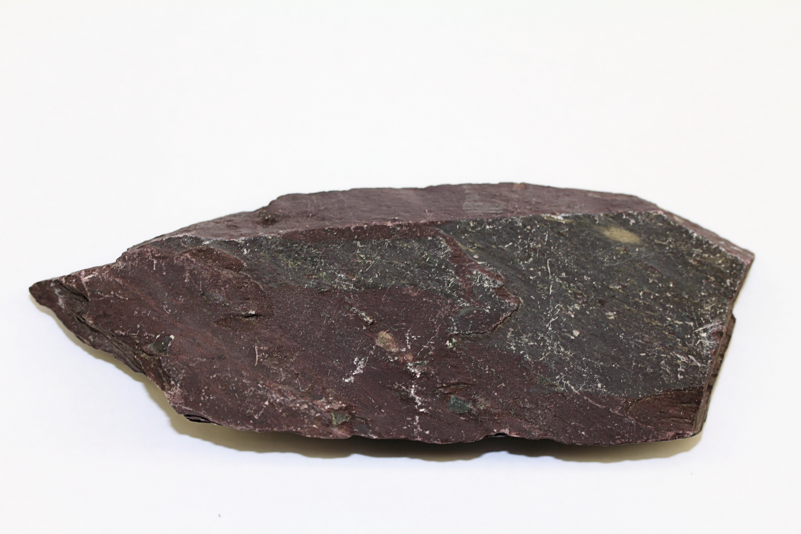
SLATE

Slide 3
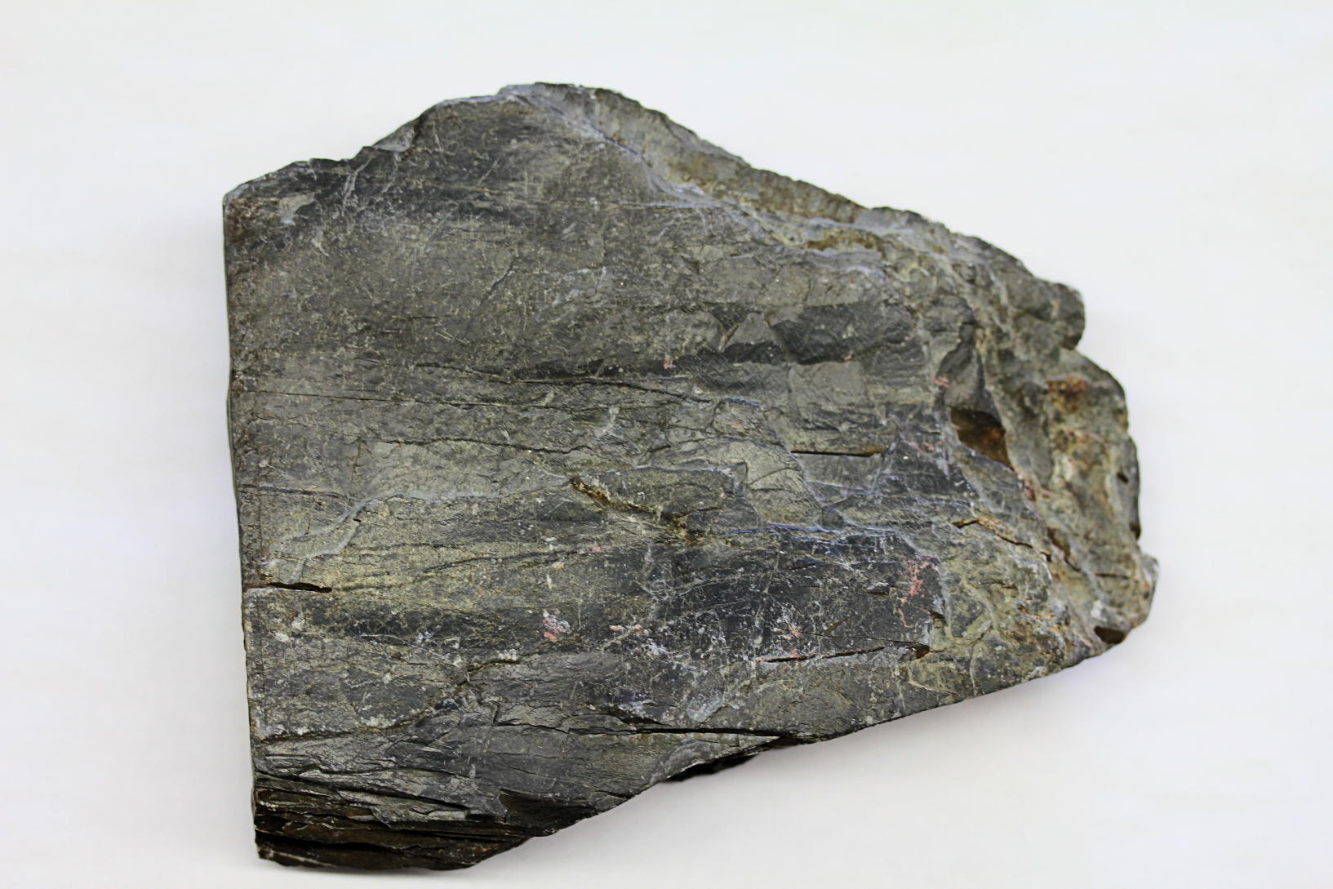
PHYLLITE

Slide 4
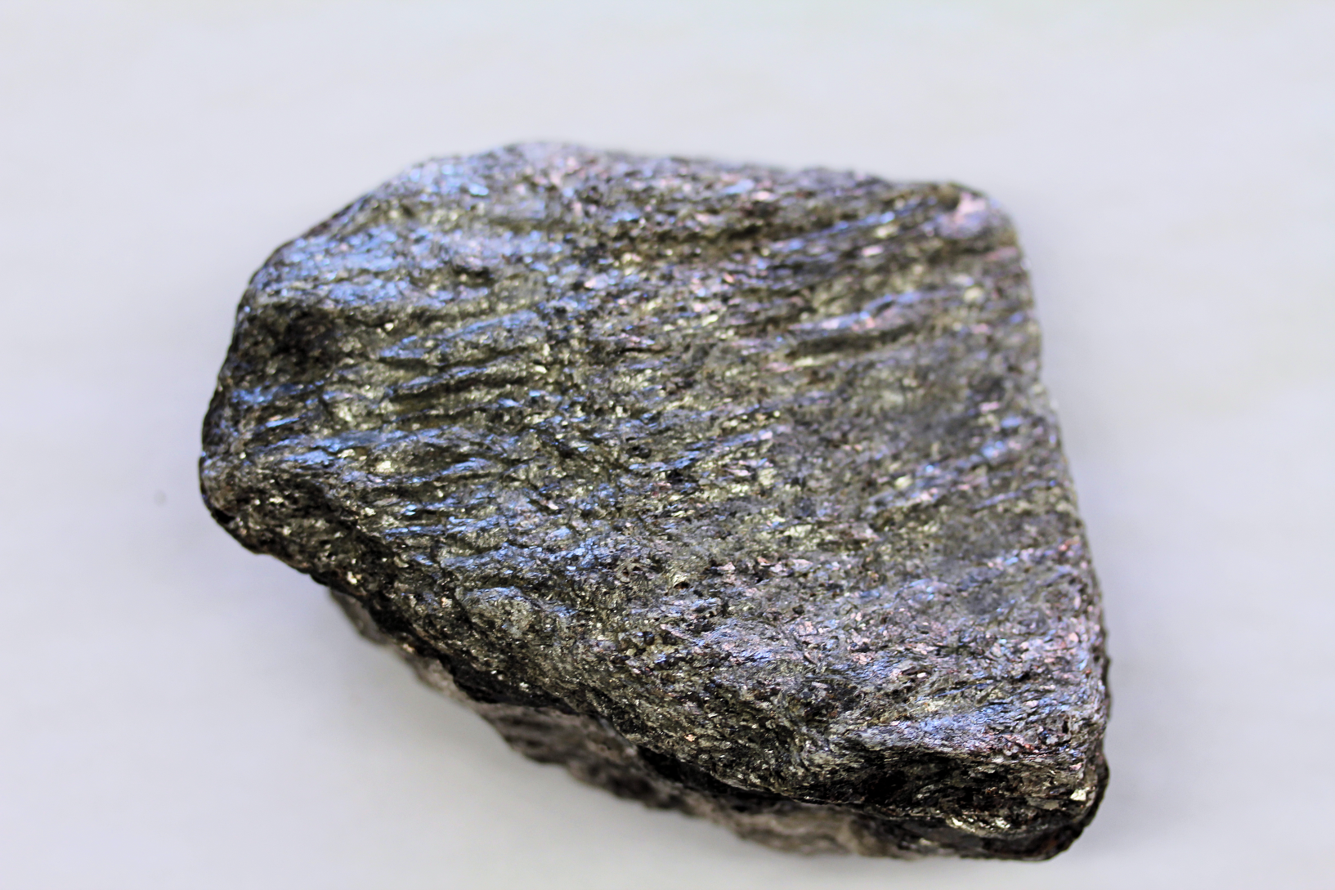
MICA SCHIST

Slide 5
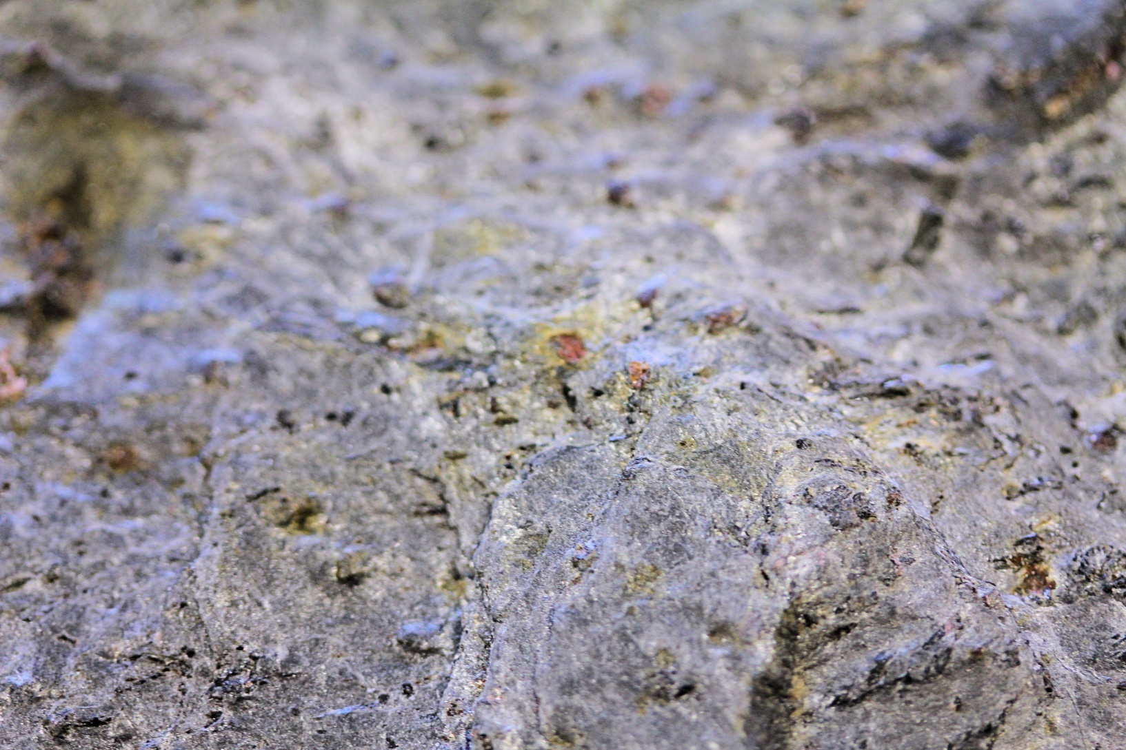
GARNET MICA SCHIST

Slide 6
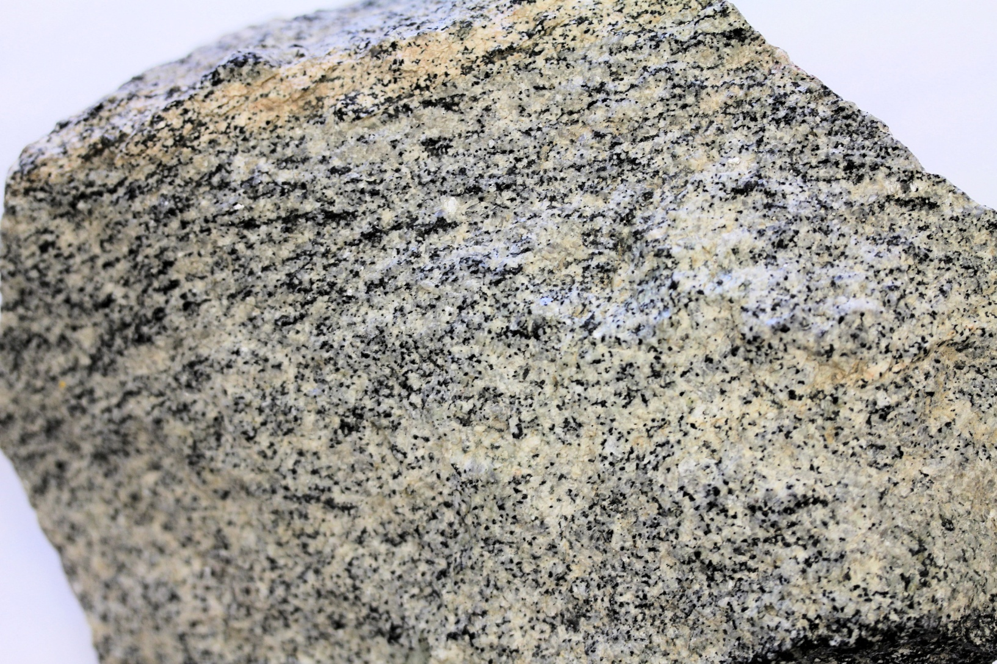
DIORITE/GNEISS

Slide 7
DIORITE/GNEISS
GNEISS
DIORITE

Slide 8
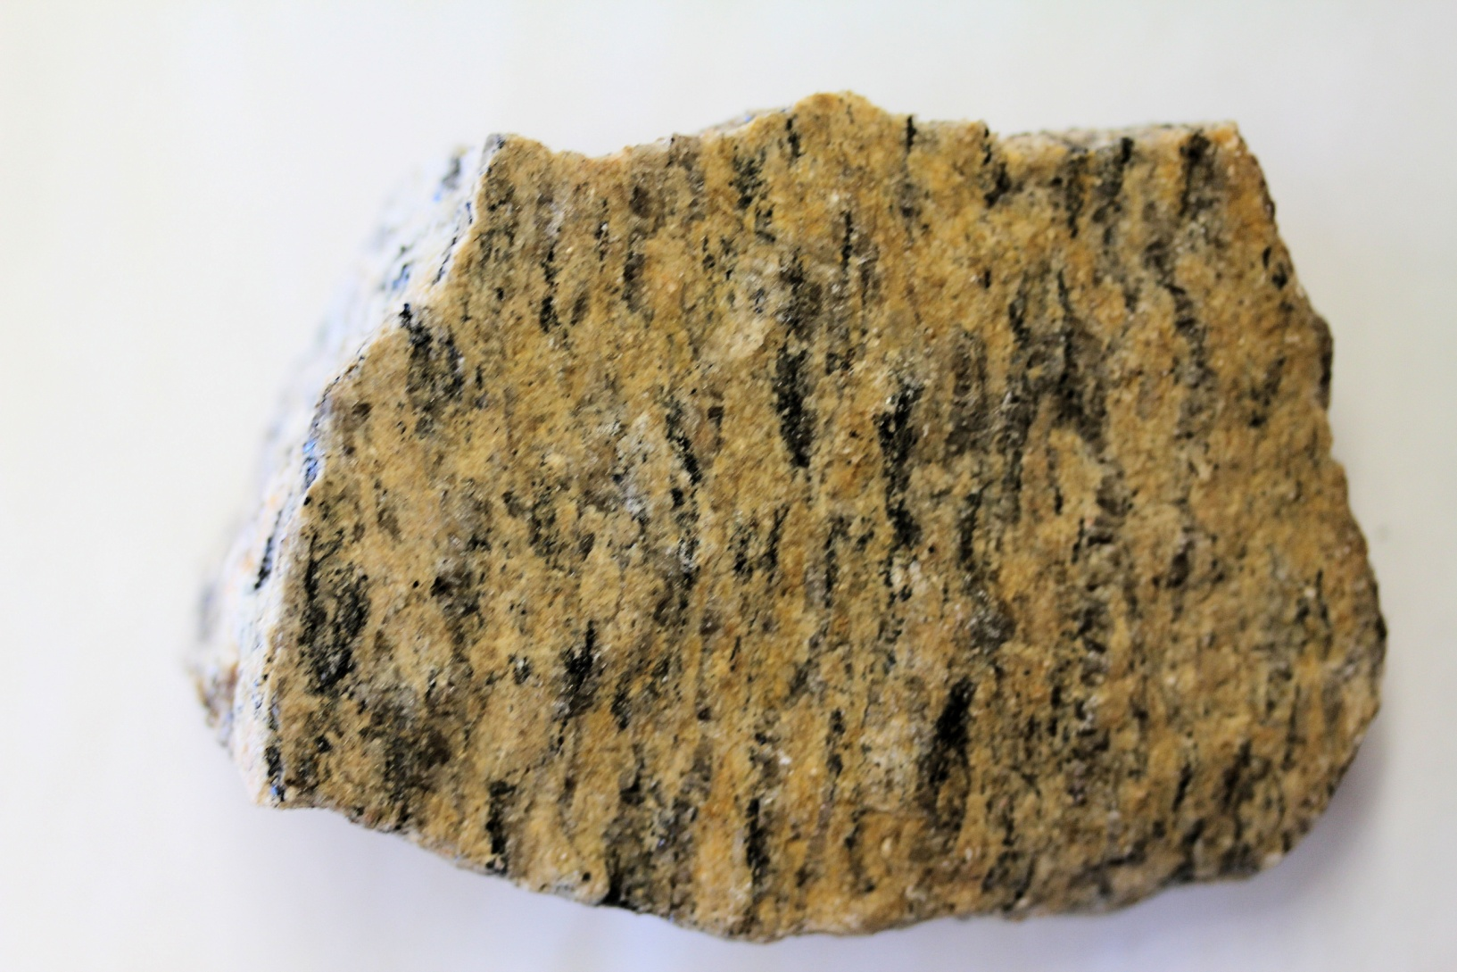
GNEISS 1

Slide 9
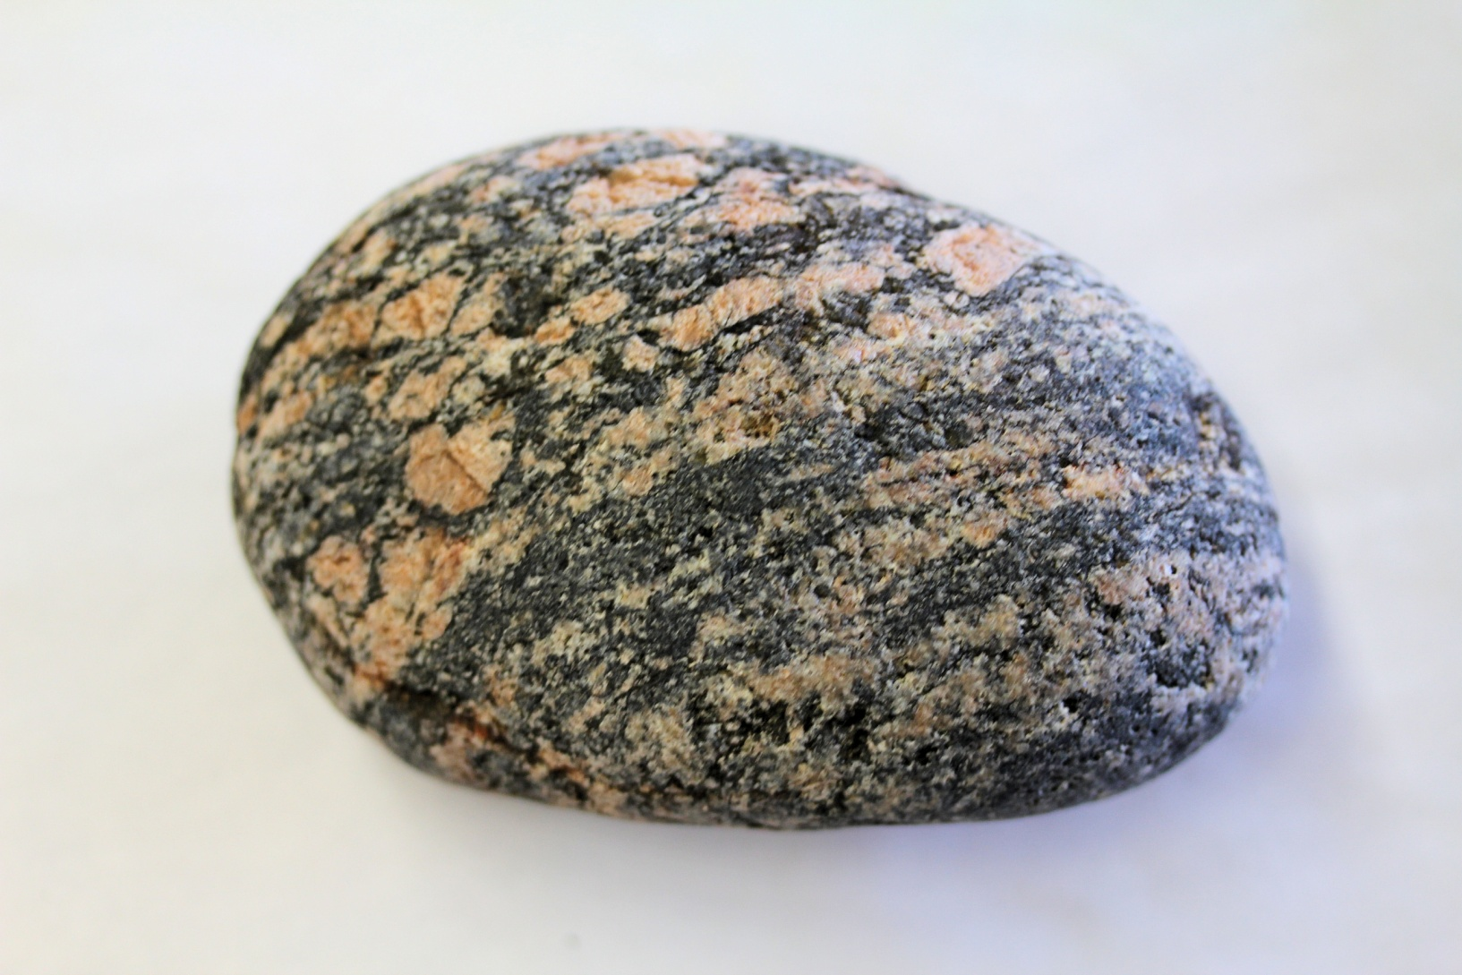
GNEISS 2

Slide 10
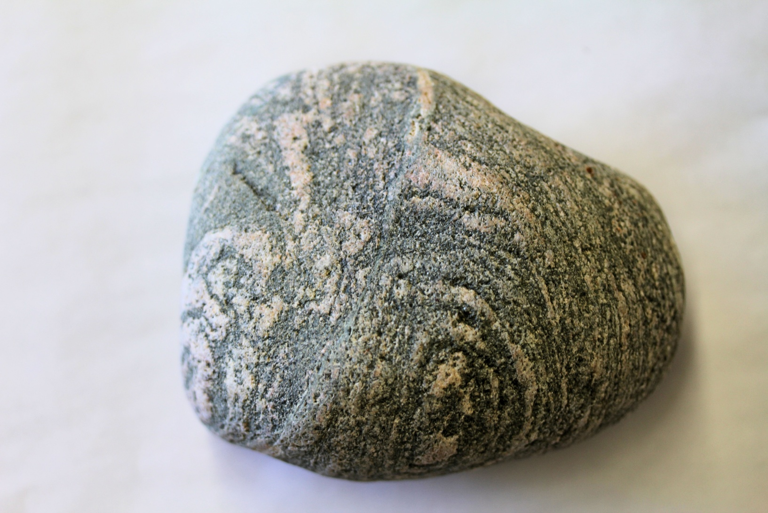
GNEISS 3

Slide 11
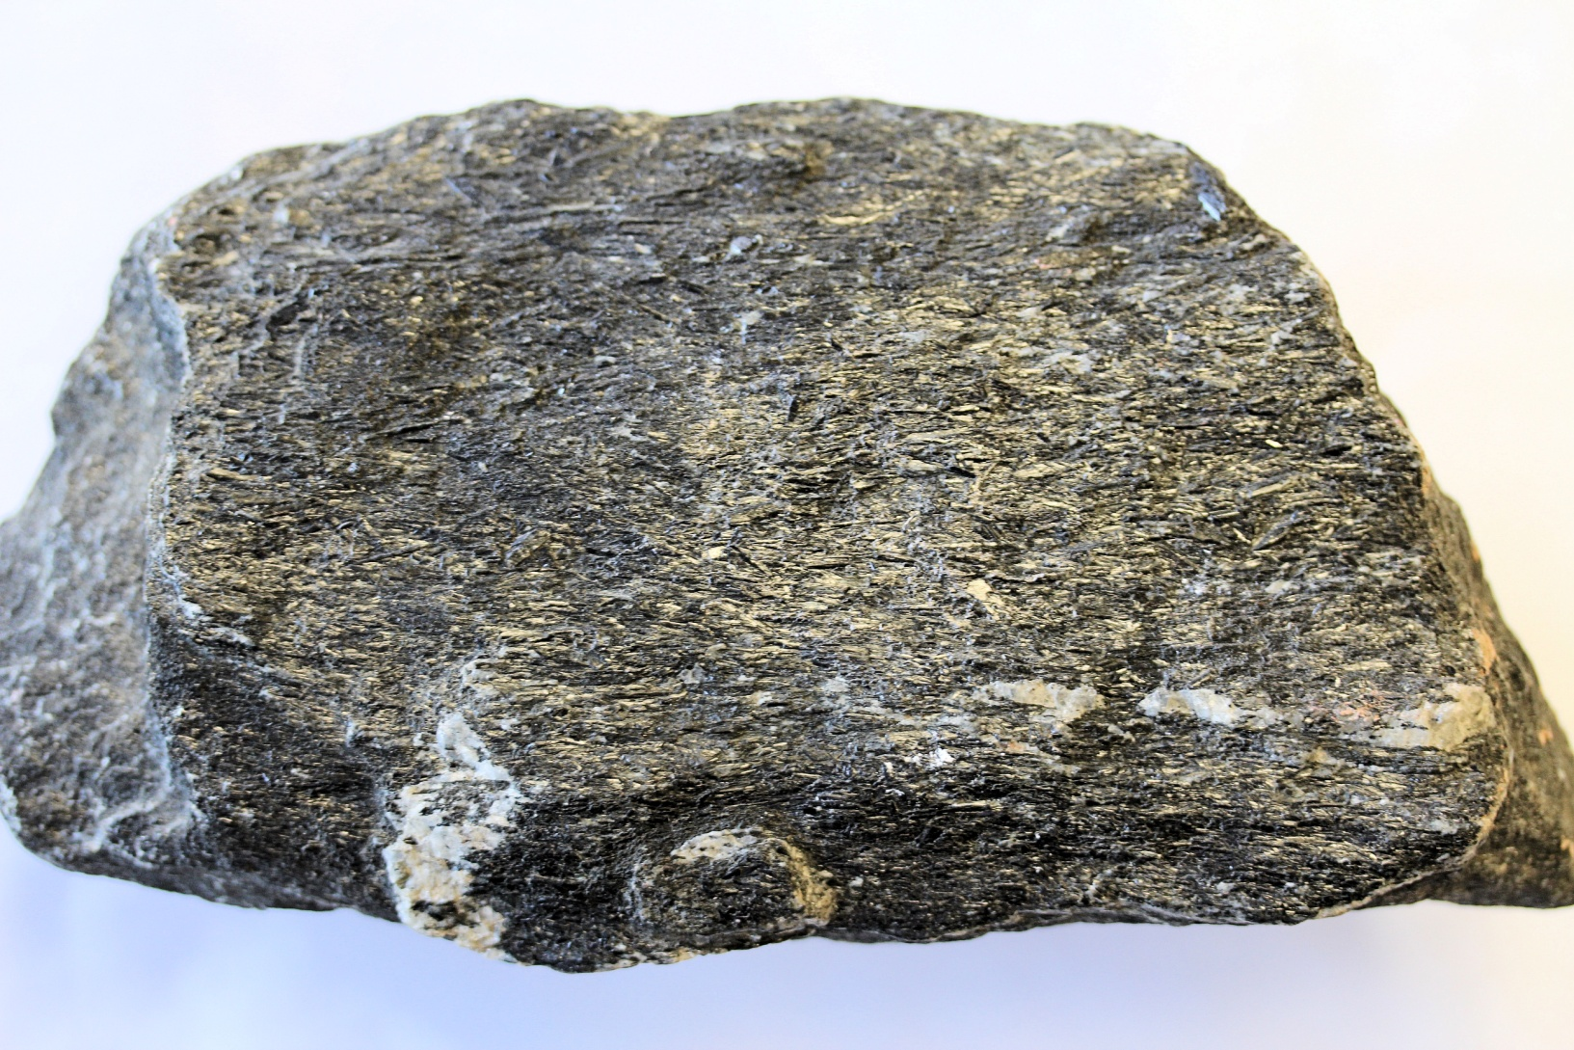
METAMORPHOSED BASALT

Slide 12
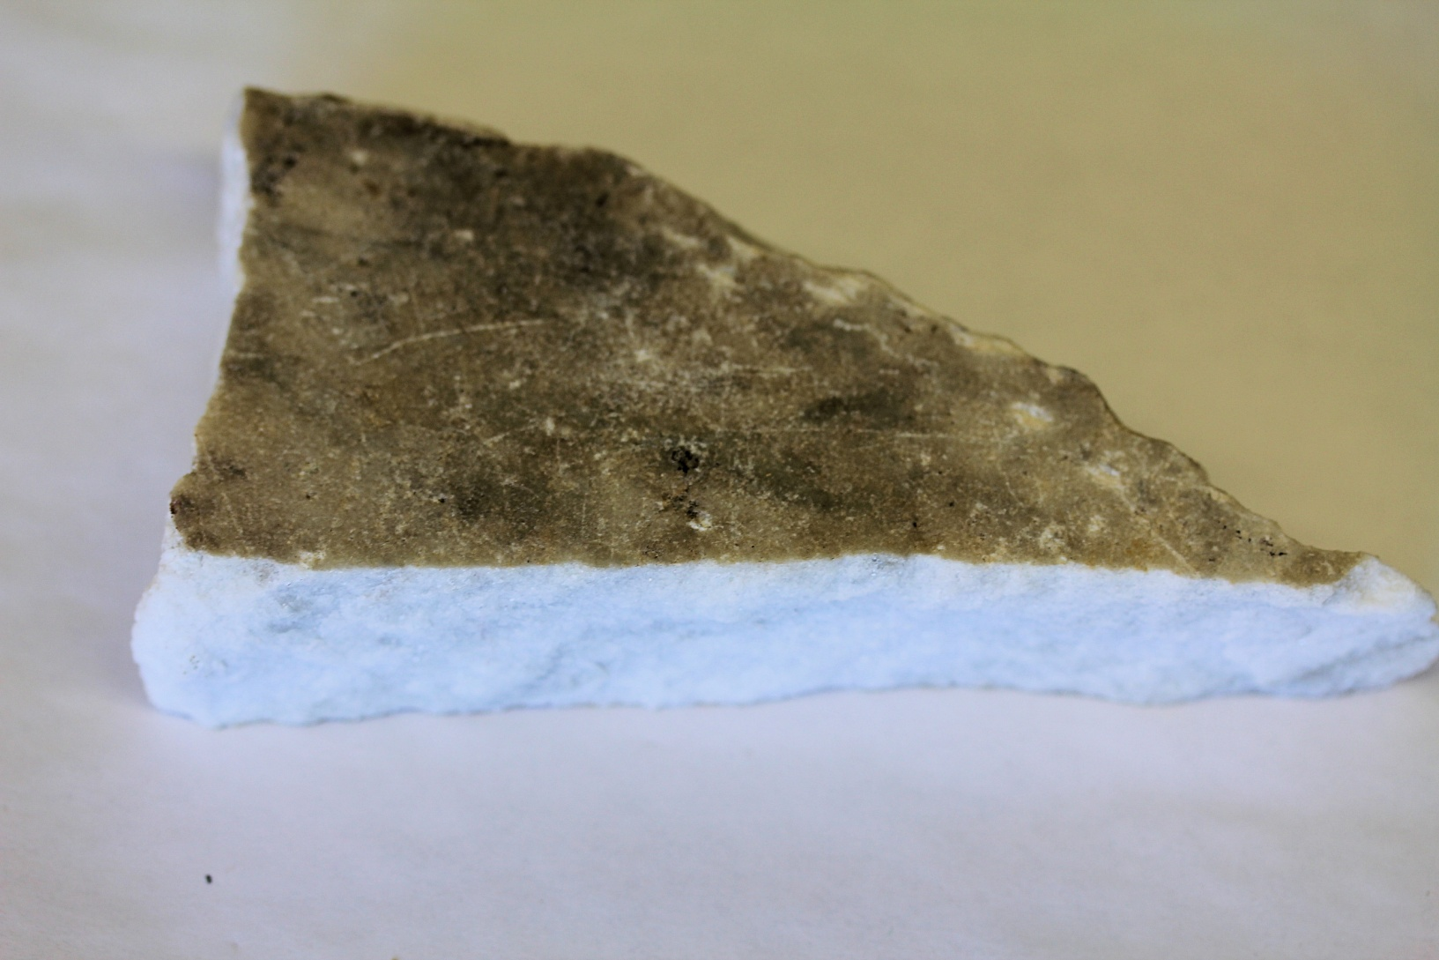
MARBLE

Slide 13
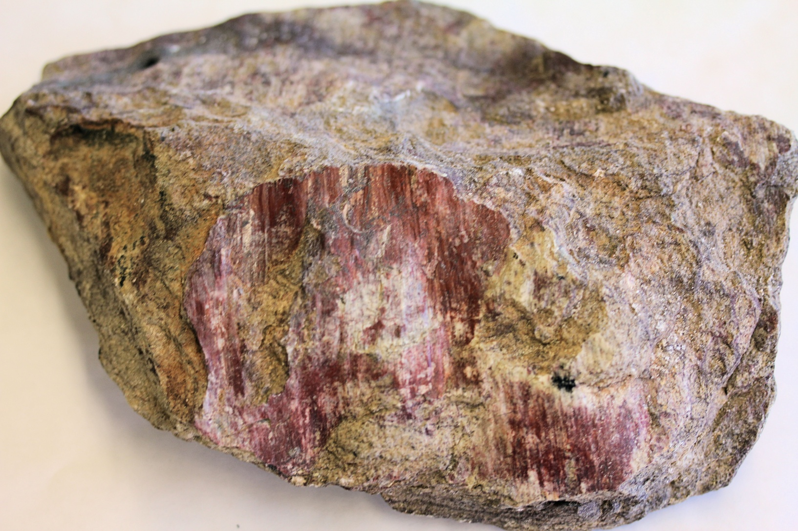
SLICKENSIDES

Slide 14
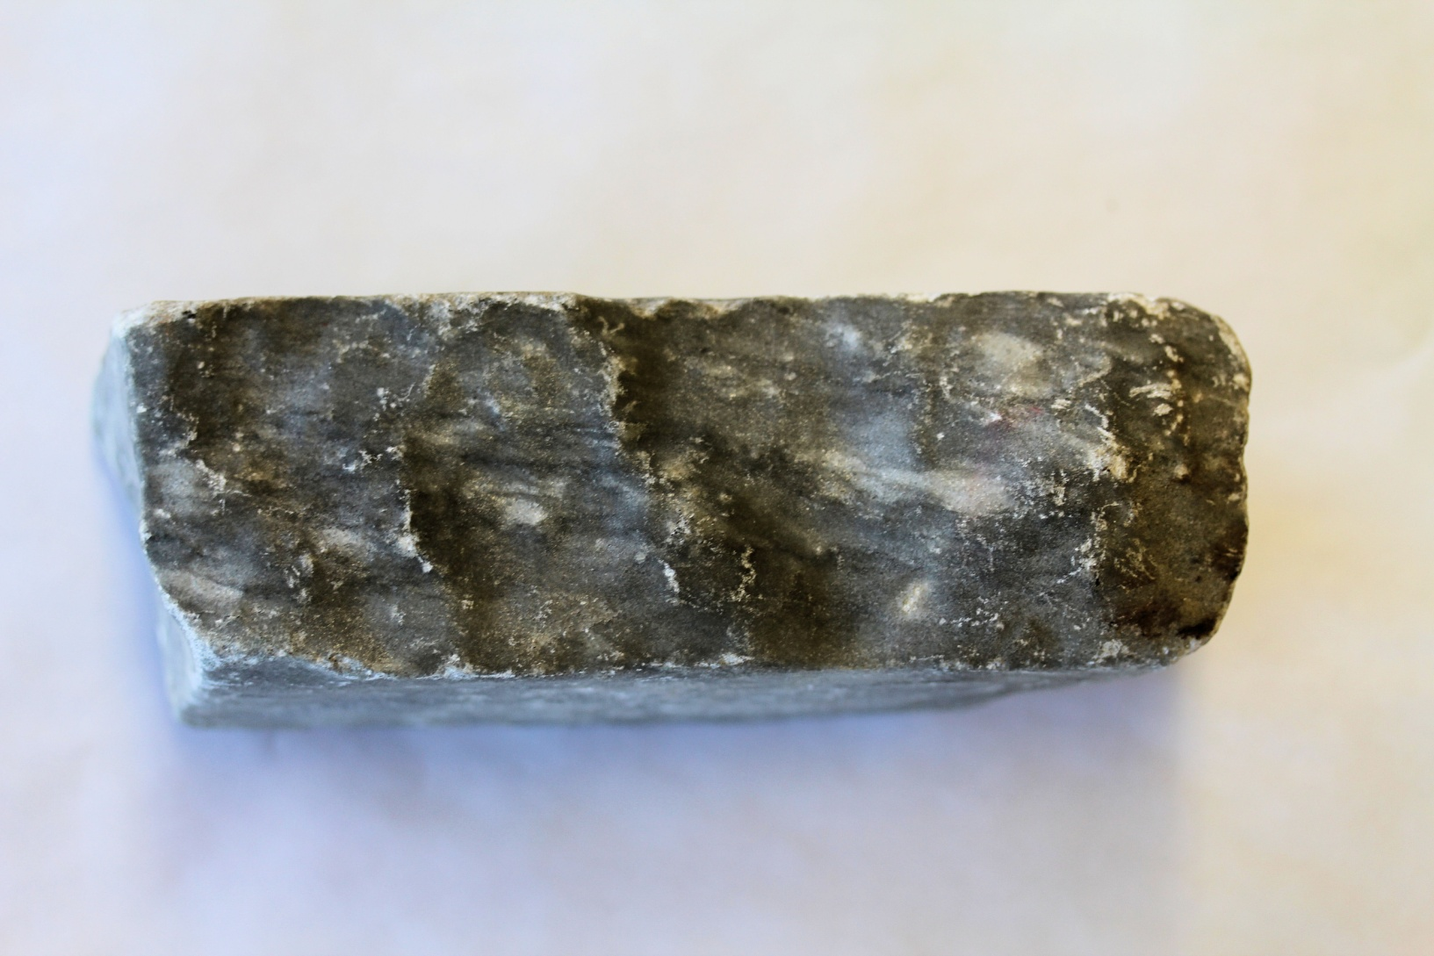
QUARTZITE

Slide 15
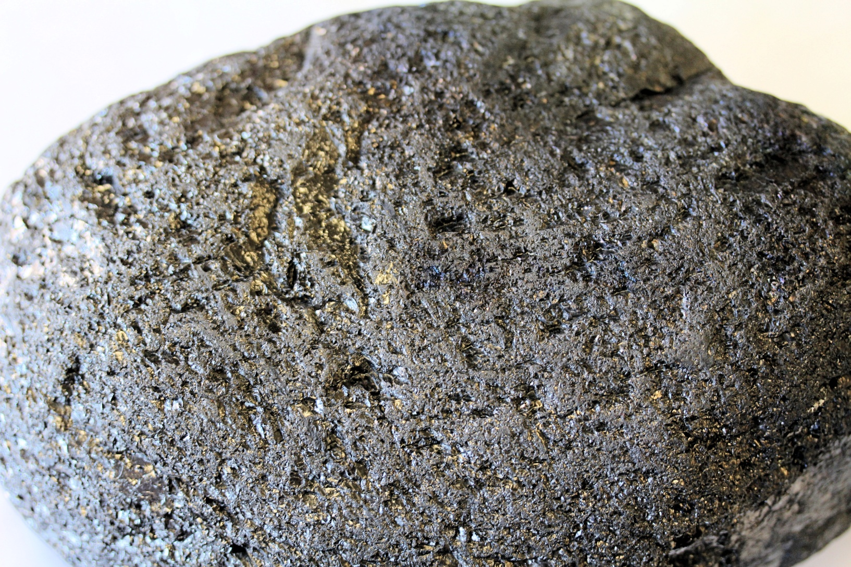
ANTHRACITE COAL

Slide 16
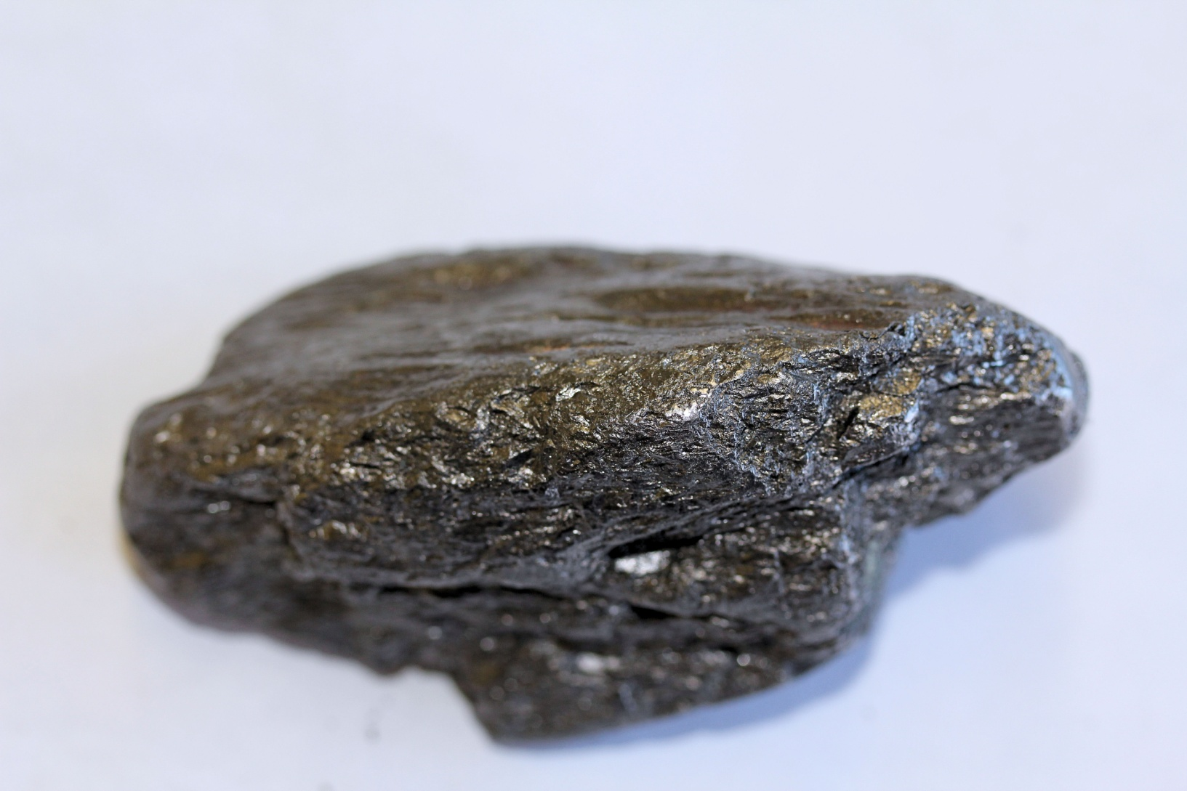
GRAPHITE

Slide 17
JUST FOR CHUCKLES

Slide 18
#1

Slide 19
#1 METAMORPHIC

Slide 20
#1 METAMORPHIC - GNEISS

Slide 21
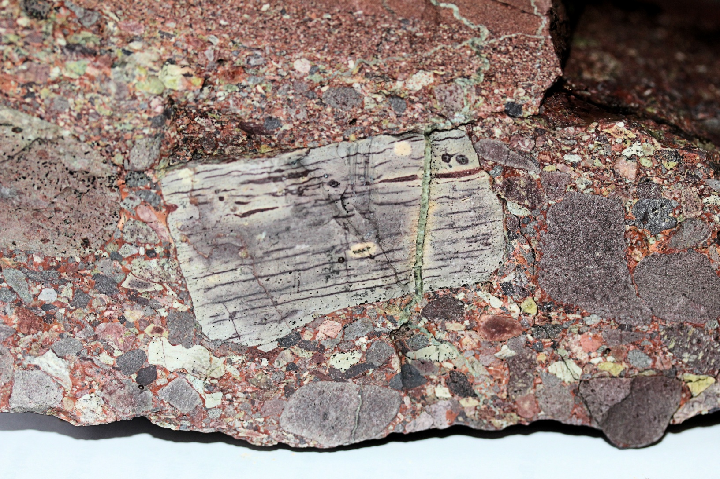
#2

Slide 22
#2 SEDIMENTARY

Slide 23
#2 SEDIMENTARY - BRECCIA

Slide 24
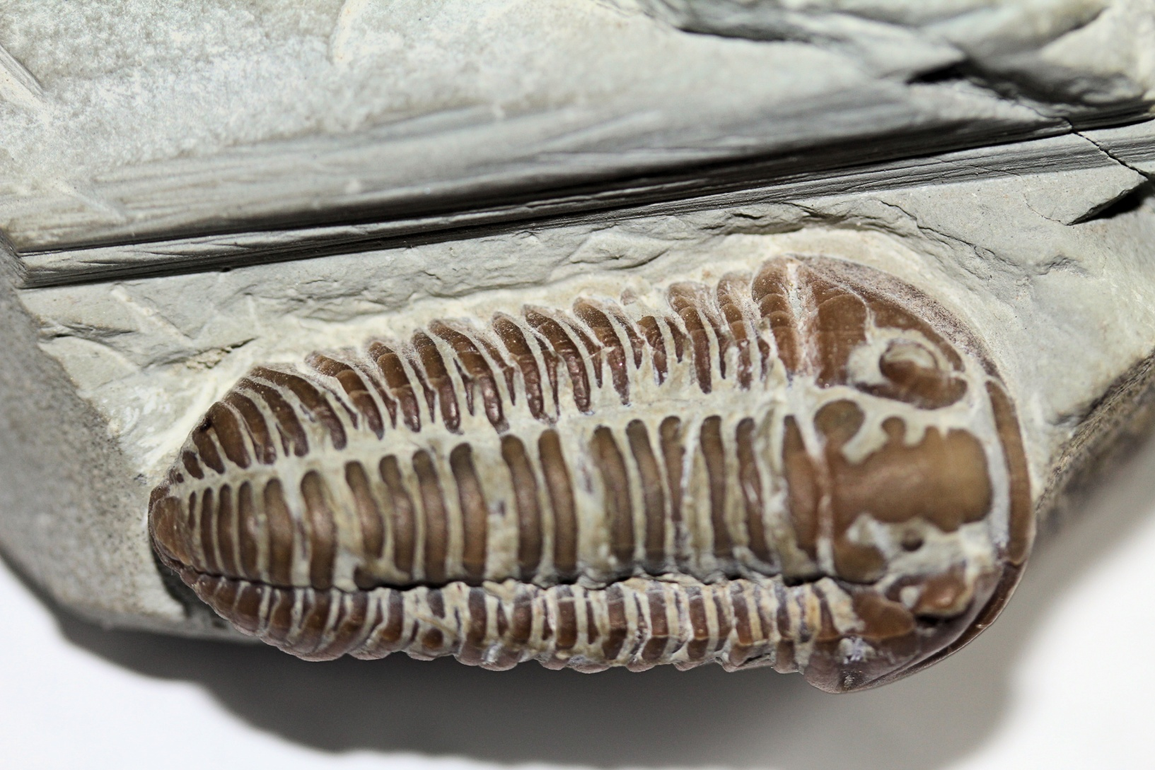
#3

Slide 25
#3 SEDIMENTARY

Slide 26
#3 SEDIMENTARY – SHALE/LIMESTONE

Slide 27
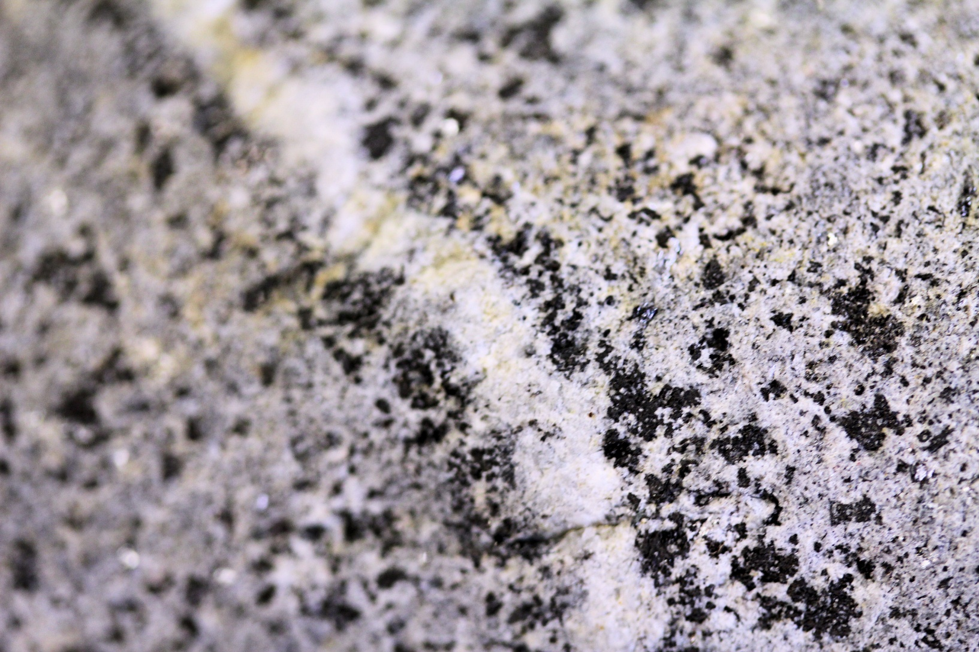
#4

Slide 28
#4 IGNEOUS

Slide 29
#4 IGNEOUS - DIORITE

Slide 30
#5

Slide 31
#5 METAMORPHIC

Slide 32
#5 METAMORPHIC - GNEISS

Slide 33
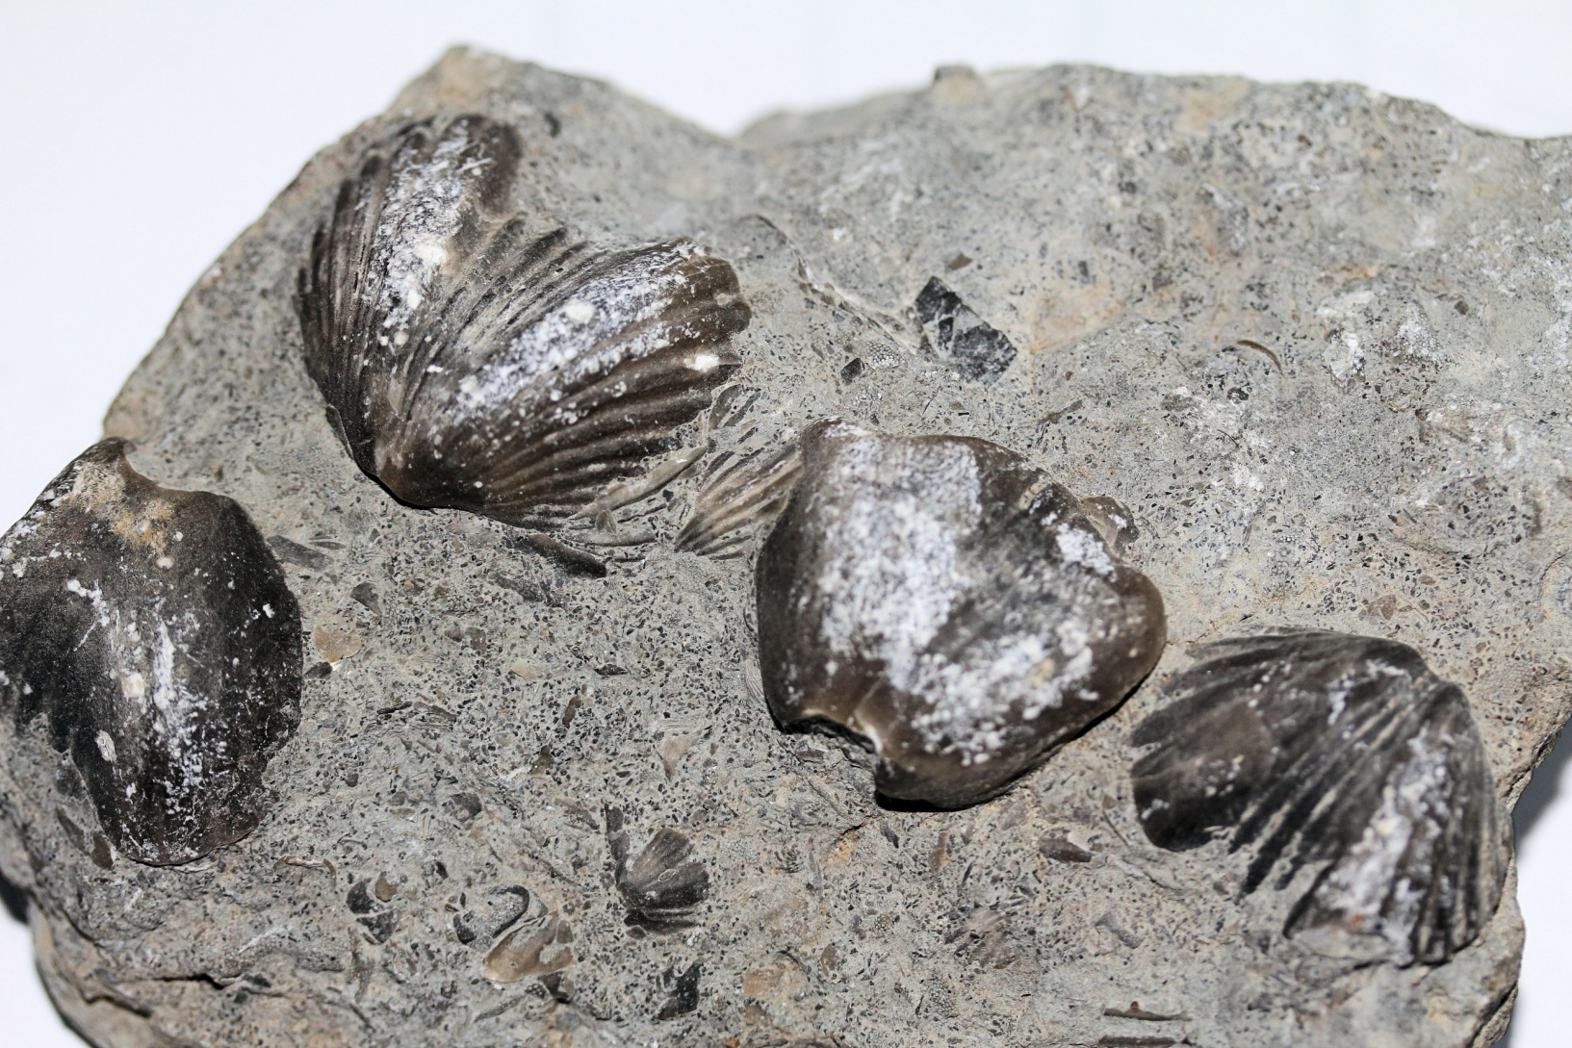
#6

Slide 34
#6 SEDIMENTARY

Slide 35
#6 SEDIMENTARY – SHALE/LIMESTONE

Slide 36
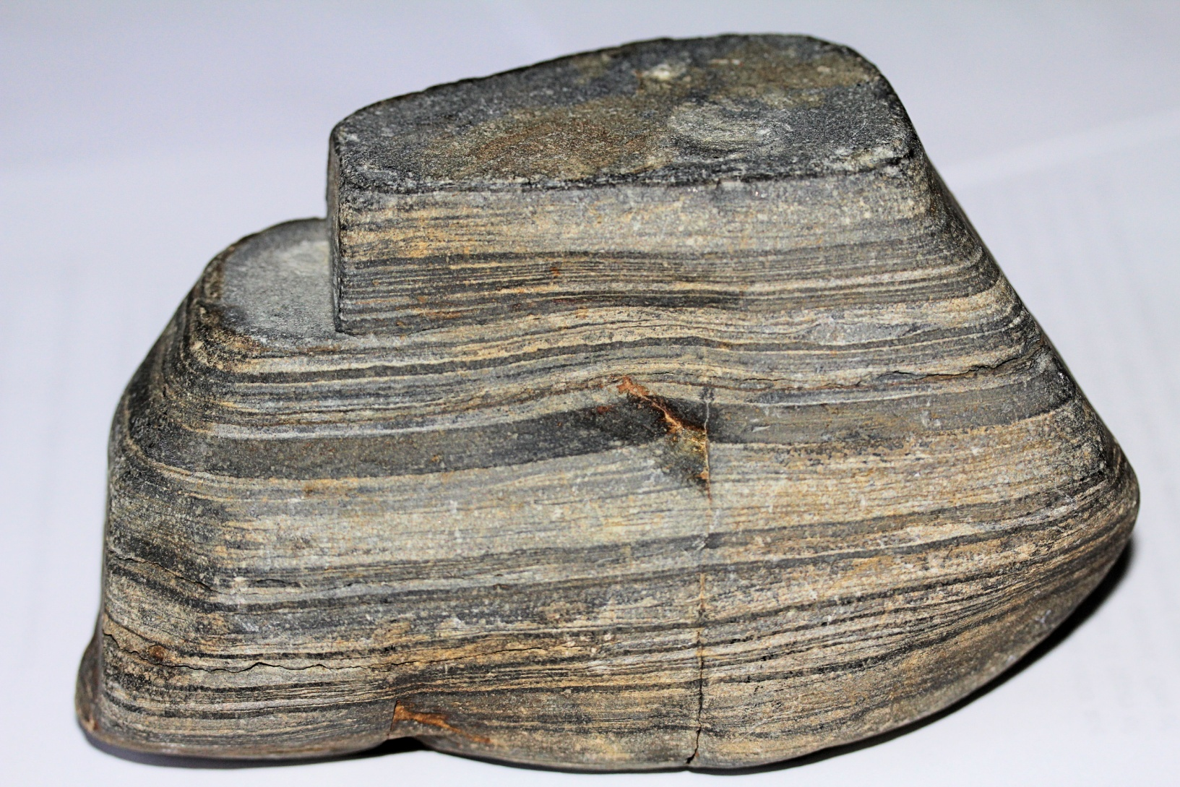
#7

Slide 37
#7 SEDIMENTARY

Slide 38
#7 SEDIMENTARY- SHALE/LIMESTONE

Slide 39
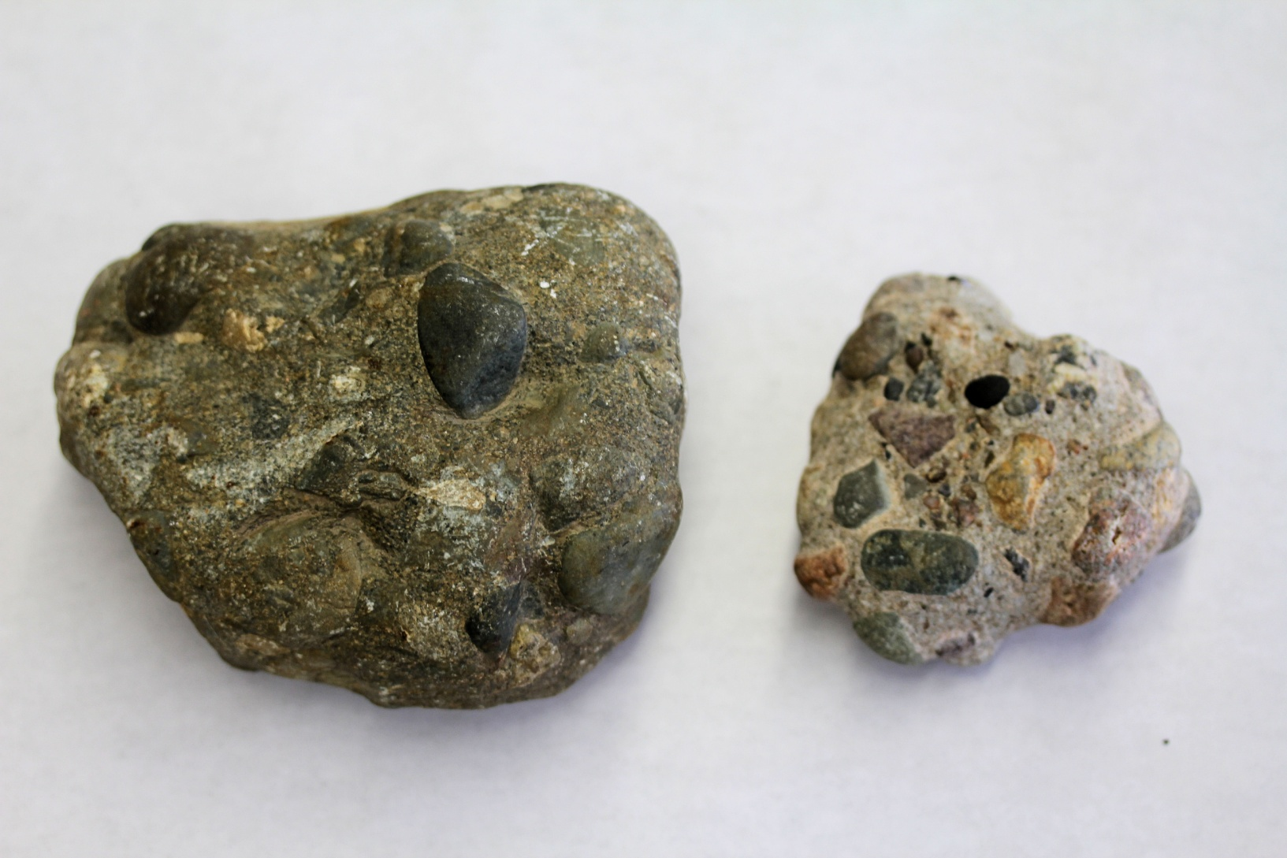
#8

Slide 40
#8 SEDIMENTARY

Slide 41
#8 SEDIMENTARY - CONGLOMERATE

Slide 42
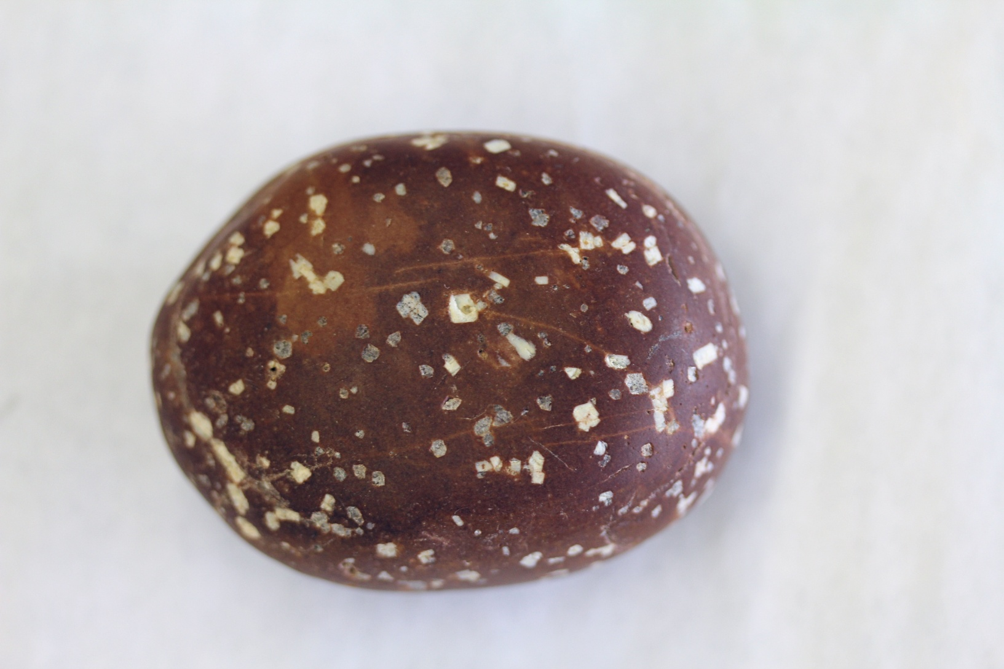
#9

Slide 43
#9 IGNEOUS

Slide 44
#9 IGNEOUS - PORPHYRY

Slide 45
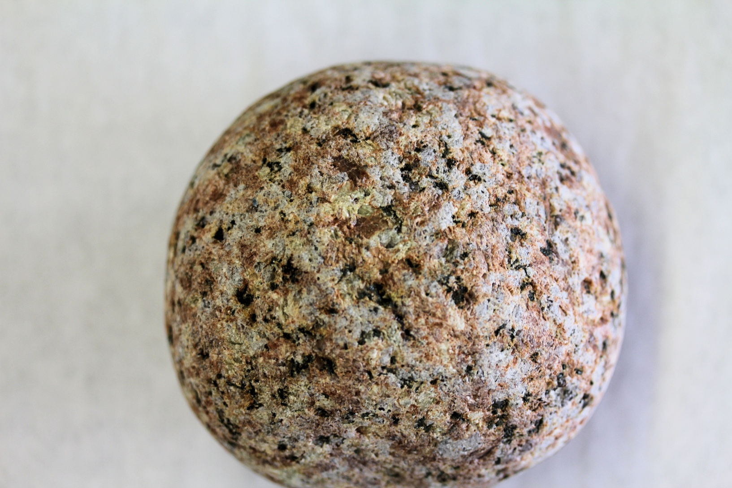
#10

Slide 46
#10 - IGNEOUS

Slide 47
#10 – IGNEOUS - GRANITE

Slide 48
#11

Slide 49
#11 METAMORPHIC

Slide 50
#11 METAMORPHIC - GNEISS

Slide 51
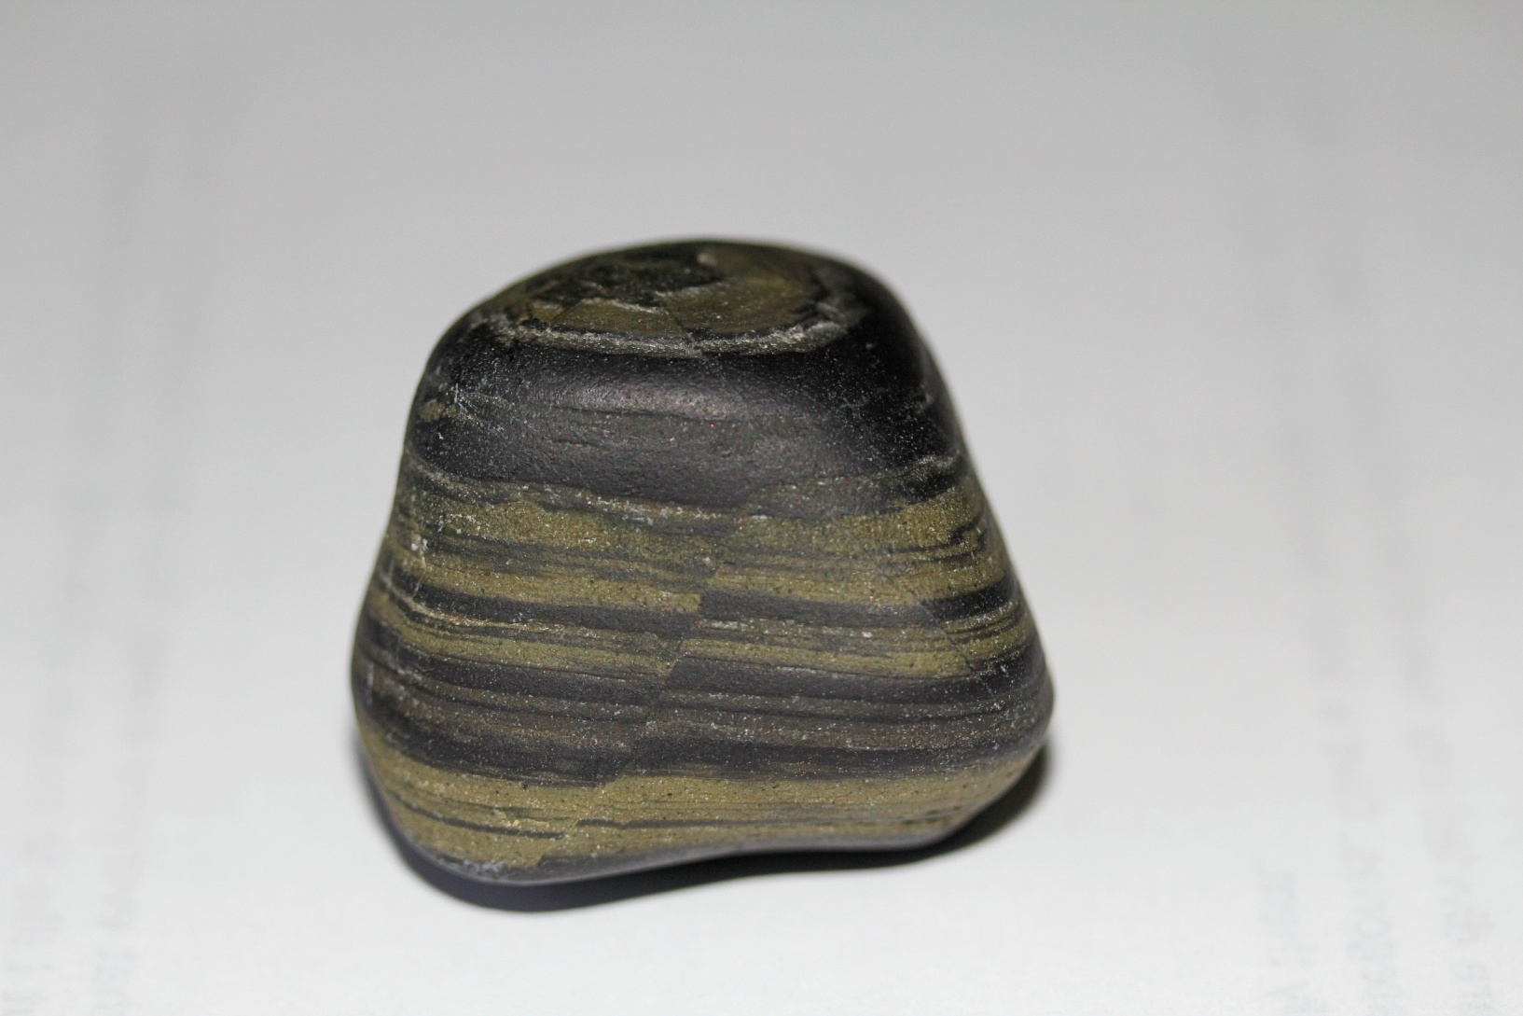
#12

Slide 52
#12 SEDIMENTARY

Slide 53
#12 SEDIMENTARY – SHALE/LIMESTONE

Slide 54
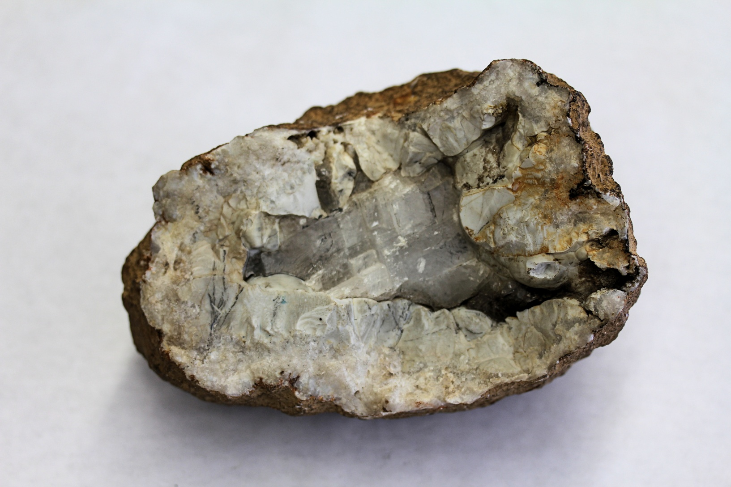
#13

Slide 55
#13 SEDIMENTARY

Slide 56
#13 SEDIMENTARY - GEODE

Slide 57
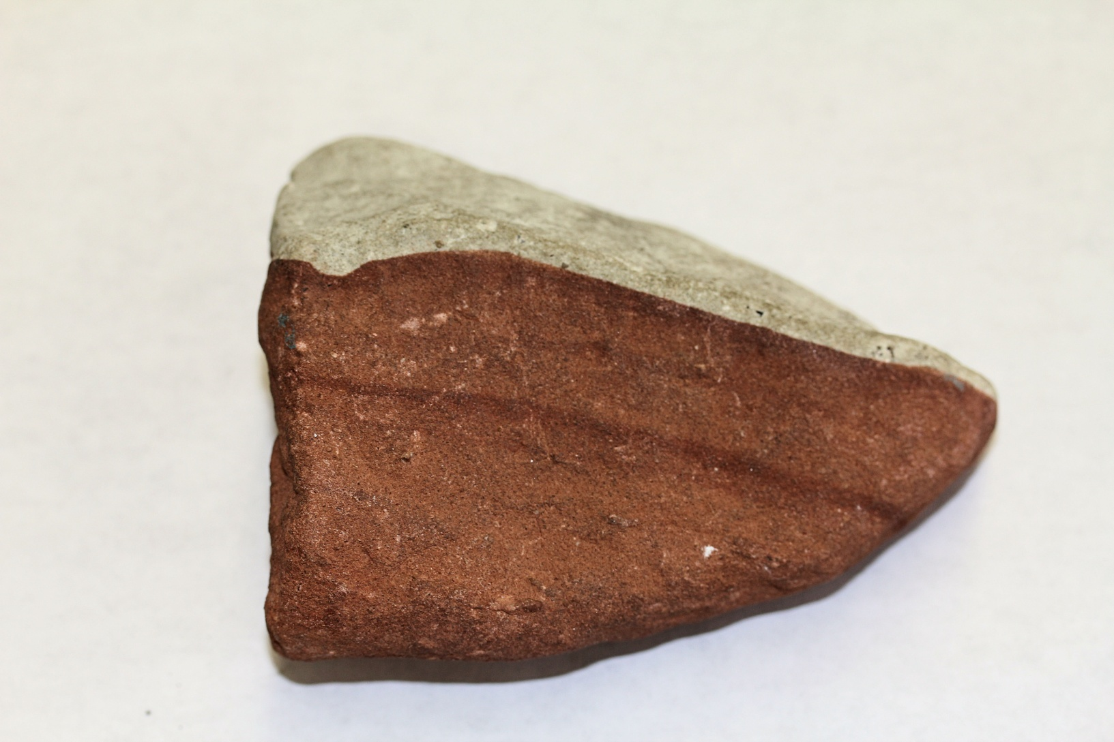
#14

Slide 58
#14 SEDIMENTARY

Slide 59
#14 SEDIMENTARY - SANDSTONE

Slide 60
#15

Slide 61
#15 METAMORPHIC

Slide 62
#15 METAMORPHIC -SLICKENSIDES

